Slide 1
HHS Office of Population Affairs PrEP for HIV Prevention in Title X Funded Family Planning Sites National Kick-Off Webinar
April 4, 2019
3:00 pm ET
Notes:
Hello everyone and welcome to today's webinar, PrEP for HIV Prevention in Title X Funded Family Planning Sites.

Slide 2
Welcome!
Objectives
Discuss the role of Title X family planning clinics in assuring access to PrEP services in their communities
Describe implementation of the PrEP program at a Title X-funded service site
Introduce two new family planning-specific resources for PrEP service decision-making and implementation
Introduction of the speakers
Cynda Hall, HHS Office of Population Affairs (OPA)
Nikita Malcolm, Atlas Research
Emily Finley, Women’s Care Center, Drexel Obstetrics and Gynecology
Shannon Weber, HIVE/University of California, San Francisco
Note: This call will be recorded
Notes:
The objectives of today's webinar are to discuss the role of Title X family planning clinics in assuring access to PrEP services in their communities; describe the implementation of the PrEP program at a Title X-funded site; and introduce two new family planning specific resources for PrEP service decision making and implementation.

Slide 3
Office of Population Affairs
The Office of Population Affairs (OPA) administers the Title X program and advises the Secretary and Assistant Secretary for Health on a wide range of reproductive health topics, including adolescent pregnancy, family planning, and sterilization, and other population issues.
Title X is the only federal program dedicated solely to the provision of family planning and related preventive services.
Notes:
The Office of Population Affairs is under the direction of the Deputy Assistant Secretary for Population Affairs (DASPA), whose responsibilities include implementation of the mandated provisions of the categorical family planning grant program, Title X of the Public Health Service Act.
The office serves as the focal point to advise the Secretary and the Assistant Secretary for Health on a wide range of reproductive health topics, including adolescent pregnancy, family planning, and sterilization, as well as other population issues.
Title X is the only federal program dedicated solely to the provision of family planning and related preventive services.

Slide 4
Title X Service Grantee Network
Approximately:
90 Service Grantees, including state, territorial, tribal, county or local health agencies, universities, faith-based and community-based nonprofit agencies
4,000 Family Planning Clinics, in the 50 states, the District of Columbia, and eight U.S. territories and jurisdictions
4 Million Clients Served Annually with family planning and related preventive health care services
Source: Fowler, C. I., Gable, J., Wang, J., & Lasater, B. (2018, August). Family Planning Annual Report: 2017 national summary. Research Triangle Park, NC: RTI International.
Notes:
There are approximately 90 service grantees in the Title X Service Grantee Network including state, territorial, tribal, county or local health agencies, universities, faith-based and community-based nonprofit agency and roughly 4,000 family planning clinics in the 50 states, the District of Columbia, and eight US territories and jurisdictions. The Title X networks serve over four million clients annually with family planning and related preventive healthcare services.

Slide 5
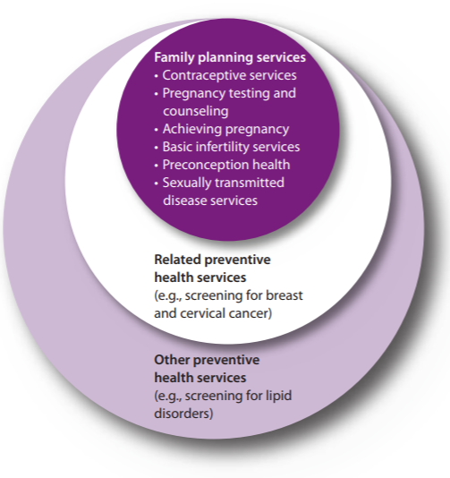
HIV Testing is a Core Family Planning Service
All Title X funded agencies are required to provide, at a minimum, HIV/AIDS prevention education, including education on risks and infection prevention, and testing, either on-site or by referral.
Notes:
In 2014, OPA and CDC released the MMWR providing quality family planning services or QFP. These recommendations outline how to provide family planning services, defining what services should be offered in the family planning visit and describing how to do so. Supporting consistent application of quality care across settings and provider types and translate research into practice, so the most evidence-based approaches are used. The intended audience is all providers of family planning services including Title X grantee. In the QFP, STD and HIV services are considered family planning services because they improve the health of both men and women and can inform a person's ability to conceive or to have a healthy birth outcome.
And all Title X funded agencies are required to provide, at a minimum, HIV/AIDS prevention education, including education on risks and infection prevention and testing, either onsite or by referral. Family planning clients who are at risk or an STD should be screened for HIV and other STD in accordance with CDC's STD treatment guidelines.
Pre-exposure prophylaxis, which is the topic of today's webinar, also offers an option for those clients who are at risk for an HIV infection. And the family planning visit provides a key opportunity to educate the clients about HIV prevention and about PrEP. And many family planning service sites are already offering PrEP services. We understand that not all Title X service sites or family planning providers will have the need or capacity to offer PrEP in their clinic service site. Our goal is to help family planning providers improve awareness and access to PrEP services for their community.
Shown in the graphic: First tier of family planning services include: contraceptive services, pregnancy testing and counseling, achieving pregnancy, basic infertility services, preconception health, and sexually transmitted disease services. Second tier includes related preventive health services (e.g., screening for breast and cervical cancer). Services also include other preventive health services (e.g., screening for lipid disorders).

Slide 6
Pre-Exposure Prophylaxis (PrEP)
PrEP, a once-a-day pill (brand name Truvada), has been demonstrated to reduce the risk of HIV infection up to 92% when taken as directed.
In 2014, the US Public Health Service released the first comprehensive clinical practice guidelines for PrEP, which were developed by a federal inter-agency working group led by Centers for Disease Control and Prevention (CDC).
Guidelines recommend PrEP as one prevention option for:
Sexually-active adult MSM, adult heterosexually active men, adult injection drug users and heterosexually-active women at substantial risk of HIV acquisition.
Source: Centers for Disease Control and Prevention (CDC). Preexposure Prophylaxis for the Prevention of HIV Infection in the United States - 2014: A Clinical Practice Guideline.
Notes:
So what is pre-exposure prophylaxis or PrEP? PrEP is a once-a-day pill that has been demonstrated to reduce the risk of HIV infection up to 92% when taken as directed. In 2014, the US Public Health Service released the first comprehensive clinical practice guidelines for PrEP which were developed by a federal inter-agency working group led by Centers for Disease Control and Prevention. The guidelines recommend PrEP as one option for sexually active adult MSM, adult heterosexually active men, adult injection drug users and heterosexually active women at substantial risk of HIV acquisition.

Slide 7
U.S. Family Planning Providers’ Knowledge of and Attitudes towards PrEP for HIV Prevention: A national survey
A 2015 national survey of 495 family planning providers found that:
Source: Seidman, D., Carlson, K., Weber, S., Witt, J., & Kelly, P. J. (2016). United States family planning providers' knowledge of and attitudes towards preexposure prophylaxis for HIV prevention: a national survey. Contraception, 93(5), 463-469.
Notes:
In 2015, a research team at the University of California, San Francisco, the National Clinical Training Center for Family Planning and HIVE conducted a national survey with family planning providers to learn more about providers' knowledge and attitudes towards PrEP for HIV prevention. 495 providers completed the survey and it was found that providers had limited knowledge about PrEP. About 1/3 of providers were able to correctly identify PrEP, correctly state the efficacy of PrEP in clinical trials and choose the correct HIV test to evaluate a client with a recent exposure.
About 1/3 of the providers responding to the survey had ever seen any PrEP guidelines, including those by the CDC, the American College of Obstetricians and Gynecologists and the New York State Department of Health. The survey also found that the majority of respondents wanted more education about PrEP, sparking additional efforts from OPA to provide resources and tools for PrEP in family planning settings.

Slide 8
OPA PrEP Training Webinar Series (Tentative)
Webinar Topic | Date
#1: Prescribing PrEP in Family Planning Sites | May 2019
#2: Financing PrEP Services in Family Planning Sites | June 2019
#3: Innovative Models for PrEP Programs in Family Planning Sites | July 2019
#4: Leveraging Partnerships for PrEP in Family Planning Sites | August 2019
Notes:
Cynda Hall:
Today's webinar along with the tools that will be shared in this webinar are resources to learn more about PrEP and providing PrEP services. Along with this kickoff webinar, OPA will also host a training webinar series on several PrEP training topics, including prescribing PrEP in family planning sites in May 2019, financing PrEP services in family planning sites in June 2019, innovative models for PrEP programs in family planning sites in July 2019, and leveraging partnerships for PrEP in family planning sites in August 2019.

Slide 9
Why PrEP in Family Planning?
Notes:
Why are we talking about PrEP in family planning settings?
We know there's been a lot of focus historically on providing PrEP services in primary care settings or in HIV and STI treatment settings. But there is also a key opportunity for family planning settings to address gaps in access, in uptake and awareness of PrEP that we'll discuss today. And also, for all of you to be able to justify to others why this is important in your setting.

Slide 10
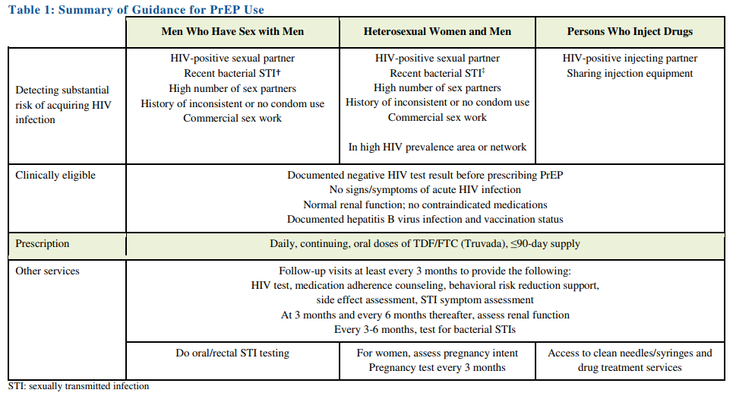
CDC Clinical Guidelines for PrEP
Source: Centers for Disease Control and Prevention: US Public Health Service: Preexposure prophylaxis for the prevention of HIV infection in the United States—2017 Update: a clinical practice guideline. Published March 2018.
Notes:
The CDC has published clinical guidelines on the use of PrEP for HIV prevention. And this table summarizes the guidance for PrEP use for different groups. Now, we won't walk through this table in detail today. There will be an upcoming webinar in the training series on prescribing PrEP that will go into more detail on the clinical aspects of PrEP services.

Slide 11
CDC Clinical Guidelines for PrEP and Women
The clinical guidelines recommend PrEP as one prevention option for women at substantial risk of HIV, defined as:
Sexually active women without an acute or established HIV infection who are not in a monogamous partnership with a recently tested HIV-negative partner and at least one of the following:
Infrequently uses condoms during sex with partner of unknown HIV status known to be a substantial risk of HIV;
In an ongoing sexual relationship with an HIV-positive partner;
Recent bacterial sexually transmitted infection (syphilis, gonorrhea) diagnosed or reported in the past six months.
Source: Centers for Disease Control and Prevention: US Public Health Service: Preexposure prophylaxis for the prevention of HIV infection in the United States—2017 Update: a clinical practice guideline. Published March 2018.
Notes:
But what we will talk about today are the CDC guidelines for PrEP use among women specifically. So the clinical guidelines for PrEP recommend PrEP as one prevention option for women at substantial risk of HIV, defined as sexually active women without an acute or established HIV infection who are not in a monogamous partnership with a recently tested HIV-negative partner and at least one of the following.
Infrequently uses condoms during sex with a partner of unknown HIV status who's known to be at substantial risk of HIV,
In an ongoing sexual relationship with an HIV-positive partner, or
With a recent bacterial sexually transmitted infection, specifically syphilis or gonorrhea, diagnosed or reported in the past six months.

Slide 12
Women and HIV
New HIV Diagnoses among Women in the U.S. in 2017, by Race/Ethnicity
Other 4%
Women accounted for approximately 20% of new HIV infections in the U.S. in 2017.
PrEP presents a new key opportunity for promoting HIV prevention among women.
Source: Centers for Disease Control and Prevention. HIV Surveillance Report, 2017; vol. 29. Published November 2018
Notes:
So as we continue to think about the CDC guidelines for PrEP use among women, we know that for women, although the HIV diagnoses have declined in recent years, more than 7,000 women received a new HIV diagnosis in the US in 2017, making them nearly 20% of the about 3,800 new HIV diagnoses in the country. And then we also know that for women of color, particularly African American and black women, have been disproportionally affected by HIV with African American women specifically accounting for almost 60% of new HIV diagnoses among women here in the United States in 2017.

Slide 13
PrEP and Women
According to the CDC, approximately 180,000 sexually active U.S. women of reproductive age (18-49 years) are potential candidates for PrEP.
Of the 78,500 PrEP users in 2016, only 4.7% of PrEP users were female.
PrEP uptake in the U.S. has increased significantly among men, while the number of women starting PrEP remained steadily low.
Sources: Bush, S., et al. (2015). Significant uptake of Truvada for pre-exposure prophylaxis (PrEP) utilization in the US in late 2014–1Q 2015. In IAPAC Treatment, Prevention, and Adherence Conference (pp. 28-30); Smith DK. (2018) By race/ethnicity, Blacks have highest number needing PrEP in the United States, 2015. Conference on Retroviruses and Opportunistic Infections. Atlanta, GA, 2018; Ya-lin, A. H., et al. (2018). HIV preexposure prophylaxis, by race and ethnicity—United States, 2014–2016. Morbidity and Mortality Weekly Report, 67(41), 1147.
Notes:
PrEP is one HIV prevention method that prevents opportunity to reduce new HIV infections among women. But there are still gaps in PrEP use for women specifically. So taking a look at this slide here, the CDC estimates that approximately 180,000 sexually active US women of reproductive age are potential candidates for PrEP which is more than half, actually about 70% of the heterosexual individuals, both men and women, in the US who may be potential candidates for PrEP or who have potential indications for PrEP according to the guidelines.
But we also know that awareness and uptake of PrEP among women at risk for HIV has been really limited. The most recent data in 2016 out of the 78,000 PrEP users in the United States, only 4.7% of those PrEP users were female. And then we can see in the graph on the right that although PrEP uptake in the US has increased significantly among men since 2012, the number of women starting PrEP has remained steadily low. And you can see here in the graph the males using PrEP in the green and then the women using PrEP in the blue.

Slide 14
Number of PrEP users, by sex and race/ethnicity
Source: Ya-lin, A. H., Zhu, W., Smith, D. K., Harris, N., & Hoover, K. W. (2018). HIV preexposure prophylaxis, by race and ethnicity—United States, 2014–2016. Morbidity and Mortality Weekly Report, 67(41), 1147.
Notes:
This is another graph from a recent CDC report and this one is particularly striking. This chart shows the number of PrEP users in the US by sex and race and ethnicity. So, you can see here that there is a disproportionately low number of female PrEP users and also going back to what we discussed earlier, thinking about the disproportionate impact of HIV in communities of color, we know that while HIV disproportionately affects African Americans, PrEP initiation among women of color has been significantly lower than among white women. So when stratified by sex, out of the about 1,100 female PrEP users that there were a recent ethnicity data available for, about half were white, about a quarter were black and around 18% of those PrEP users were Hispanic.
When stratified by sex, among the 1,146 female PrEP users with race/ethnicity data, 554 (48.3%) were white, 297 (25.9%) were black, and 201 (17.5%) were Hispanic.

Slide 15
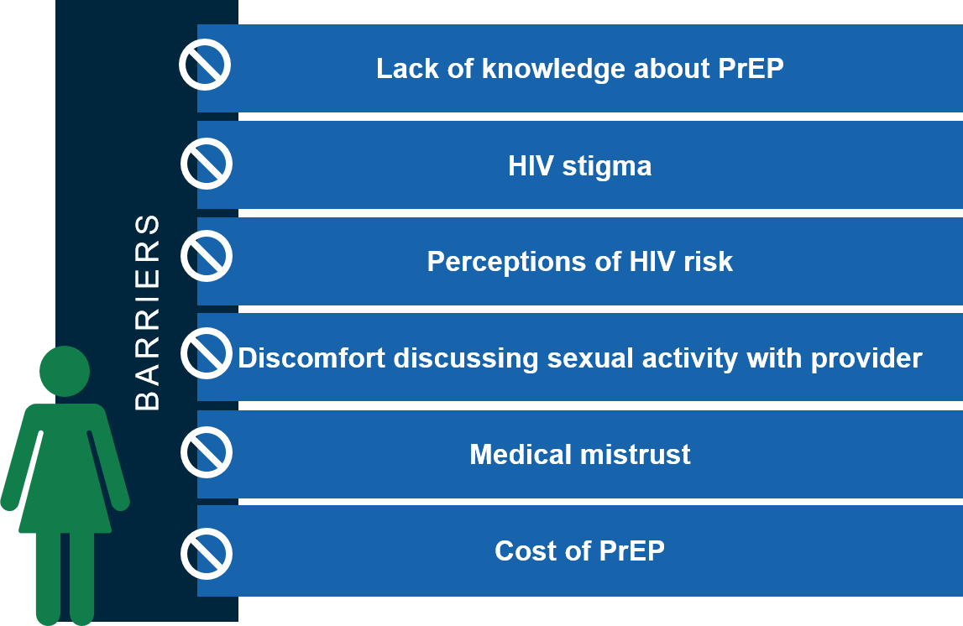
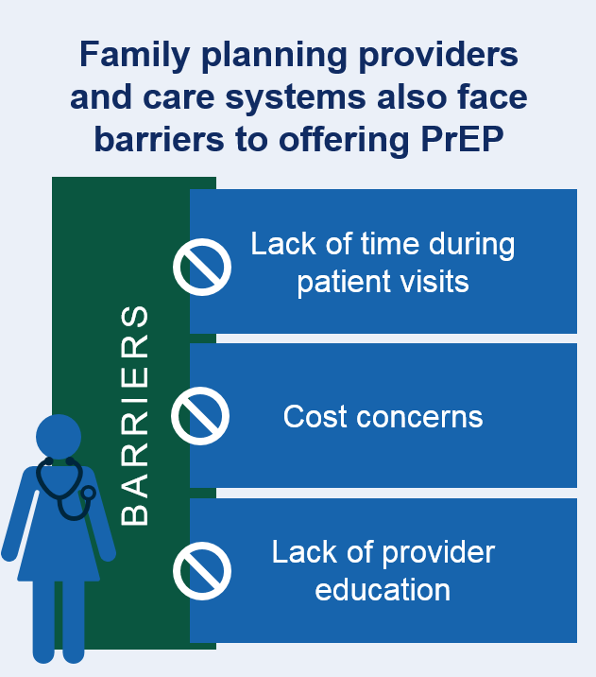
Women face barriers to PrEP awareness and access
Sources: Auerbach, J. D., et al. (2015). Knowledge, attitudes, and likelihood of pre-exposure prophylaxis (PrEP) use among US women at risk of acquiring HIV. AIDS patient care and STDs, 29(2), 102-110.; Seidman, D., et al. (2016). United States family planning providers' knowledge of and attitudes towards preexposure prophylaxis for HIV prevention: a national survey. Contraception, 93(5), 463-469.; Sheth, A. N., Rolle, C. P., & Gandhi, M. (2016). HIV pre-exposure prophylaxis for women. Journal of virus eradication, 2(3), 149.
Notes:
When we look at the barriers to PrEP awareness and access and uptake among women in particular, we see barriers for both women and for providers and family planning health systems. So for women, when we think about what those barriers to PrEP are, we know that there is generally a lack of knowledge or awareness about PrEP service. And one recent focus group actually found that women were dismayed and many of them actually angry or upset that they hadn't heard about PrEP before once they learned about it in the focus group.
We know that for women, thinking about PrEP services, HIV stigma and perceptions of HIV risk can also present a barrier to care. Women potentially may not recognize their own HIV risk or may potentially feel ashamed or stigmatized when discussing some of those factors. We know that many women do have really great relationships with their providers and with their family planning providers and particularly, and many women say that their family planning providers are a primary source of information and services and resources for them.
But there are still many women who may experience discomfort discussing their sexual activity with a provider or medical mistrust. And of course, the cost of PrEP services, we know, can be a barrier to many women. And then on the other side, for family planning providers and care systems, there are also barriers to being able to offer PrEP services, including lack of time during patient visits, cost concerns and lack of provider education.

Slide 16
Family Planning Services and PrEP
Title X family planning sites are a primary source of care for many women, serving approximately 3.5 million women annually
Family planning providers are exceptionally qualified to provide HIV prevention services to women while incorporating clients’ health goals into individual health care decisions
Women also consider family planning clinics a preferred source for information about PrEP and access to PrEP services
Sources: Auerbach, J. D., et al. (2015). Knowledge, attitudes, and likelihood of pre-exposure prophylaxis (PrEP) use among US women at risk of acquiring HIV. AIDS patient care and STDs, 29(2), 102-110.; Sales, J. M., et al. (2019). Patient recommendations for PrEP information dissemination at family planning clinics in Atlanta, Georgia. Contraception.; Seidman, D., & Weber, S. (2016). Integrating preexposure prophylaxis for human immunodeficiency virus prevention into women's health care in the United States. Obstetrics & Gynecology, 128(1), 37-43.
Notes:
When we come back to the question with this understanding, why are we talking about PrEP in family planning services? So, we know that Title X family planning sites are a primary source of care for many women, serving about 3.5 million women every year in the country. Family planning providers in particular have extensive experience providing sexual and reproductive health counseling, education and services and truly are exceptionally qualified to provide HIV prevention services to women, while incorporating each clients' individual health goals and individual health care decisions.
Studies also show, like I mentioned earlier, that women do consider family planning sites a preferred source for information about PrEP and access to services. And Title X sites and family planning sites really do have a key opportunity to start to think about and address those gaps in PrEP access and awareness among women by considering integrating PrEP services into their existing HIV prevention services which often include HIV and STI education, testing and referral, risk reduction, counseling and many other services.
And in fact, many Title X sites are already offering PrEP services and starting to integrate it into their HIV prevention services.
Emily Finley at the Women's Care Center at Drexel Obstetrics and Gynecology will now share with us about the PrEP program at their site.

Slide 17
Get PrEPed! PrEP Services at the Drexel Medicine Women’s Care Center
Emily D. Finley, MPH Community Health Educator
Notes:
(Emily Finley, I'm Community Health Educator at Drexel Medicine Women's Care Center in Philadelphia)
Today, I'll be talking a bit about our PrEP services at our family planning site.

Slide 18
Drexel Women’s Care Center
Women’s Care Center is an outpatient OBGYN & Family Planning clinic in Center City Philadelphia, PA
Part of Drexel University College of Medicine
Receives Title X funding through AccessMatters (covers Southeast PA)
Appointment Hours: M-F, 8am – 4pm
Title X Patient Demographics, 2018:
Total Users: 3,432
Largest Age Groups: 25-29 (30%); 20-24 (21%); 30-34 (18%)
Female Users: 98% of total
Race/Ethnicity: Black/African-American (67%); White (14%); Hispanic/Latino (9%); Asian (4%)
Income 100% FPL and below: 99% of total
Notes:
Drexel Women's Care Center is an outpatient OBGYN and family planning clinic located in Center City Philadelphia. We're part of Drexel University College of Medicine network and we receive Title X funding through AccessMatters, which is our grantee for Southeastern Pennsylvania. Our appointment hours are Monday through Friday, 8 AM to 4 PM.
In 2018, we had about 3,433 Title X patients in total and most of our family planning clients are in the age range of 25 to 29, about a third, and then about one fifth are 20 to 24. Another 18% are 30 to 34. So those are the ages that we're most reaching. 98% of our family planning clients are female. And they're also predominantly black and African American, two thirds are black and African American, about 14% are white, 9% Hispanic Latino and 4% Asian. And we are reaching low income users, 99% of our clientele were at 100% federal poverty or lower in 2018.

Slide 19
PrEP at Drexel Women’s Care Center
Full range of PrEP services offered on-site: Counseling, Risk Assessment, Prescription Services, and Follow-Up Services
Eligibility: History of an STI, Interest in PrEP, Any HIV risk (MSM, IDU, HIV+ partner, inconsistent condom use, transactional sex, etc.)
PrEP services are available to all eligible patients by appointment and PrEP counseling is offered on a walk-in basis with Rx services provided same-day or within 48 hours
Key Staff:
2 full-time Family Planning Counselors provide initial counseling and risk assessment
Medical Assistants collect labs at baseline + follow-up visits
OBGYN Clinicians provide risk assessment and prescription services
Health Educator assists with enrollment in Gilead Advancing Access programs
Drexel Medicine PrEP Navigator provides follow-up support & adherence counseling
Notes:
At Women's Care Center, we offer the full range of PrEP services on site so that includes counseling, risk assessment, prescription services and follow-up services. The eligibility at our site is pretty broad. But it includes recent history of STI, an interest in PrEP if the client comes in requesting PrEP, any HIV risk which would include having an HIV-positive partner, injection drug use, inconsistent condom use, transactional sex and other risks.
Our PrEP services are available to all eligible patients, both by appointment and we also offer counseling on a walking basis. And prescription services are provided the same day as the counseling occurs or within 48 hours. We try to get the prescription as quickly as possible. So the key staff that we utilize are two full-time family planning counselors, provide initial counseling and risk assessment. Our medical assistant collect the patient labs at the baseline visit and follow-up visits. Our OBGYN clinicians provide additional counseling, risk assessment and do the prescribing.
The Health Educator which is myself assists with enrollment in Gilead Advancing Access programs. Those are programs for people who may not be able to afford their PrEP, whether because they have high copays or because they are uninsured. So there are programs to assist with that. And then we also have a Drexel Medicine, a PrEP navigator who provides follow-up support and adherence counseling for all of our patients who have been prescribed PrEP.

Slide 20
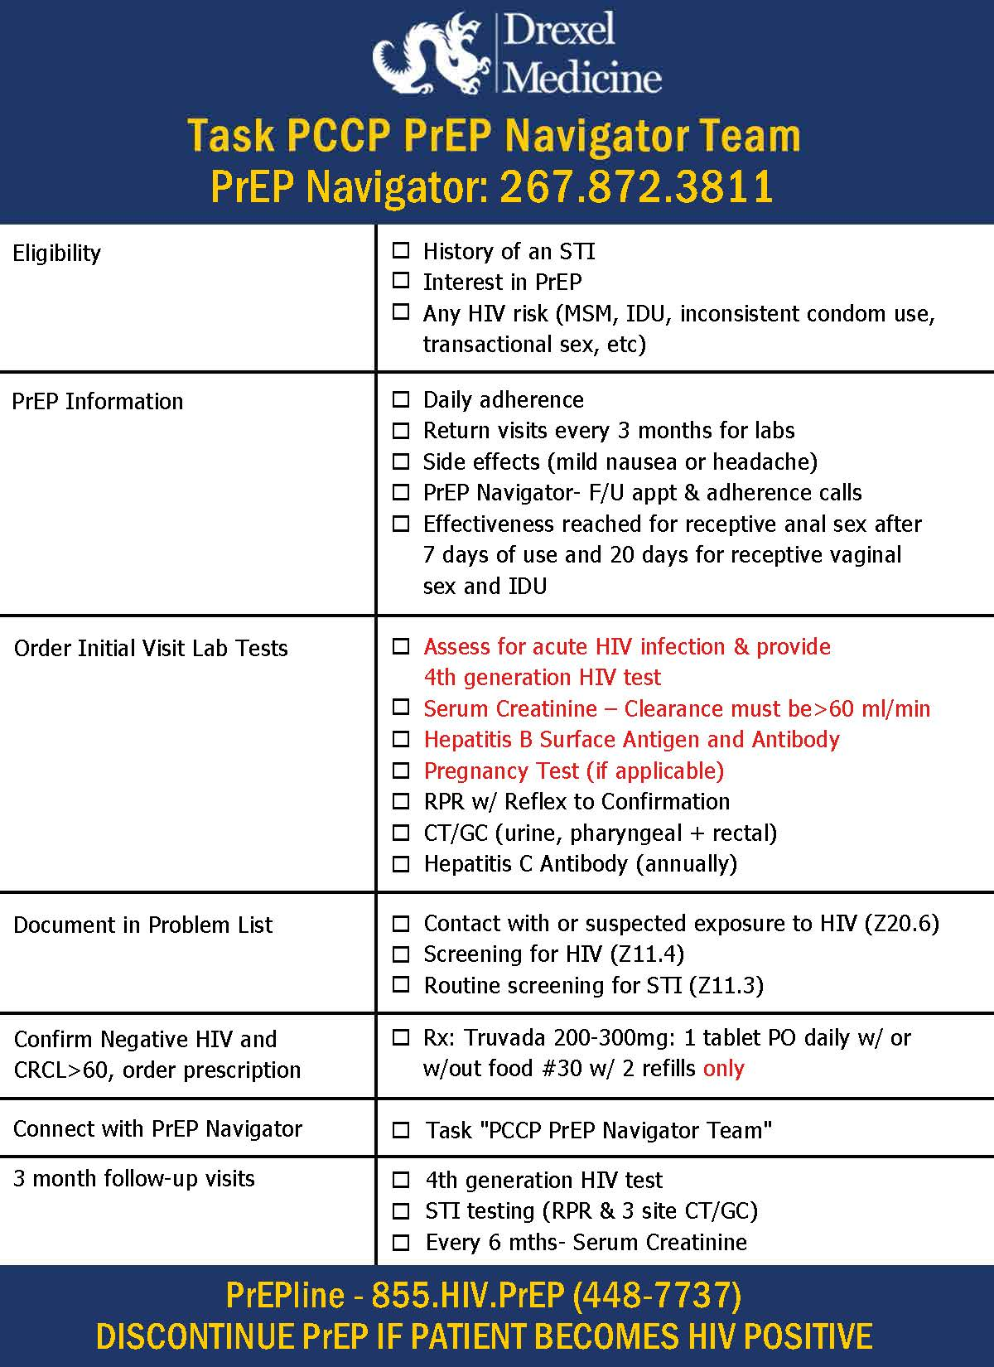
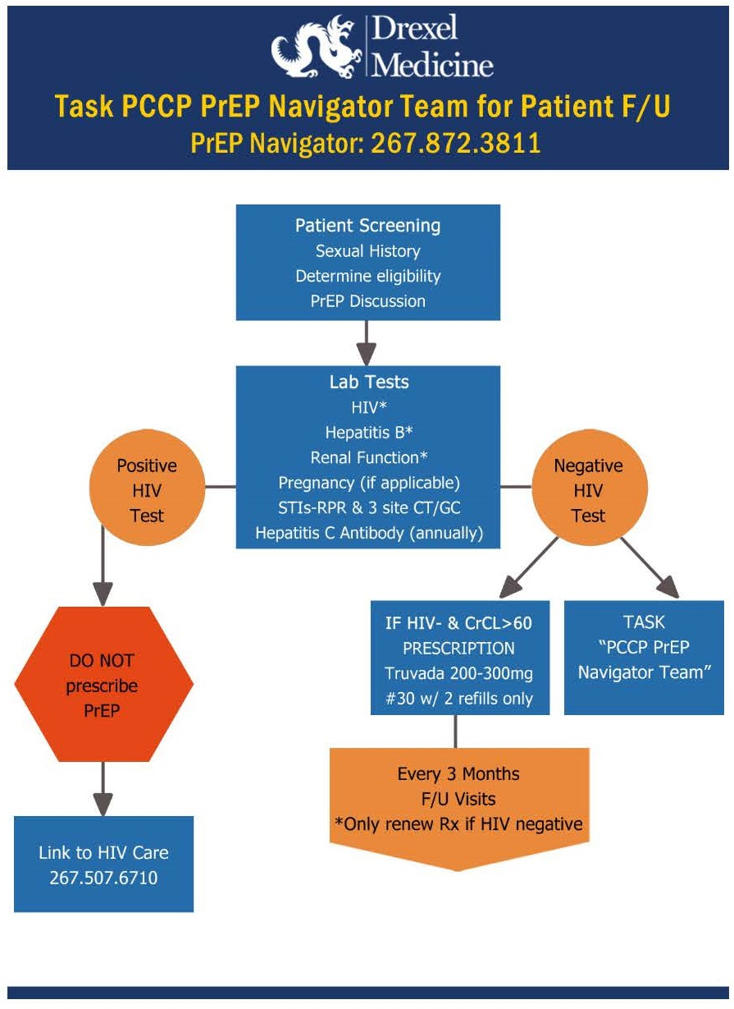
PrEP at Drexel Women’s Care Center, Cont’d
Notes:
This is an example of some PrEP materials that we made for our providers. So this is the front and back of a postcard that we made that runs through the checklist of eligibility, basic education about PrEP, the labs that are required before the prescription is given, how to document PrEP in the chart which is important for an insurers, confirming the negative HIV, connecting with the PrEP navigator and then doing those three month follow-up visits. So we have that both in the checklist format and then on the other side, this flowchart format.
And that's just designed as a pocket card for our clinicians to carry with them throughout the day and if they have someone requesting PrEP or they're recommending PrEP, they can run through that checklist really easily. And we found that to be a really great tool.

Slide 21
Why PrEP in Family Planning?
What helped us decide to offer PrEP?
Our female clients did not have equitable access to PrEP services
In 2017-2018, we received a grant from Gilead through AccessMatters to provide PrEP education and counseling to 400+ Family Planning clients
WCC is the only site in the Drexel Medicine network offering comprehensive Family Planning services to clients who are uninsured or receiving public insurance – these are key clients to reach!
Benefits of our PrEP program:
Clients receive PrEP from providers they know and trust
One-stop-shop for well-woman exams, contraception, prenatal care, HIV/STI testing, and PrEP
Providers have developed comfort and expertise offering PrEP services
Women in Philadelphia now have greater access to PrEP
All of our PrEP materials are female-inclusive!
Notes:
So, why did we decide to offer PrEP at our family planning clinic? Well, we knew that our female clients really weren't getting equitable access to PrEP services in Philadelphia and as you saw from the charts that Nikita showed earlier, that's really a nationwide issue. So, in 2017 to 2018, we received a grant from Gilead, the manufacturer of PrEP through AccessMatters to provide PrEP education and counseling to over 400 family planning clients.
So that grant was a really great incentive to help us get our programming off the ground and get our training off the ground and really start educating our patients. And Women's Care Center is the only site in the Drexel Medicine network that offers comprehensive family planning services to clients who are uninsured or receiving public insurance. And those are really key clients to reach and clients who may be at higher risk for HIV and also may have additional barriers to accessing health services. So it's very important to reach those clients.
The benefits of our program are the clients are receiving PrEP from providers that they already know and trust. We offer a one stop shop for well woman exams, contraception, prenatal care, HIV/STI testing and PrEP. So we don't send our PrEP patients to a different clinic just for that one thing. Our providers have developed comfort and expertise in offering PrEP. And women in Philadelphia now have greater access to PrEP through our clinic.

Slide 22
Challenges and Opportunities
Challenge #1: Providers feel uncomfortable prescribing PrEP. “Isn’t that an HIV medicine? Shouldn’t we send the client to infectious disease? What if there are side effects I can’t address? How do I do a risk assessment for PrEP?” | Opportunity #1: Training, training, training! With support from AccessMatters, we provided monthly trainings to prescribing clinicians and Family Planning counselors on all steps of the PrEP protocol; support staff (MAs, call center, etc.) also received training.
Challenge #2: Patients are unfamiliar with PrEP. “I’ve never heard of PrEP. Does that pill prevent other STIs? Can I still take it if I’m pregnant? Will PrEP give me HIV?” | Opportunity #2: Offer PrEP counseling alongside family planning and HIV/STI test counseling. Our Family Planning counselors are trained to discuss PrEP with high-risk clients. We also offer PrEP counseling on our walk-in services request sheet and have posters and educational materials on-site.
Challenge #3: PrEP patients are not retained in care. Patients no-show for follow-up visits and clinicians are unsure why. | Opportunity #3: Designate a PrEP Navigator. In 2018, Drexel Medicine hired a PrEP Navigator to provide follow-up support and adherence counseling to all Drexel clients with an Rx for PrEP. This is essential support that clinicians often don’t have time to provide.
Notes:
We did run into some challenges when we launched our PrEP program. One challenge we had was that providers felt uncomfortable prescribing PrEP. And some of the things we would hear would be concerns about PrEP being an HIV medicine and maybe being higher risk or how do I do a risk assessment? And so we used that as an opportunity to do a lot of training. So with support from AccessMatters, we were able to offer monthly trainings to prescribing clinicians and family planning councilors on all steps of our PrEP protocol. And we also made sure that our support staff so that was the medical assistants, the call center, receptionist, anyone with patient interaction, also received training on our PrEP program.
So a second challenge we had was that our patients were also unfamiliar with PrEP. Most often, we would ask a patient, "Have you heard of PrEP?" And they would say, "No, I have no idea what you're talking about." And we know that PrEP hasn't really been marketed that vigorously, especially to women, at this point. I think that's starting to change.
But, we use that as an opportunity to offer PrEP counseling, alongside our family planning and HIV/STI test counseling that we were already doing. So, our family planning counselors were trained to discuss PrEP and as I said before, we also started offering PrEP counseling as a walk in service. So we have walk in services five days a week and they fill out a sheet that says I want an HIV test, I want a chlamydia, gonorrhea test, I want a pregnancy test. And then we also added a bullet point that said I would like to learn more about PrEP, the HIV prevention pill. So that's integrated into those other walking services and patients can request that. And then we also started producing some posters and educational materials to have on site.
The third challenge that we encountered was that our patients who did start PrEP often wouldn't be retained in care. So there would be no-shows for follow-up visits and our clinicians weren't sure why. Maybe it was because their circumstances changed and they felt they were no longer at risk for HIV. Maybe they had side effects that they weren't comfortable with. Maybe they got to the pharmacy and it was too expensive and they never even filled their prescription. These are all different scenarios that can happen but we wanted to figure out what was going on with that.
So Drexel Medicine hired a PrEP navigator to provide follow-up support and adherence counseling to our clients with a PrEP prescription. So that person actually works for the entire Drexel Medicine network, not just Women's Care Center. But it's a really great support when clinicians don't have time to follow up with patients so rigorously. Okay.

Slide 23
Lessons Learned
Offer PrEP training to ALL STAFF, not just counselors and clinicians. Make sure your whole team (front desk, call center, admin) understands the PrEP services offered at your site.
Take a pro-active approach to client education! Don’t wait for clients to ask you about PrEP. Ask them, “Do you know about PrEP, the daily pill that prevents HIV?”
Supply PrEP education materials (postcards, brochures, etc.) to both clients and providers. Make your own or download existing resources – use materials that reflect your population.
Designate a PrEP Navigator or PrEP Champion for your site – someone who can field workflow questions from staff and track PrEP client follow-up.
Don’t forget about PEP (post-exposure prophylaxis)! Clients requesting PrEP may actually be candidates for PEP. Train clinicians to screen appropriately for HIV exposure and refer for PEP services, if not offered at your site.
Notes:
One lesson we learned is to offer PrEP training to all staff, not just counselors and clinicians. You know, make sure that your whole team understands the PrEP services offered at your site or at least understands how to refer a patient in. Really, anyone who is having any contact with a patient or potential patient should have familiarity with the site offering.
And then also the second point is to take a proactive approach to client education. So not waiting for clients to ask about PrEP because we know that a lot of people still haven't heard of it. So we try to ask them. "Do you know about PrEP, the daily pill that prevents HIV?“
Our third lesson is to supply PrEP education materials to clients and providers. You can create your own or download existing resources. I know there are a lot of great resources at HIVE and other places. And it's important to use materials that reflect your population, whether you're trying to reach more women, trans people, people of color, etc. It's really important to have your populations reflected in those materials.
And then the fourth lesson or tip is to designate a PrEP navigator or PrEP champion for your site, someone who can field workflow questions from staff and tracks PrEP clients for follow-up. And then finally, it's important not to forget PEP, post-exposure prophylaxis. So some clients coming in requesting PrEP may actually be candidates for PEP if they've had an HIV exposure in the past 72 hours. So it's really important to train clinicians to screen appropriately for the HIV exposure so that they can refer for PEP services if that's what's required.

Slide 24
Thank you!
Emily D. Finley, MPH
Drexel Women’s Care Center
1427 Vine Street, 5th Floor
Philadelphia, PA 19102
Tel: 267-507-6623
Email: edf37@drexel.edu

Slide 25
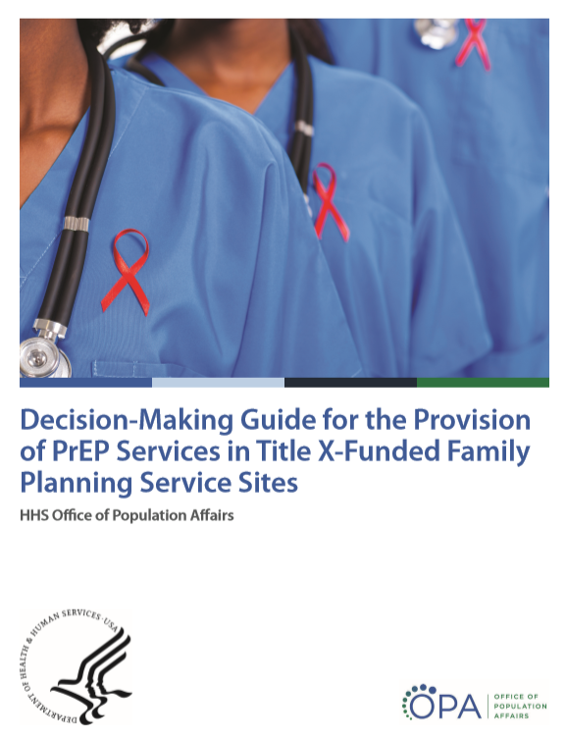
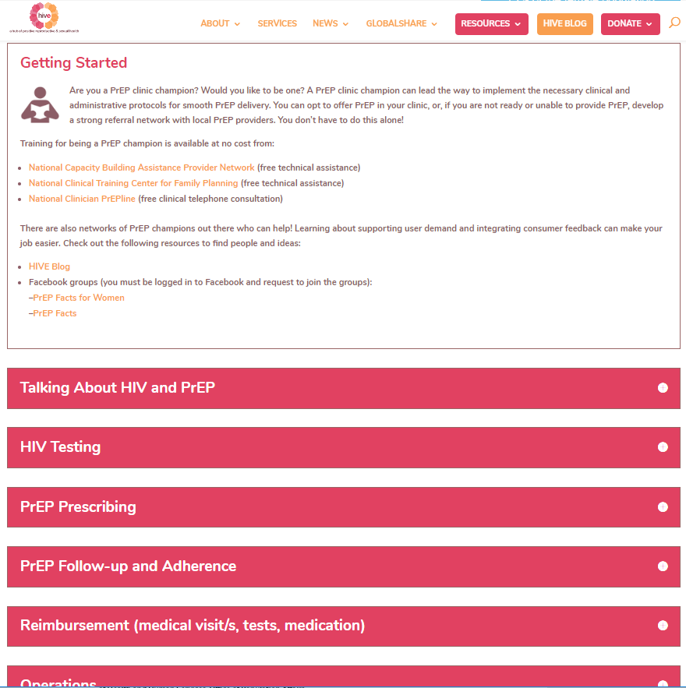
New Family Planning-Specific PrEP Resources
Notes:
We are now going to be discussing two new family planning specific PrEP resources for deciding on PrEP services and implementing PrEP services at your site. One is the Decision Making Guide for the Provision of PrEP services in Title X sites and the other is the Family Planning Provider PrEP toolkit.

Slide 26
Decision-Making Guide for the Provision Of PrEP Services
OPA published the Decision-Making Guide for the Provision of PrEP Services, a new resource to help Title X family planning service sites make evidence-informed decisions about their role in assuring access to PrEP for HIV prevention services in their communities.
The development of this guide involved a thorough analysis of peer-reviewed literature on PrEP implementation, key informant interviews with family planning clinic administrators, and the convening of a Technical Expert Panel.
While developed to inform PrEP decision-making in Title X-funded organizations, it may also be applicable for other settings where family planning services are offered.
Notes:
OPA has recently published a Decision Making Guide for the Provision of PrEP services and this is a new resource to help Title X family planning sites make evidence-informed decisions about their role in assuring access to PrEP for HIV prevention services in their communities. This Decision Making Guide, again, it's specific to family planning settings. It was developed to inform decision making in Title X funded organizations but it may also be applicable to other settings where family planning services are offered.
And this Decision Making Guide is really an opportunity for family planning settings to take a holistic look at their organizational capacity and consider whether or not it is appropriate to offer PrEP and at what level of service would make the most sense for the site. So it's really great for organizations that are not offering PrEP services yet but are thinking about offering PrEP. And even for sites that are offering PrEP services but thinking about maybe offering a different level, maybe you're offering referral services but considering whether it makes sense to actually offer the full range of services on site. This Decision Making Guide walks through each of those options.

Slide 27
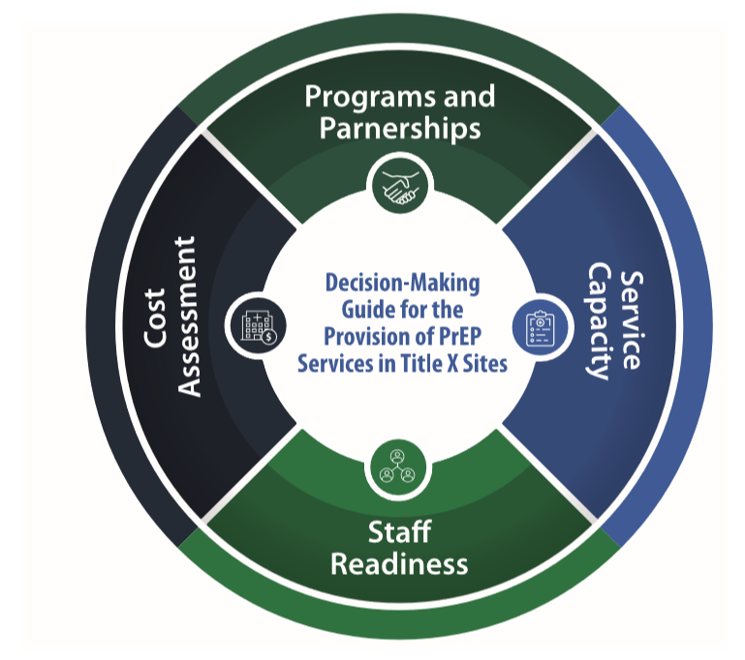
Overview of the Decision-Making Guide
The guide describes the key decision-making factors for PrEP services:
PrEP Programs and Partnerships: Assessing existing programs and organizational partners in the service area.
Service Capacity: Examining capacity for offering PrEP services based on the site’s unique structural and functional qualities.
Staff Readiness: Identifying and understanding the level of readiness among leadership, clinicians and staff.
Cost Assessment: Understanding the cost of PrEP services for the client and the site.
Notes:
The Decision Making Guide is really an organizational level Decision Making Guide and it walks through four key decision making factors for PrEP services. So the Decision Making Guide starts off by talking about PrEP programs and partnerships and the importance of assessing the existing programs and partners in your service area. For example, we know that some family planning sites are in areas where maybe the PrEP providers in the area are saturated and there are plenty of PrEP providers in the area that women and your clients would feel comfortable going to. So maybe it makes sense in that case to set up a partnership and become a referral site.
There are many family planning sites that are in service areas where there really aren't a lot of other PrEP programs in the area. And so maybe this is an opportunity for that family planning site to start to offer PrEP services.
The Decision Making Guide also talks about service capacity. So thinking about your capacity for offering PrEP services, based on the site's unique structural and functional qualities. And sorry, some of that's getting cut off at the end. But thinking about, what does it actually take to set up PrEP services, can we do the initial baseline assessments? What do we need to do to prescribe? What does the follow-up look like and do we have the capacity to do that at our site?
Thinking about staff readiness is also in their Decision Making Guide and working to identify and understand the level of readiness among clinic leadership, clinicians and staff and thinking about what the training needs are there. And then finally, the Decision Making Guide will also walk through thinking about a cost assessment and making sure that as you're making decisions about PrEP, the site does understand the cost of PrEP services to both the client and the site and understands the resources that are out there to help with those costs.

Slide 28
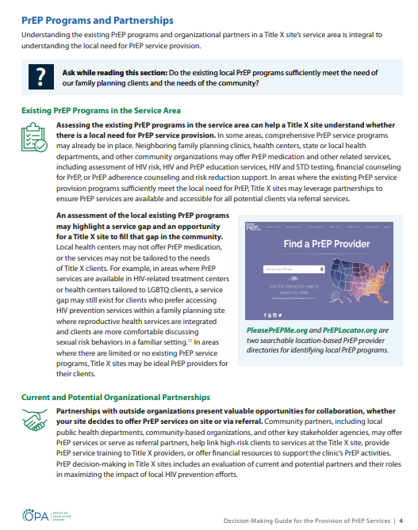
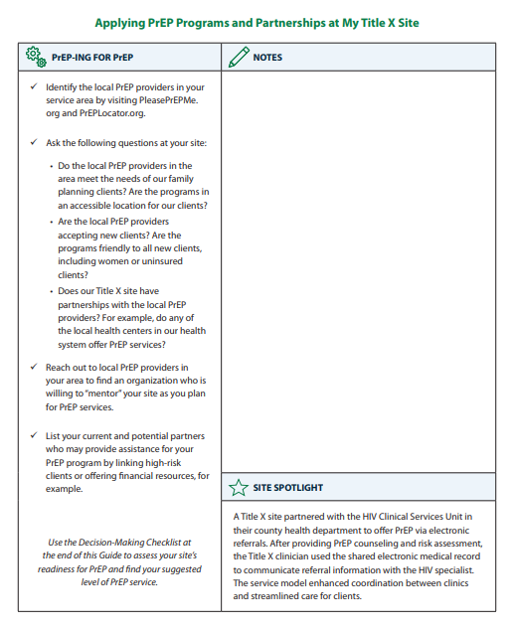
Decision-Making Guide for the Provision of PrEP Services
Notes:
This is just a screenshot of what the Decision Making Guide looks like. So each section of the Guide is based on those four factors that I just walked through. PrEP program, service capacity, staff readiness and cost assessment. And then each section of the Guide also features an interactive worksheet for you to document notes and action items and also suggest some action items that a family planning clinic could take after reading each of these sections.

Slide 29
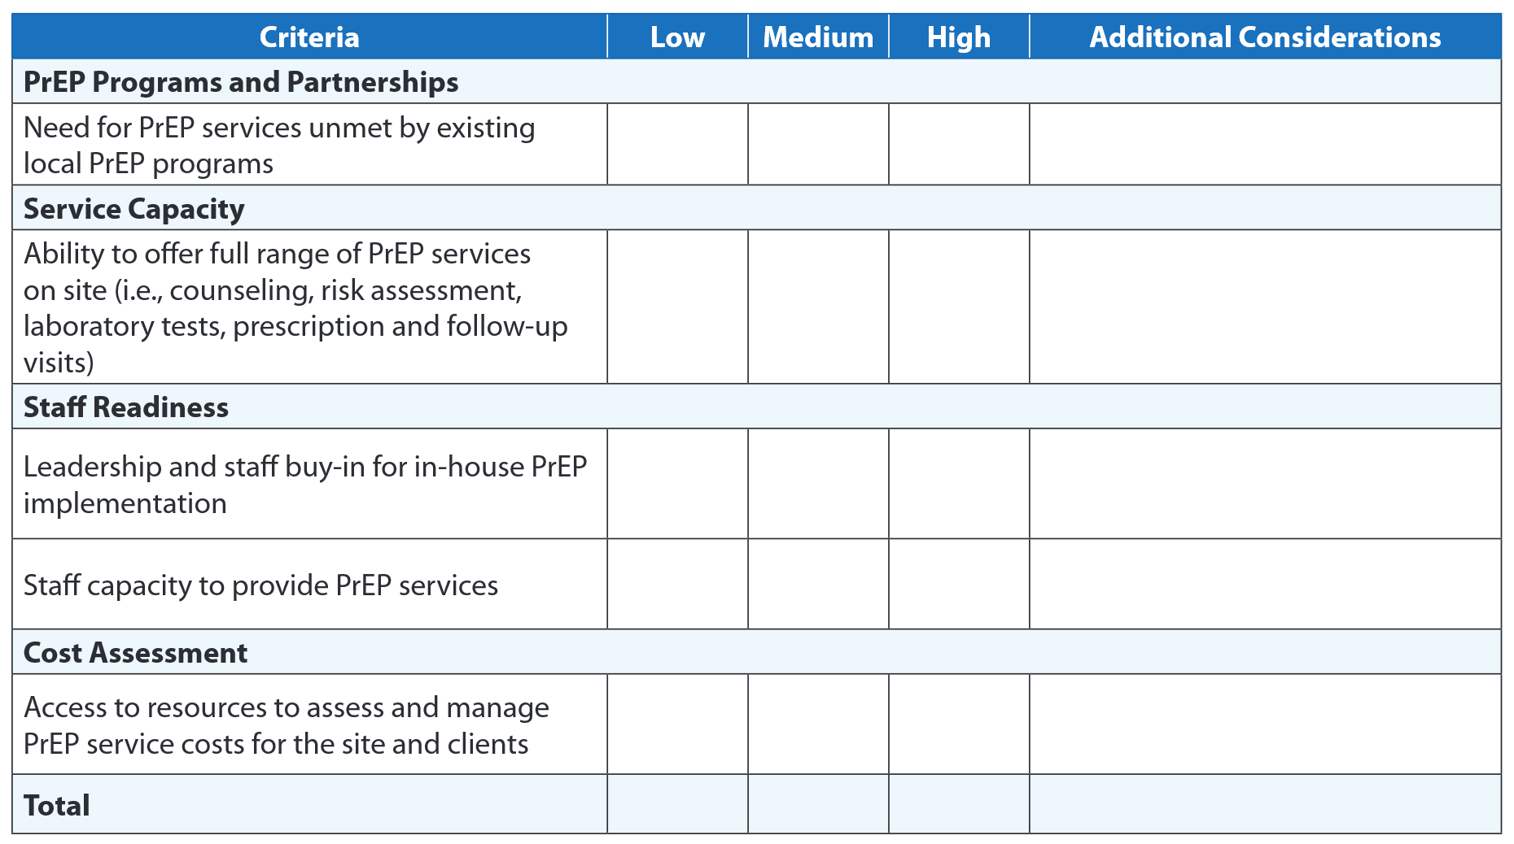
Decision-Making Checklist
The Decision-Making Guide is accompanied by a self-assessment checklist to help Title X sites determine the appropriate level of PrEP service provision for their site.
Notes:
After reviewing each section of the Decision Making Guide, there is also a decision making checklist at the end of that Guide. And the checklist is really intended to be kind of an organizational assessment tool to help you in family planning settings to assess the appropriate level of PrEP service provision for their site. Of course, Title X sites, they're always encouraged to make PrEP service provision decisions that fit their own specific context, capacity and needs. And this checklist goes back to each of those four areas and asks you to do kind of an organizational assessment for each topic. Would we rank ourselves low in this area, medium or high for each of these four sections?

Slide 30
Tiers of PrEP Service Provision
The Decision-Making Guide is accompanied by an organizational assessment tool to help Title X sites determine the appropriate level of PrEP service provision for their site, by considering:
Their current level of PrEP service provision, if any, and
The resources required to provide a level of service that assures access to PrEP services in their communities.
Notes:
Then once you were complete that tool, that Decision Making Guide would then recommend a potential appropriate level of services from either offering PrEP counseling, risk assessment and referral services on site, the second level would be PrEP counseling, risk assessment prescription services on site and then referring out for those follow-up services. And the third level would be similar to what Emily described at Drexel, offering the full range of PrEP services on site. So doing the assessment, writing the prescription and doing the follow-up services on site.

Slide 31
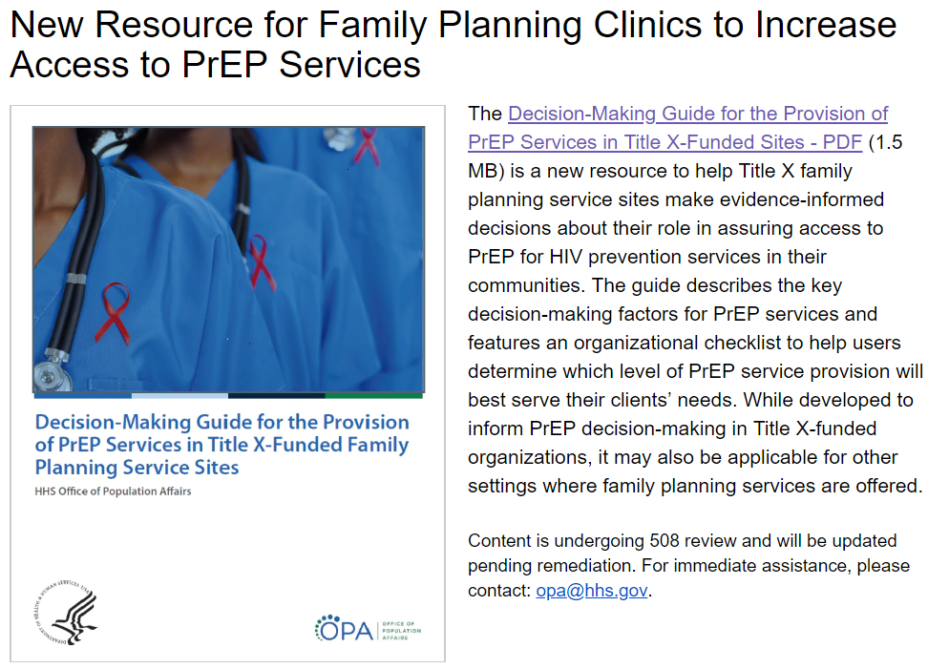
To view the Decision-Making Guide for the Provision of PrEP Services,
visit: https://www.hhs.gov/opa/reproductive-health/hiv-and-staying-healthy/index.html
Notes:
This new resource is available on the OPA website. It is on the HIV and staying healthy page. The web link is here and after the webinar, you all will receive the slides and also have this link. So if you're interested in looking at the Decision Making Guide, it is now available and it's on OPA's website. https://www.hhs.gov/opa/reproductive-health/hiv-and-staying-healthy/index.html

Slide 32
PrEP for Family Planning Providers: The Development of a Toolkit
Shannon Weber, Jacki Witt, Kimberly Carlson, Jonathan Fuchs, Yamini Oseguera-Bhatnagar, Dominika Seidman.
Notes:
(Shannon Weber, Director of HIVE)
Wee began offering PrEP to women in and around pregnancy in 2010. And not long after the FDA approval, we started the gaps in both information as well as uptake for PrEP for women.
We started a collaboration with the San Francisco Department of Public Health Capacity Building Program and the Title X National Clinical Training Center to develop a toolkit for family planning providers. And our idea was that we had a website which is hiveonline.org where we were starting to document the early PrEP implementation tools and sharing them with folks and look for a way that we could work together to create something that lived online that could be updated as the field emerged and make it rapidly available to clinicians who wanted to do this important work.
HIVE online link: HIVEonline.org

Slide 33
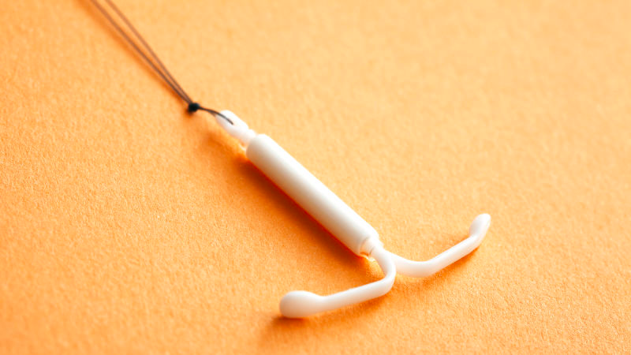
Why Family Planning Clinics?
Women are diverse and have a variety of needs – we must meet women where they are.
In focus groups women expressed that family planning clinics were one of the best places to receive information about PrEP.
40% of women access reproductive health care only, making family planning clinics a logical and efficient location for offering PrEP to women.
Notes:
Why do we focus on the family planning clinics? Well, we know that 40% of women access reproductive health care only, making family planning clinics a logical and efficient location for offering PrEP to women. Family planning providers are also uniquely skilled to offer these options with the shared decision making model. And early focus groups, which have continued to be true to the focus groups that are still done today, women say that they want to hear about PrEP from their family planning providers.

Slide 34
Survey of Family Planning Providers
Of 342 potential PrEP prescribers: only 38% correctly defined PrEP
Providers identified lack of training as the main barrier to PrEP implementation; 87% wanted PrEP education.
Consumer PrEP Awareness = Increasing demand for PrEP
Provider PrEP Awareness = Increasing supply of PrEP
Source: Seidman Dominika, et al, United States family planning providers’ knowledge of and attitudes towards pre-exposure prophylaxis for HIV prevention: A national survey, Contraception (2016), doi: 10.1016/j.contraception.2015.12.018
Notes:
Prevention of STIs, including HIV, is a core part of providing quality family planning services. So, in 2015, as part of this collaboration, we conducted a national survey with family planning providers to learn more about their knowledge, attitudes and beliefs about PrEP and HIV prevention. 495 providers across the country completed the survey, I wonder if that's any of you who are on this call today. If so, thank you for participating. And we found that providers at that time had a limited knowledge about PrEP. About one third of providers were able to correctly identify PrEP and the providers identified a lack of training as the main barrier to PrEP implementation. The majority of the folks who responded also said that they wanted more education about PrEP. And this is what led us to believe that developing this online toolkit could be helpful.
Shown in graphic: Consumer PrEP Awareness = Increasing demand for PrEP (red left arrow), and Provider PrEP Awareness = Increasing supply of PrEP (green right arrow)

Slide 35
PrEP Implementation Challenges in a Family Planning Environment
Notes:
In creating the toolkit, though, we are super aware that family planning clinics are busy clinical encounters that address multiple health priorities in a limited amount of time. And so trying to integrate a new service into this environment can feel daunting, particularly when PrEP provision may require navigation for benefit coverage for clients who are underinsured or uninsured. And there is more frequent lab testing and follow-up than other family planning services.
Even figuring out how to screen for HIV vulnerability can seem like an overwhelming task, given that there is no validated questions that accurately assess a woman's risk in the US. In addition to these structural challenges, providers and clinic staff require training on both the medical provision of PrEP. While it's not overly complicated, it does require familiarity, it is something new. And also in counseling on the variety of HIV prevention options so that it can be done from that shared decision making approach. And while many family planning providers agree that PrEP is part of their scope, they do want more training.

Slide 36
Family Planning Staff Already Know How to Do This!
OCP (Oral Contraceptive Pill)
PrEP (Pre-Exposure Prophylaxis)
Daily administration
Adherence = Efficacy
Ongoing assessment of sexual practices & pregnancy intention
Daily administration
Adherence = Efficacy
Ongoing assessment of sexual practices & HIV vulnerability
Contingency plan with emergency contraception
Contingency plan with PEP (Post-Exposure Prophylaxis)
Notes:
We do know and want to build upon the fact that family planning staff already have the skillset. So quick starting contraception is similar to the concept of same day PrEP. So in both, we want to be reasonably sure that in one case the person isn't pregnant and in the other case, the person doesn't have HIV and they take advantage of the fact that the person is in the clinic today and wants to get started on a prevention method. And so we worked to build out components of this toolkit, utilizing the structure that family planning providers are already familiar with.
Shown in graphic: OCP (Oral Contraceptive Pill): Daily administration, Adherence = Efficacy, Ongoing assessment of sexual practices & pregnancy intention, Contingency plan with emergency contraception (left blue arrow), and PrEP (Pre-Exposure Prophylaxis): Daily administration, Adherence = Efficacy, Ongoing assessment of sexual practices & HIV vulnerability, Contingency plan with PEP (Post-Exposure Prophylaxis) (right orange arrow)

Slide 37
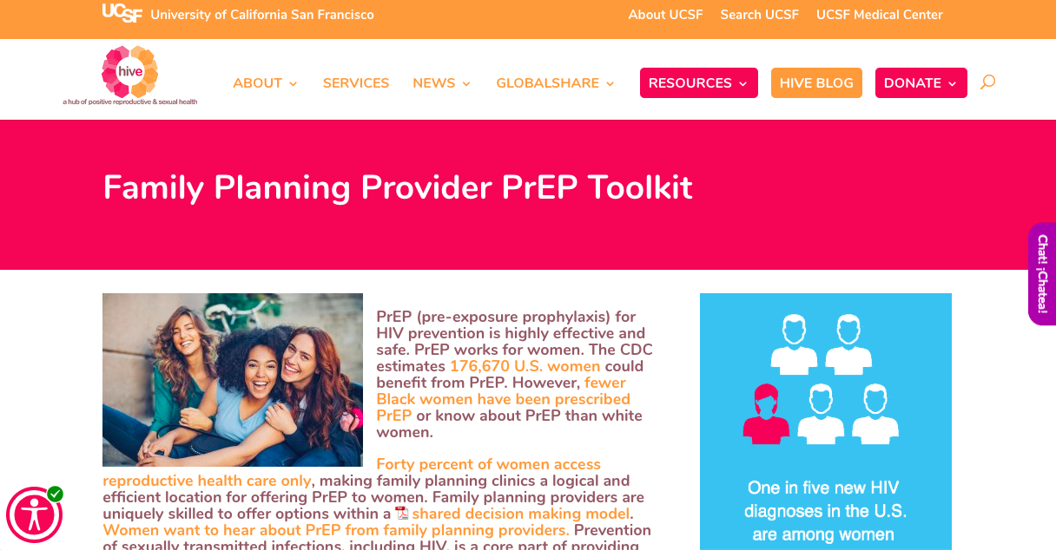
The Toolkit
Collaboration: HIVE, San Francisco DPH Center for Learning and Innovation (CBA), National CBA Provider Network Resource Center, National Clinical Training Center for Family Planning
Published at: www.hiveonline.org/PrEP4FamilyPlanning
Approved by CDC
Notes:
The Family Planning Provider Toolkit aims to support proper implementation, based on existing tools and resources and the toolkit links out to tips on eligibility, reimbursement, clinic flows, roles and many other nuts and bolts what you need to know to operationalize PrEP. But the toolkit goes a step further. It encourages conversation and learning, it encourages relationship building and shared decision making when we interact with patients. And it's really pushing us all to examine what our role is, wherever we are in the process in bringing PrEP to women nationwide.
This really calls on those of us who are here right now to be champions within our clinics and environment and figure out how we can best support patients and PrEP users in stepping forward and also by telling their story.

Slide 38
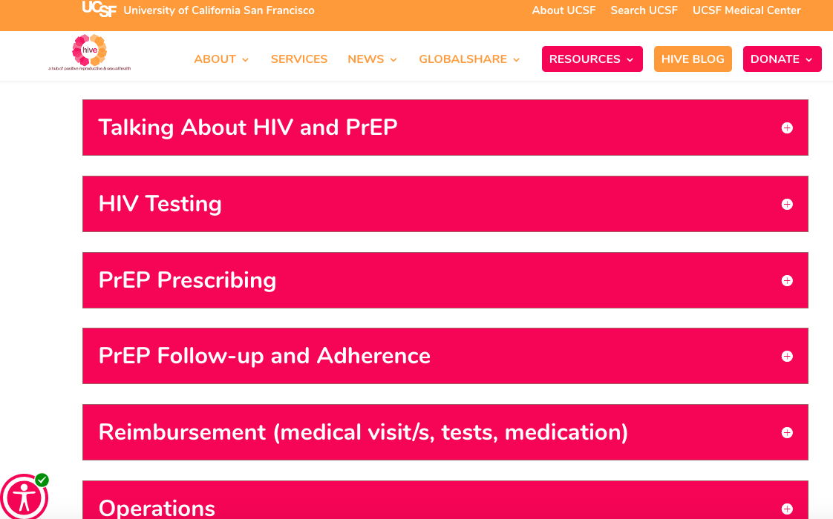
Family Planning Provider PrEP Toolkit
Notes:
We created the toolkit in this format that has this accordion field and we're able then to build it out as if it was like a notebook, taking you from start to finish for the questions that people may have about what it takes to implement PrEP. So for example, under HIV testing and PrEP, there will be a little blurb and then resources. PrEP prescribing, there's resources for clinicians including expert consultation.
ollow-up and adherence, about reimbursement. One of the pieces that became quite clear to us as we were developing the toolkit, though, and we even noticed this in the webinar today is that we talk a lot about the disparity, the health disparity and racial equity.

Slide 39
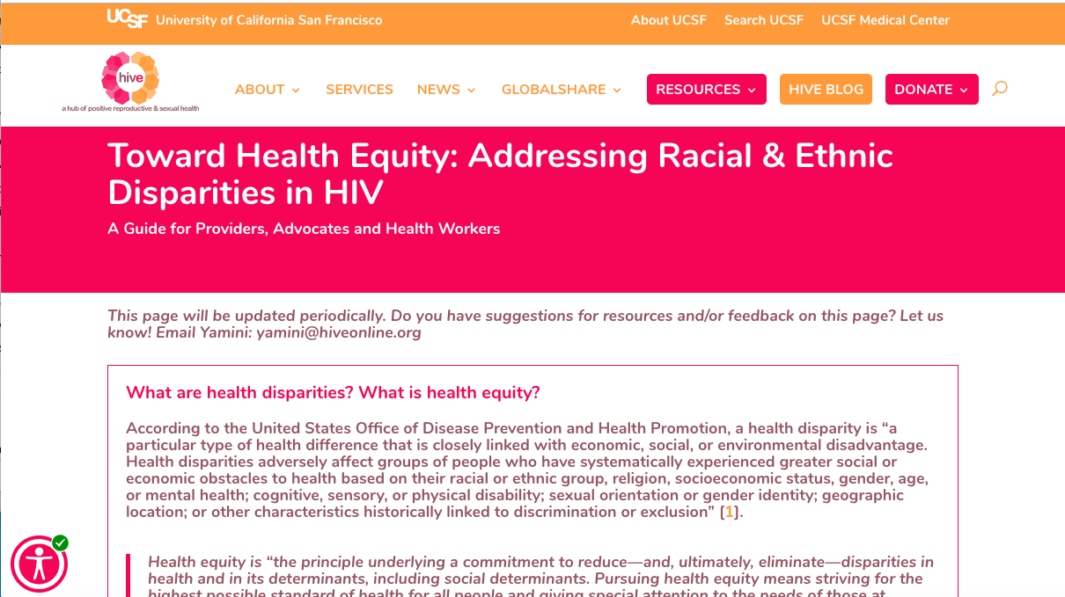
Family Planning Provider PrEP Toolkit, Cont’d
Notes:
As part of building out the toolkit, we also created this Towards Health Equity: Addressing Racial and Ethnic Disparities in HIV page. And as part of that, try to create and collate as part of our webinar series, resources that we can use on an individual, at a clinic level and at a system's level to help address the racial disparity gap that exists and really put us on track and accountable for working towards health equity.
In conclusion, I want to say that HIVE, we've been at the forefront and very passionate about this and in so many ways, it's been a reflection of you and the good work that you're doing. So all of this that we've been able to create has been in collaboration with lots of feedback from folks and I want to definitely acknowledge that you are all part of HIVE and part of this work.

Slide 40
The time is now!
Art by: Lauren Crew (top right), Victoria Garcia (bottom right), Jessica Sabogal (bottom left).
Notes:
I also want to acknowledge that while women are behind in PrEP uptake and knowledge, we're also really diverse in our needs and I will really want to challenge each of us to acknowledge that we have this important work to do and it's really now is the time for us to do it to make sure that women in all of our varieties have access to PrEP.

Slide 41
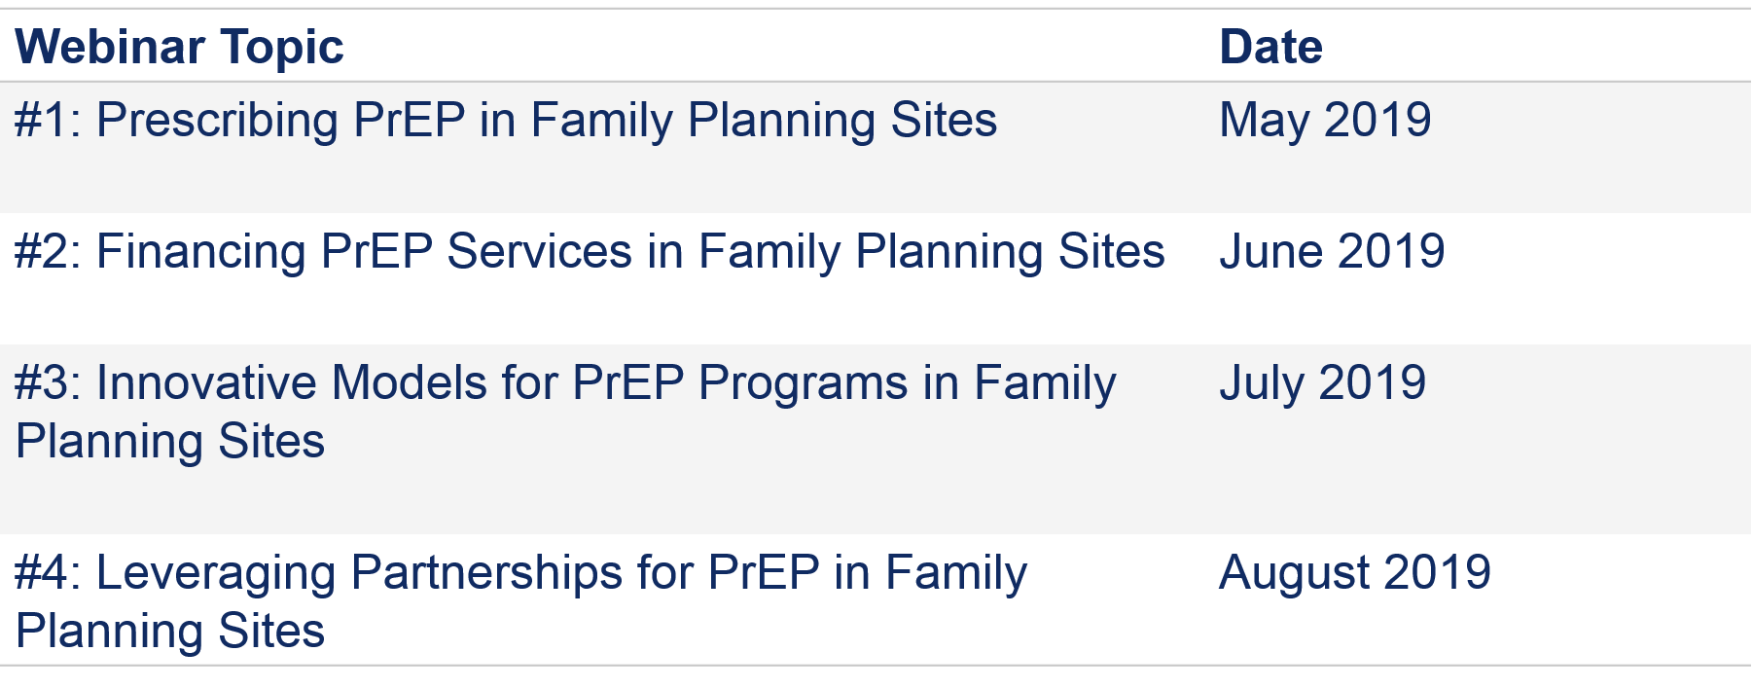
Reminder: OPA PrEP Training Webinar Series (Tentative)
Notes:
To recap, the first in a series of webinars about PrEP and the implementation of those webinars will take place over the next few months. So please stay tuned for that.

Slide 42
QUESTIONS?
Notes:
All resources are posted on fpntc.org
Thank you

