Slide 1
New FPNTC.org Features to Support Tracking of Title X Staff Training
November 5, 2018
Notes:
Elizabeth Costello:
Hello, everyone and welcome. This is Elizabeth Costello from the Title X Family Planning National Training Center and I'm delighted you are here with us today for today's webinar, as we introduce new features on our FPNTC website to support tracking of Title X staff training. During today's webinar, we will be discussing how you and your organization can use these features to track completion of training on the FPNTC website, which is a feature that numerous grantees have asked us for and that we're very excited to debut. A few things before we begin. Everyone on the webinar today is muted, given the large number of participants so please use the chat at the bottom left of your screen to ask questions at anytime.
We're going to hold all of those questions at the end of the presentation. A recording of today's webinar, the slide deck and the transcript will be available on fpntc.org in the coming days.

Slide 2
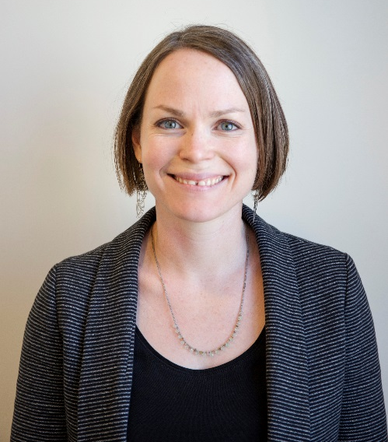
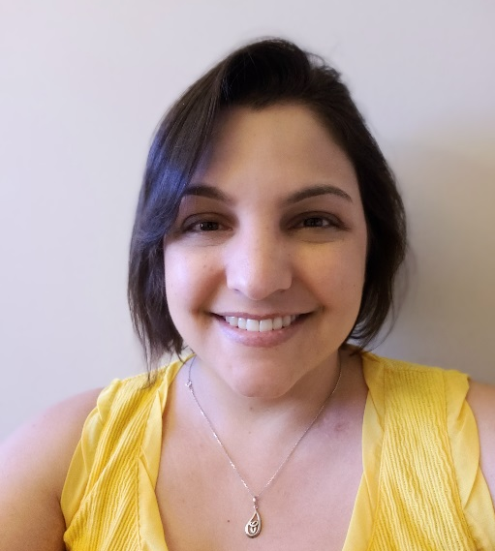
Speakers
Elizabeth Costello, MPH
Knowledge Management Team Lead,
Family Planning National Training Center
Theresa Russo, MSLIS
Website Manager,
Family Planning National Training Center
Notes:
Elizabeth Costello:
I am joined today by my colleague, Theresa Russo who is the website manager for the FPNTC. Theresa has worked in the fields of knowledge management and library science for over six years and she is part of the team that conceptualized and built the new website features that we're sharing today.

Slide 3
Objectives
Learn how to create and share a Training List with program staff and track training participation
Distinguish between a regular website account and a Training Administrator account
Know how to request a Training Administrator account on fpntc.org
Identify a new tool that summarizes federal Title X training requirements
Notes:
Elizabeth Costello:
Here's what you can expect from today's webinar. Through a live demo, Theresa and I will show you, how to create and share customized training list with program staff and how to track training participation after you shared the list.
We will also distinguish between how a standard user interacts with the training tracking system versus a user with a training administrator account. We'll show you how to request one of those accounts.
Finally, we'll share a new tool, we're currently developing that summarizes federal Title X training requirements that can be used as a starting point for developing training list.

Slide 4
Intended Audience
Title X grantees and subrecipients that are responsible for:
Developing training plans for their networks
Tracking network staff completion of assigned trainings
Ensuring that subrecipients and service sites comply with Title X training requirements
Notes:
Elizabeth Costello:
Just a note on the intended audience, the new features we're sharing today were designed for Title X grantees and sub-recipients that are responsible for developing training plans for their networks, tracking network staff completion of assigned training and ensuring that sub-recipients and service sites comply with Title X training requirements.
Therefore, this webinar is most appropriate for staff in these roles. As noted just now on the objectives, we are going to spend some time today differentiating between how a staff with different roles within the Title X network can use the system.

Slide 5
Existing Training Tracking System (TTS) Features
Any user registered on fpntc.org can:
Save training and resources from fpntc.org for easy access
View list of trainings they have registered for and completed
Download certificates of completion and continuing education (CE) credits
Download Training Report
Add non-FPNTC trainings to Training Report
Notes:
Elizabeth Costello:
With that in mind, let's start by reviewing some of the existing features of the training tracking system before we dive in to the new ones. When we launched our re-designed website a year ago, we introduced some initial features to allow individual training participants to track their own training on fpntc.org. Any user who creates an account on the website is able to save training and resources from the site to their account, for easy access later.
They're also able to view a list of trainings they registered for and completed as well as downloading certificates of completion and continuing education credits where applicable. Individual users can also download their personal training reports which is a simple PDF that summarizes all of the training they've completed on the site. Finally, individual users can add non-FPNTC trainings to their training reports and we'll review all of these features during our live demo as well.

Slide 6
Poll
How has your organization been using the current training tracking features? (check all that apply)
Ask staff to create an account
Ask staff to complete training on fpntc.org
Staff share FPNTC certificates of completion
Staff share Training Reports
We are not using the training system
I’m not sure
Notes:
Elizabeth Costello:
Before we show the new features, I want to take a quick poll to see how you and your organization maybe using these current features. Have you asked your staff to create accounts on the FPNTC website?
Do you ask your staff to complete training on fpntc.org? Do your staff provide you with certificates of completion from FPNTC trainings or perhaps do they share trainings reports with you or you might not be using the training system yet or you're not sure if your staff are using it? You can select multiple answers. We'll keep this open for just a little bit longer before we review the results. All right, so I'm going to close the poll. Great, it looks like half of the participants today have asked staff to complete trainings and I'm very happy to see that 37% of you have asked staff to create an account and that staff are sharing their certificates of completion with you.
It looks like there's another group here that hasn't started using these features so we're excited to share ... we're excited to have these new features with you, if you've been using the site and if you're not using these new features, you'll get to see all of these components today.

Slide 7
New TTS Features
Training Administrators
Create and share customized Training Lists
View Training List completion
Download completion reports
Training Participants
Accept (“opt-in”) to Training Lists
This allows Training Admin to access their completion information
Notes:
Elizabeth Costello:
Before we start to demo, I want to provide a quick overview of the new features we'll be demonstrating today. All of the features we launched with last year were for individual users and there are almost 10,000 people who have registered for accounts on the new site and we hope that includes many staff in your own networks.
Today, we're introducing a new training administrator role, we created on the website, which again is intended for Title X grantees and sub-recipients that are responsible for developing training plans at their agency and ensuring that sub-recipients and service sites comply with Title X training requirements. You may have a different title within your agency but we'll refer to the role as training admins throughout this webinar. On the FPNTC website, users with the training admin role can create customized list of training resources. For example, your list might include recorded webinars, E-learning courses, and other training materials and you can ... as a training admin, you can share these list with a program staff for them to complete those trainings.
For example, a training list may consist of two E-learning courses and the publications for review. We'll talk more about training lists in a minute. Training admins can also view and download completion reports for all staff that have opted in to complete the training list. In order for a training admin to view completion information, it is very important that staff accept or opt-in to the training list and we'll cover this again in the demo shortly. All right, with that, we're going to jump over ... I'm going to jump over to my web browser to begin the live demo and during the demo, please feel free chatting your questions if they come up but remember that we'll be holding these until the end of the presentation.

Slide 8
Live Demo
Notes:
Elizabeth Costello:
All right. Thanks Theresa. I'm going to go back to my desktop now. Okay, so hopefully, you can see my screen again. Let's go back to my training list tab again, as the training administrator. Theresa just showed us how the individual user would walk through that experience of accepting the list and participating in it. Now, as a training administrator, we want to see what starts to happen with the list once that begins. When you come back to your list and we have ... I also shared this list just now with a few other members on my team so I can see that there are three participants that have accepted the list.
Remember that even if you send the link to multiple users, so I actually sent this link list to four people but I'm only seeing this number three here so you'll only see them show up on your list if they accept the link. You can hit the manage users button to see who's accepted your list. There's also an option here to ... a little trashcan, if you need to delete a user from your list, that option is there if you ever need it. Now, I want to look at the completion report for this list and again, we just created this list and shared it so we're not going to have too much here to see but the completion report ... I can view the completion report specifically here for this list, click that.
The completion report is going to show all of the E-learnings and archived events from your training list. Everything that showed up in the top of the list. The other resources, the things like, the training guides, your job aids, the things that you're asking people to review, they're not going to show up here because they don't have a certificate of completion. We really can't say that somebody completed them or not but it lists the resource in order and it'll show you the completion information. I can see that Theresa has completed the ... she completed the human trafficking webinar and the Title X orientation E-learning.
They'll show up as completed here and then I can see that for the other staff, those are incomplete because they just got these links but again, it did want to kind of confirm what Theresa said that if you do staff that has completed these trainings already, they should get credit for them here in the completion. If you share a list with a lot of staff, you might already see completion information that's entered there when you come here. There's also an option here to download the spreadsheet so all the information ... these columns here, you can download this to a CSV file that you can open in Excel or another program that will allow you to filter and sort and integrate this information with your other reporting processes.
I'm going to go back out to the training list, because right now, I just have one training list and I wanted to show you there's a little arrow here, you can click on and off to expand and hide. If you end up creating multiple training list, you can also view a completion report for all of the list and download the spreadsheet with all of the list together so if that ... I wanted to present that a couple of different ways so people can ... if you do end up with multiple list, you can just do it in one click to get the information. That concludes our live demo and the basics of creating sharing and tracking the training list.

Slide 9
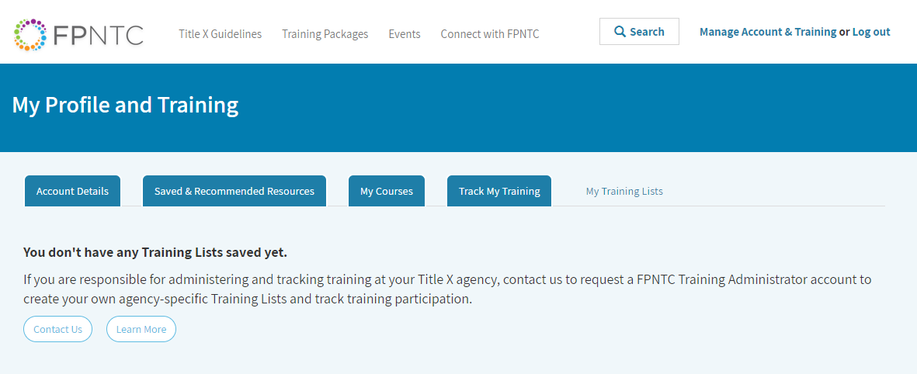
Admin Logs In
Notes:
Elizabeth Costello:
All right. Hopefully, you can see my web browser now, I'm on the FPNTC website. Right now, I'm logged in as just a regular user so let's start by familiarizing ourselves with the training account interface. You can access that training account in the upper right hand corner. Right now, for me, it says Manage Account and Training but if you're not logged in, you can ... first you want to log in there with your FPNTC account information. Theresa is going to review some of these different training account tabs for individual users in a bit but I'm going to start at the new tab on the far right which is my training list. If you're a training admin, this is where you will go to create and track training lists.
If you're a training participant, this is where you will go to see the lists you've accepted and to complete the training on those lists. For those of you that want to get a training admin account, this is also where you will go to request an account by clicking on the contact us button and we'll discuss that more at the end of the demo. I'm going to log out of this account and log in with my training admin credentials. Just give me one minute. Always a miracle, when I can remember a password. All right, so please note that if you try to log into the site right now, if you don't have a training admin account, you will not see the features I'm going to show because we haven't granted that access to you so I just want to avoid any confusion if you're trying to follow along with me.

Slide 10
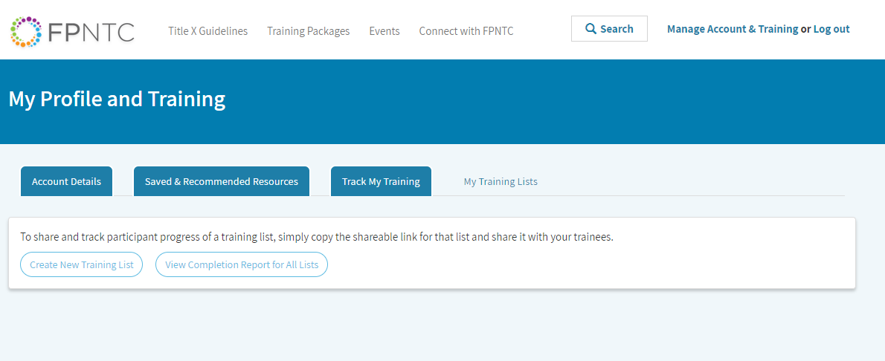
Admin Creates a List
Notes:
Elizabeth Costello:
Now, that I'm logged in ... I'm still logged in but to go through a few of these tabs that I can see. Again, my first tab here that I start with is the account details. This is where you can see what information you signed up with and you can edit your account details if you need to change your password for example. There's also a list here of saved and recommended resources, where you can quickly access any resources that you saved while browsing the site. There's a save and un-save button on every resource on the site. You can also see a list of resources on our site that we recommend to help you meet Title X program requirements and queue up key recommendations.
Then now, I'm going to jump to the my training lists. Theresa is going to go over the my courses and the track my training tab when I turn the demo over to her. All right, so now that I'm logged in as a training admin, I actually have two options. Before I was logged in as a regular user, you saw, there is an option for lists that are assigned to me and then now, I have this new option to manage my list. When I first come to this page, I'm not going to see any training list but before we create one, let's think about what type of list you might create and why. You might create a training list for all new staff for your agency, such as onboarding to Title X.
You might want to create lists for different staff roles at your agency such as a list for front desk staff or clinical staff or staff who do clinic ... who do billing and coding and you might ask a staff to complete these lists annually. You could also create dramatic list by topic area, such as training support, implementations of QFP recommendations. If you like to share what other types of training list might be useful for your agencies, please feel free to chat that with us in the chat box as we go through the demo.

Slide 11
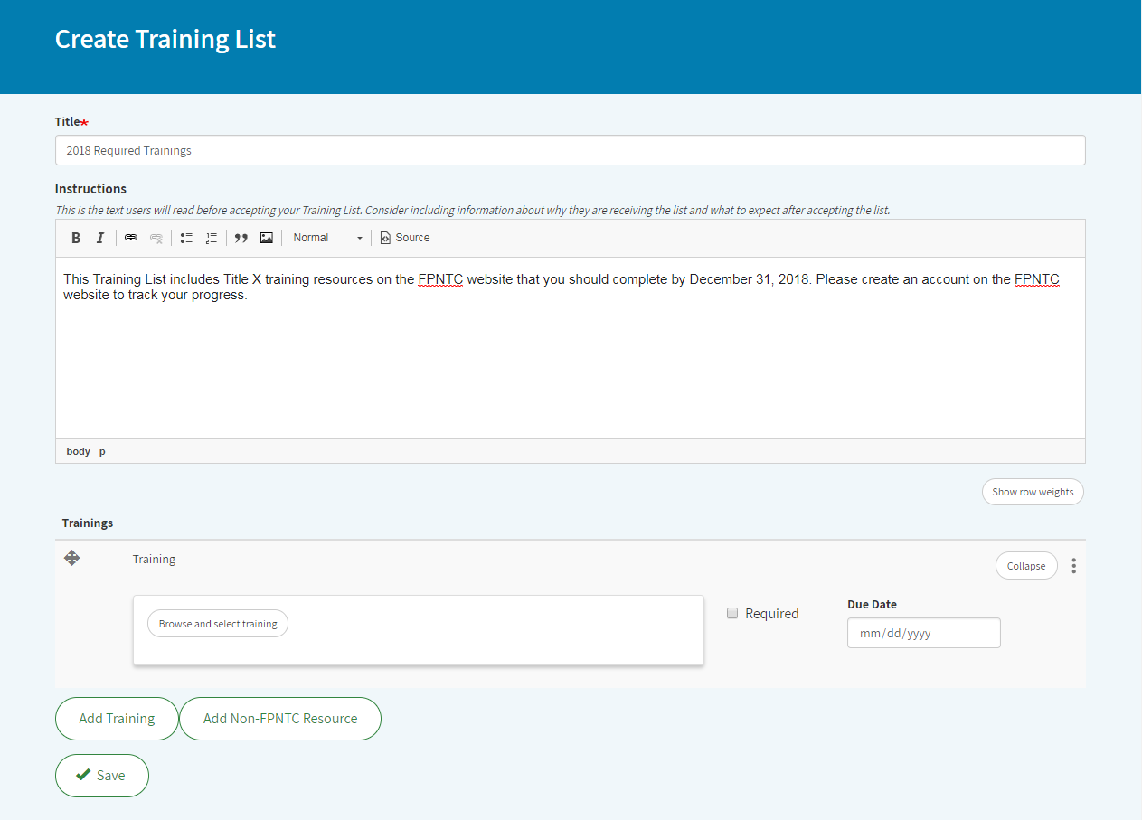
Notes:
Elizabeth Costello:
Now, let's walk through how to create lists. First we're going to hit the create new training list button here, then you will be prompted to name your list and provide instructions for the list.
I'm going to name this one, new staff training list for all staff associated with the Title X grant. Now, the list name and the list title and the list instructions, they will be visible to users. They will see this before they accept your training list. Consider including information about why there is even a list and what to expect after accepting this list in the instructions so I'm going to quickly add something here. You are receiving this list because ... please, you are receiving this list because you're associated with our Title X grant. Please complete this training by 12/31/2018. You could put a date on it.
We'll also show you how you can put dates below but again, just giving them some context about why they're getting the list.

Slide 12
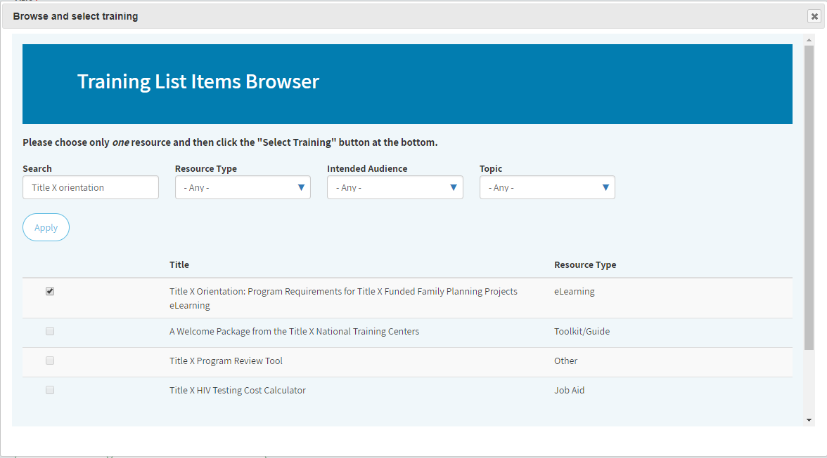
Notes:
Elizabeth Costello:
Okay, so now, it's time to add some trainings. As you scroll down, there's a button here to add training and when you click that button, it opens a new window to browse and select training. If you know a specific resource name or search term, you can search for it here. For example, if I know I want to add the Title X orientation, I can search for that here. I'd type in my search term and I hit apply then I click the check box next to the resource title where I find the resource I want to add and I scroll down to select training.
That takes me back to my list builder page and I can see that I've added that training there. Then for each resource, that each training resource that you add, there's two optional settings. One is for whether it's a required resource or not. I'm going to go ahead and set this one as required. You can also put in a due date so if I wanted to set it, again, I have to say by the end of the year, say, 12/31/2018. All right, now, I'm going to add another resource so we can see the other browsing options here and again, any resource that is available on the FPNTC website is going to be available through this training list on browser.
You can browse by resource type so we've got our different modalities here so if you know this is who you want to look for, an E-learning module or maybe you want to look for a video, you can choose that way. You can also browse by intended audience so if you're thinking about lists for different staff roles that might be helpful. Then, all of the topics for our training packages, they also show up here in the topic area. I know I want to include a resource on human trafficking so I'm going to find that, I could search for it but I'm going to find that as ... I'm going to look for that as a topic and again, you're going to hit apply.
You can also ... if you know you wanted, you can combine the search term so if I want to look for an event archive for human trafficking, that'll give me specifically the recorded webinar so I'm going to select that one. I've seen that one before and I wanted to add that to my list and again, that's going to come back out here. I'm going to mark this one required and I know, I'd also like to include the training guide on encouraging family participation so this one, I'm going to search for the title and also choose training guide and that one comes up right here. Again, just selecting the check box and hit select training and it adds it to my list.
Now, I see I have ... I've got three resources on my new draft train list and you'll see I've got a mix of resource types here. I have an E-learning module. I have an archived webinar and I also have a training guide. Again, you can add any resource from the FPNTC website to a training list. We do have an option here to add a non-FPNTC resource if you like. It's pretty simple. It allows you to add a URL and then to give that a name so that's another option as well. If you need to remove any of the resources, you can remove them here, obviously this big red button is pretty obvious to find. You can also remove them here on the side. All right.
I have not saved my list so first let's go ahead and do that, hit save my list. Now, this takes me back ... once I saved my list, this takes me back out to my, my training list and before where we had just these buttons to create a new training list or view completion report, now, I can see my new list here. If you need to change anything about this list, maybe I want to add more of the instructions or I want to ... maybe I want to go back and set a due date for the human trafficking webinar. You can hit the modify list and just takes you back to the screen where we're just on before and you can make those changes. You can also do a few more things while you're in here. If you want to reorder any of the resources, you can drag them and drop them around.
That will ... if you end up with a longer list and just want to reorder them. I'm going to go ahead and save that information and come back out.

Slide 13
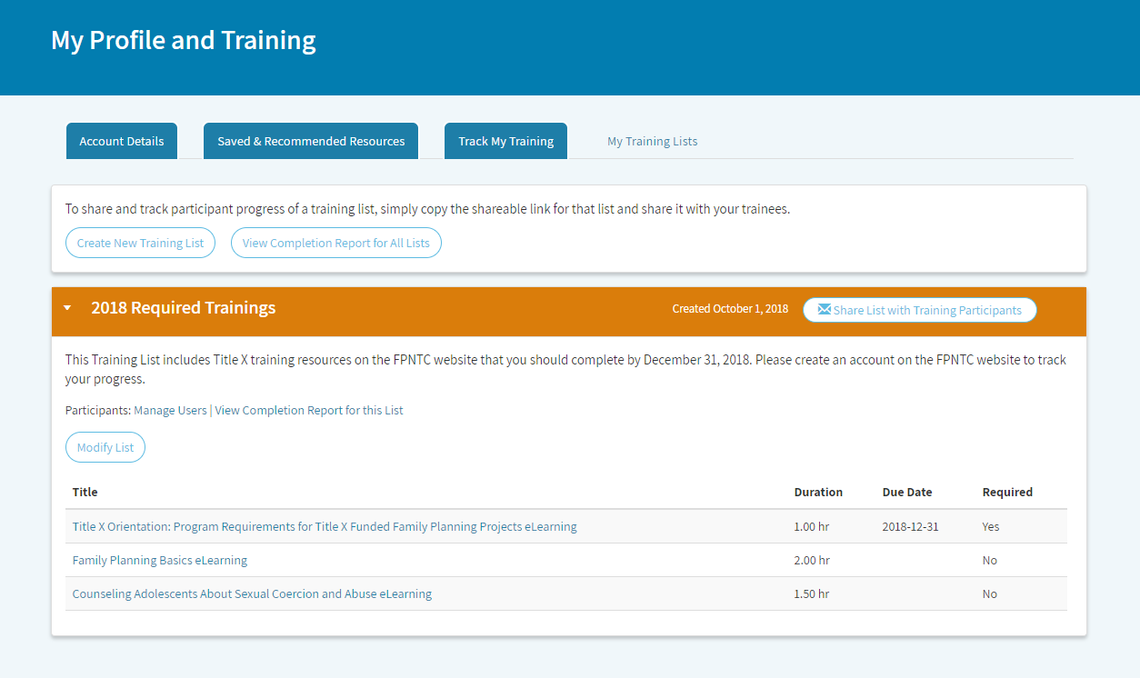
Notes:
Elizabeth Costello:
If you need to change anything about this list, maybe I want to add more of the instructions or I want to ... maybe I want to go back and set a due date for the human trafficking webinar. You can hit the modify list and just takes you back to the screen where we're just on before and you can make those changes. You can also do a few more things while you're in here. If you want to reorder any of the resources, you can drag them and drop them around.
That will ... if you end up with a longer list and just want to reorder them. I'm going to go ahead and save that information and come back out. You can modify a list at anytime so even after you've ... even after you've shared it with your staff, you can still go back and add to it, you can add new courses or new resources to it and you can also ... changing the information within it. All right, so now it's time to share this list with your program staff. Here on the far right, next to my title, there's a button to share a list with training participants. When you click this box, it's going to open up a little window here with a link that you can copy and paste via email or some other sharing mechanisms.

Slide 14
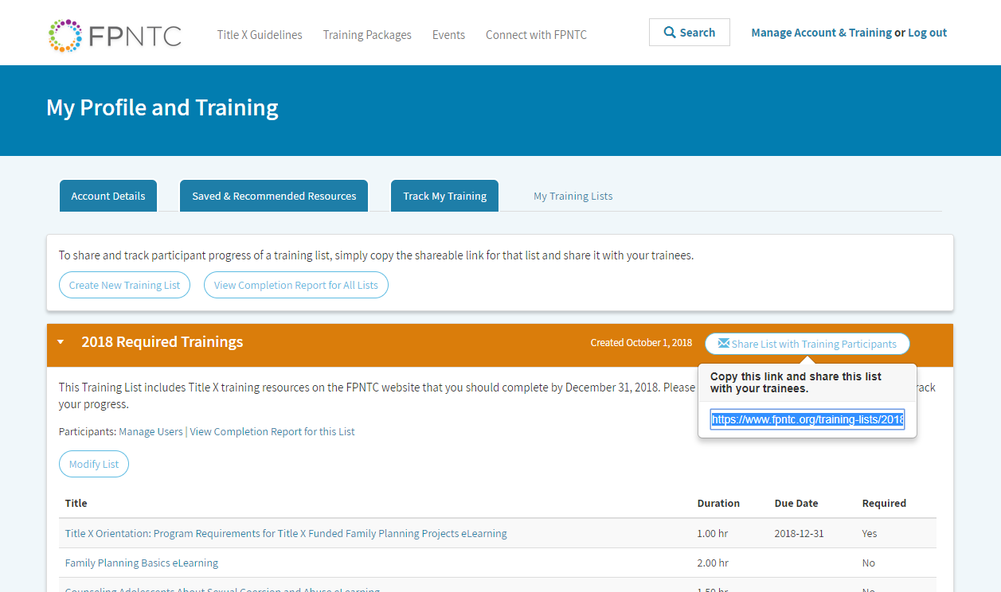
Admin Shares List
Notes:
Elizabeth Costello:
When you click this box, it's going to open up a little window here with a link that you can copy and paste via email or some other sharing mechanisms.
We know that email is a primary way, you're already sharing and assigning training to program staff so this stays within your ... we're hoping this stays within your current workflow and enables you to control who gets the training request and hopefully, you will have ... we saw that many of you had already asked your staff to create an account on FPNTC before you share the list and ask them to complete the training but if you do share the list with someone who doesn't have an account yet, they will be prompted to create one before they can accept the list. All right, so I'm going to copy this link and I'm going to end my screen sharing and share this link with Theresa and turn the demo over to her to show you the next steps from the view point of a training participant.
Bear with us for one moment while I chat this link to Theresa and when she's got that up, she'll go ahead and share her screen.

Slide 15
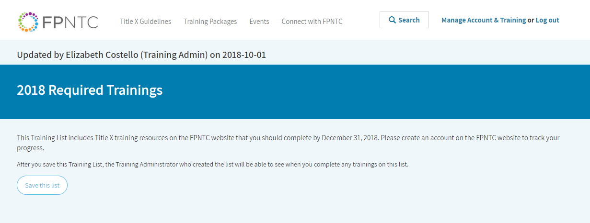
User Accepts List
Notes:
Theresa Russo:
This is the link that Elizabeth sent me. Now, I'm looking at this, the link that she sent me. You can see that it shows me who created the list, Elizabeth Costello and when it was last updated. That was today. I can also see any instructions that she entered as well as some standard language that's included with all training list that says after you save this training list, the training administrator who created the list will be able to see when you completed any trainings on the list and that's right here. Then, I have the option to save this list. Now, this step is the most crucial step in ensuring that connection between training administrators and training participants.
The only way that the training tracking system can associate an administrator with the participant is through this process of opting in to save the list. Now, an administrator cannot see any other information about a training participant only the completion information for the training list that they've accepted.

Slide 16
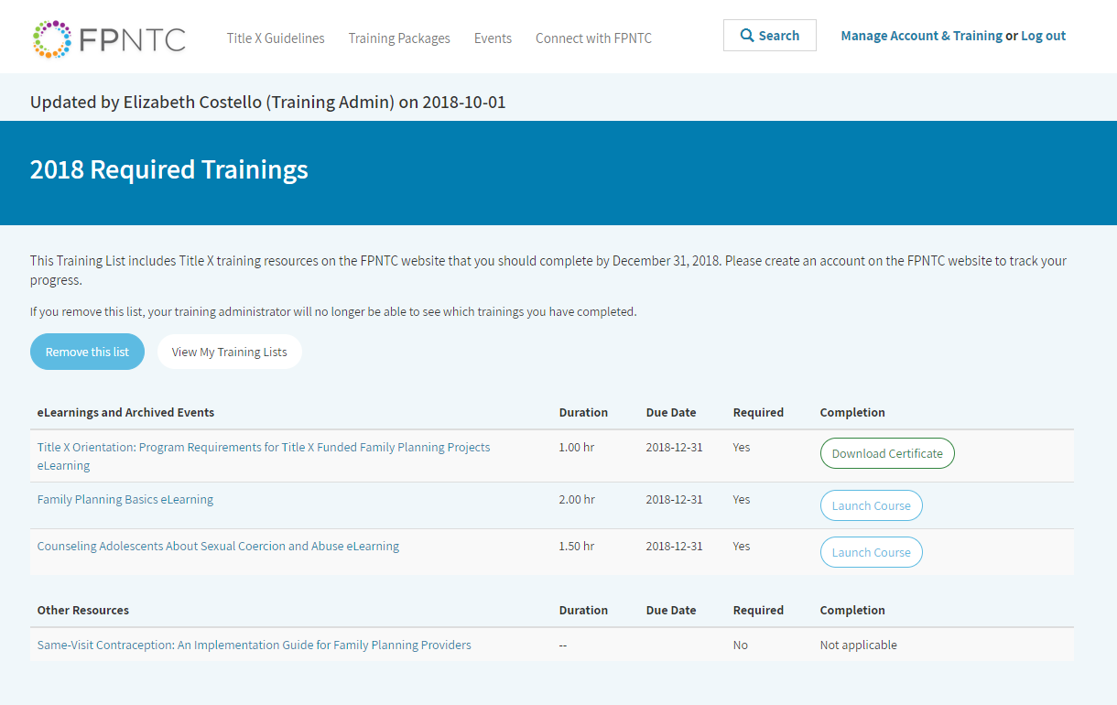
Notes:
Theresa Russo:
Okay, so I'm going to save this list and now it shows me the different resources that are associated with it. I can see that the resources are separated into two categories. E-learning and archived events and other resources. Just because E-learnings and archived events, offers certificate of completion and CE credits, it's applicable but other resources don't.
I can also see how long the resources take right here under duration, when they're due, under the due date and if they're required, if the training admin entered that information. Here, I can also see my completion information. In this case, I see that the Title X orientation was assigned but I've already completed that course in the past so it automatically shows up ... shows my certificate of completion. As Elizabeth mentioned earlier, there are almost 10,000 website users and we have thousands of course completions in the past year or so. We want to ensure that staff get credit if they already completed something.
I can also see that the list includes the resource I haven't completed, assuming human trafficking archived webinar so I can click here on the title and it'll quickly register for that event. I can view the recordings and then I can complete the evaluation that appears at the end. For the sake of time, I'm going to go ahead and jump right to the evaluation that's available after I view the archived webinar. I'll click through that really quickly so that we can see what happens once I say that I've done it.

Slide 17
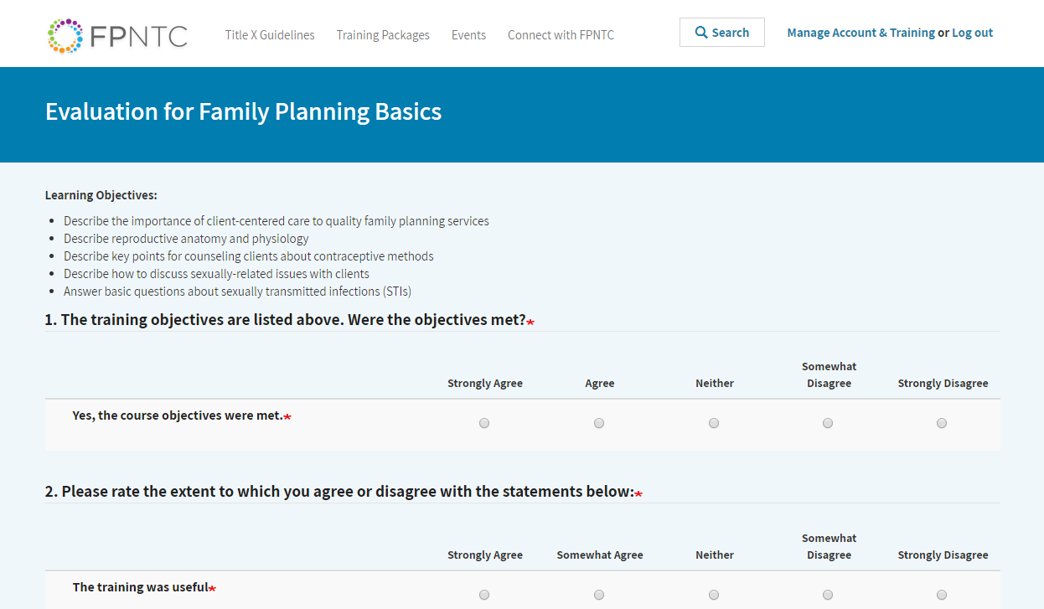
User Completes Training
Notes:
Theresa Russo:
For the sake of time, I'm going to go ahead and jump right to the evaluation that's available after I view the archived webinar. I'll click through that really quickly so that we can see what happens once I say that I've done it.

Slide 18
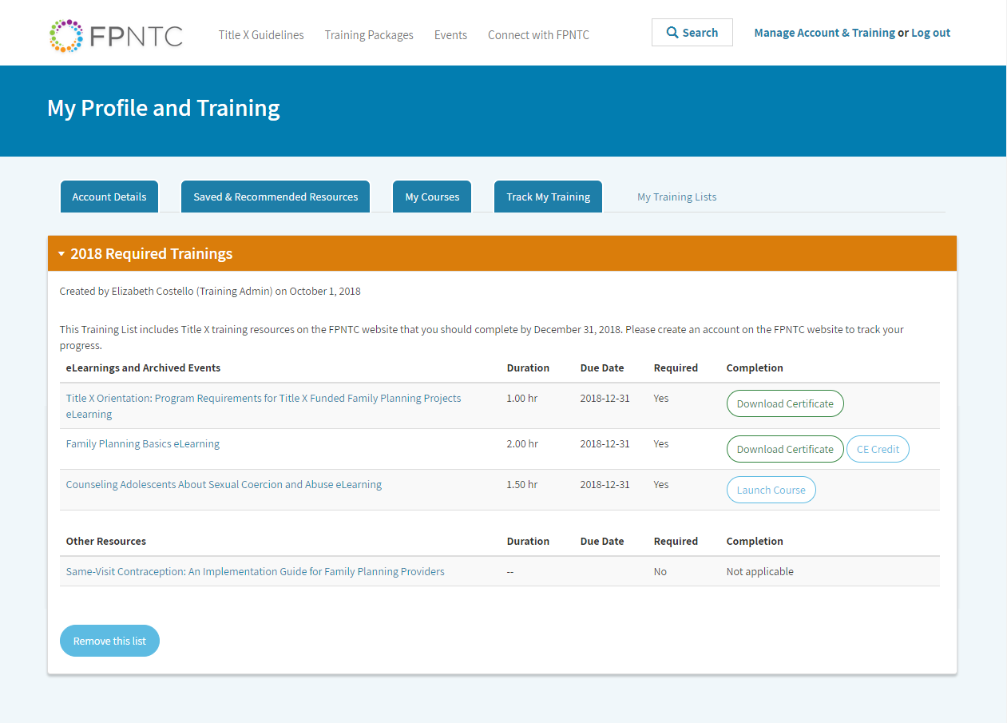
Notes:
Theresa Russo:
Right, so I'm going to submit that and then I can go back and refresh this page and now, we can see that I have my certificate for that because I've completed that and I can access that here.

Slide 19
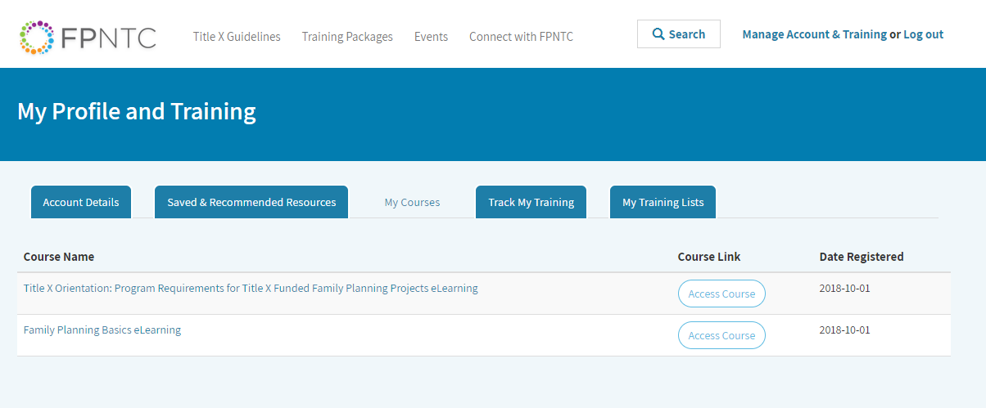
Notes:
Theresa Russo:
I also want to walk through the training account interface from an individual user perspective. I'm going to go back to manage my account and training. Earlier in the presentation, Elizabeth reviewed the training tracking system features available to individual users. This is where users can access those features. In my courses, this tab allows users to quickly access any trainings that they have registered for, either on their own or through a training list. This tab has been in place since last October and here you can see that I have registered for the family planning basics E-learning but I haven't taken it, that course yet. This is just like a reminder that I've registered and I can access it quickly for ... right from here.
The next tab is the track my training tab and it shows completions for all trainings whether they've been assigned through a training list or not, this feature has also been available since last October. It shows completion for individual trainings or users can click it and download a training report that summarizes the same information in a PDF and that option is up here with this button, create training report. Finally, the new my training list tab, shows the user any training list they've accepted and the resources in that list so we can see this one that I just accepted, that Elizabeth sent me and users can accept multiple training list at the same time.
If someone is a front desk person and they also do billing and you have two different lists, they can be on both list so they can accept them both at the same time. Okay, now, I'm going to turn it back over to Elizabeth so we can see how my completion information for the training list, she shared shows up for a training admin.

Slide 20
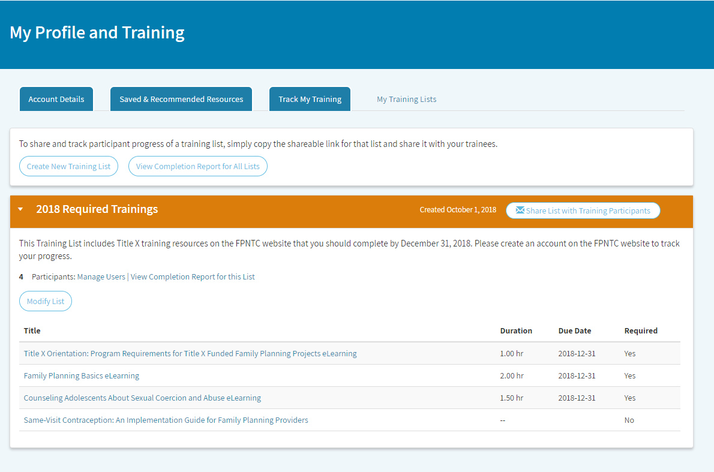
Admin Views Users and Completion Report
Notes:
Elizabeth Costello:
All right. Thanks Theresa. I'm going to go back to my desktop now. Okay, so hopefully, you can see my screen again. Let's go back to my training list tab again, as the training administrator. Theresa just showed us how the individual user would walk through that experience of accepting the list and participating in it. Now, as a training administrator, we want to see what starts to happen with the list once that begins. When you come back to your list and we have ... I also shared this list just now with a few other members on my team so I can see that there are three participants that have accepted the list.
Remember that even if you send the link to multiple users, so I actually sent this link list to four people but I'm only seeing this number three here so you'll only see them show up on your list if they accept the link. You can hit the manage users button to see who's accepted your list. There's also an option here to ... a little trashcan, if you need to delete a user from your list, that option is there if you ever need it. Now, I want to look at the completion report for this list and again, we just created this list and shared it so we're not going to have too much here to see but the completion report ... I can view the completion report specifically here for this list, click that.

Slide 21
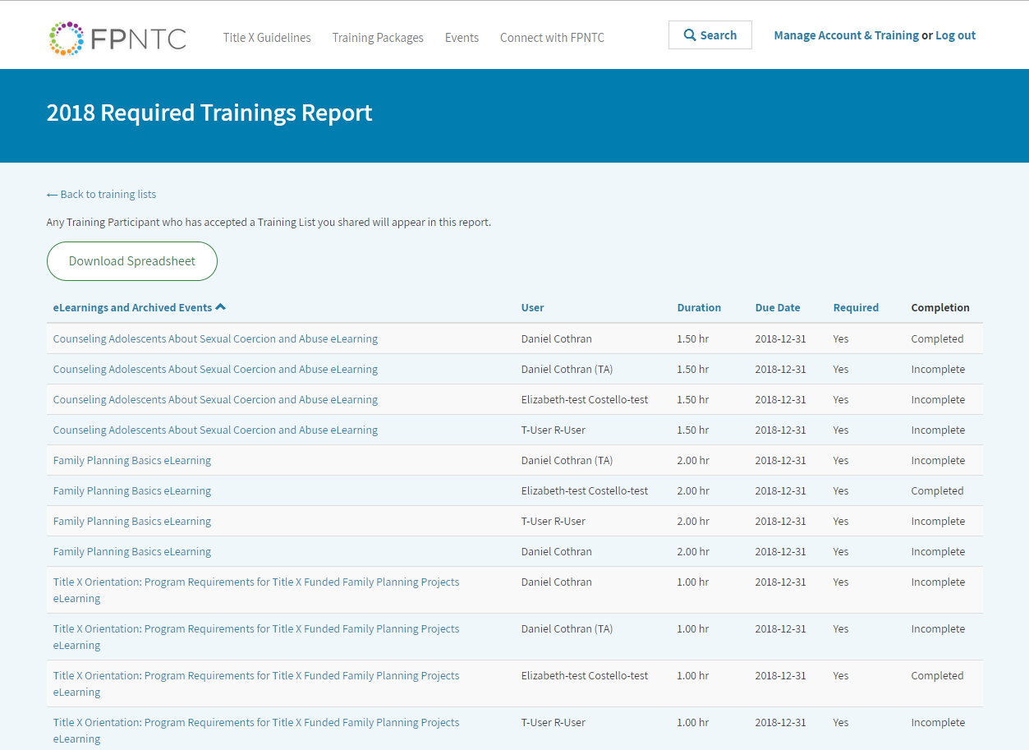
Notes:
Elizabeth Costello:
The completion report is going to show all of the E-learnings and archived events from your training list. Everything that showed up in the top of the list. The other resources, the things like, the training guides, your job aids, the things that you're asking people to review, they're not going to show up here because they don't have a certificate of completion. We really can't say that somebody completed them or not but it lists the resource in order and it'll show you the completion information. I can see that Theresa has completed the ... she completed the human trafficking webinar and the Title X orientation E-learning.
They'll show up as completed here and then I can see that for the other staff, those are incomplete because they just got these links but again, it did want to kind of confirm what Theresa said that if you do staff that has completed these trainings already, they should get credit for them here in the completion. If you share a list with a lot of staff, you might already see completion information that's entered there when you come here. There's also an option here to download the spreadsheet so all the information ... these columns here, you can download this to a CSV file that you can open in Excel or another program that will allow you to filter and sort and integrate this information with your other reporting processes.
I'm going to go back out to the training list, because right now, I just have one training list and I wanted to show you there's a little arrow here, you can click on and off to expand and hide. If you end up creating multiple training list, you can also view a completion report for all of the list and download the spreadsheet with all of the list together so if that ... I wanted to present that a couple of different ways so people can ... if you do end up with multiple list, you can just do it in one click to get the information. That concludes our live demo and the basics of creating sharing and tracking the training list.

Slide 22
Request a Training Administrator Account
Notes:
Elizabeth Costello:
I'm going to hop back over to the presentation to introduce a new feature ... sorry, introduce a new resources that we're developing that may help you as you develop your training list. First, I'd like to ... as a reminder, if you'd like to request a new training account, you go to the same my training list button and request the account through the contact form that's linked there and we recommend that each agency ideally identifies one staff person to create a training account. If you have multiple people that will need to access the account, and manage training, we can also create an account with a shared agency email.

Slide 23
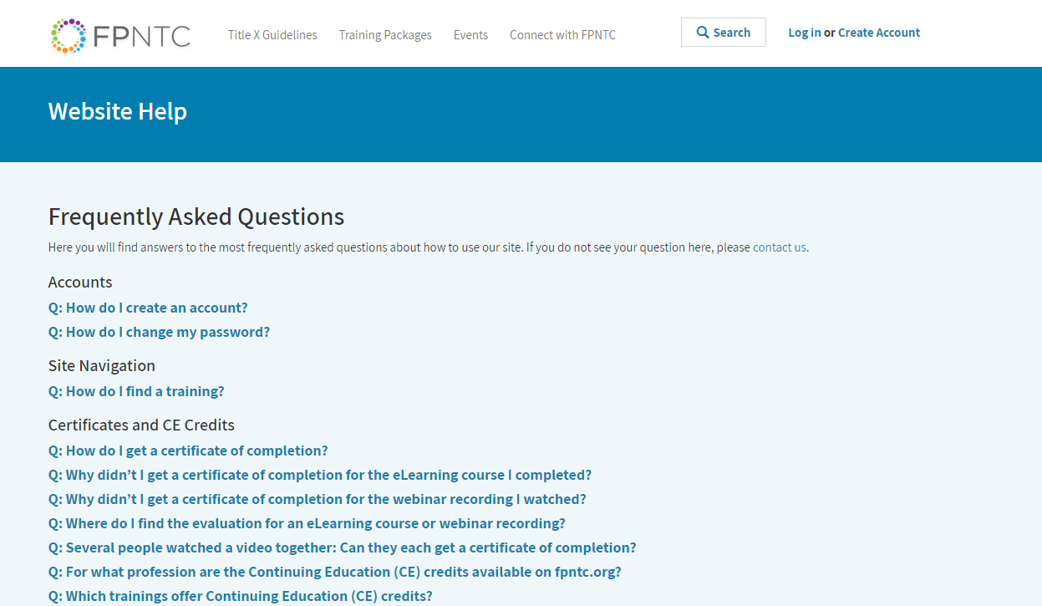
Get Website Help
Notes:
Elizabeth Costello:
For example, I could create an account for our fpntc@jsi.com email address, which multiple people on my team could access. Instead of necessarily associating it with my own work email address. We do have those options. We can work with you on that. You can also get more information about the training tracking systems through the connect with FPNTC section of our website, under get website help. We've added new FAQs here and we will continue to add to them as we get more feedback and questions from users about using the system. After this webinar, we will also post the slides there and make it easy to quickly jump to and review a portion of the demo such as jumping right to creating a training list.

Slide 24
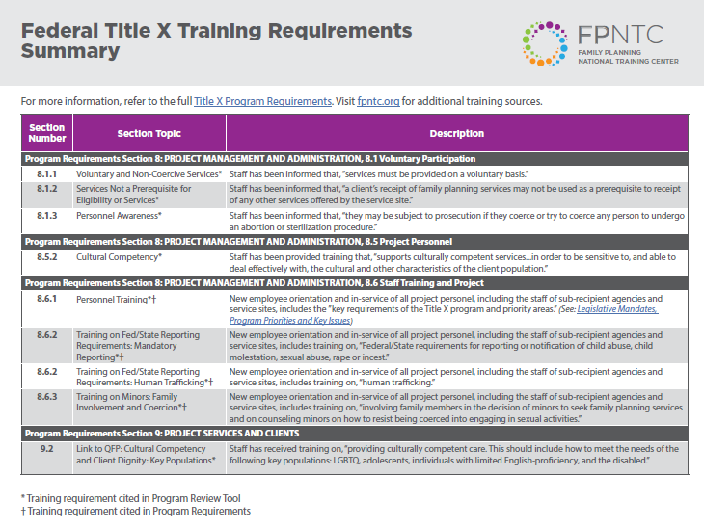
Federal Training Requirements Summary
Sections and topics in Program Requirements (PR) and Program Review Tool (PRT) with designated training component
Notes:
Elizabeth Costello:
All right, before I take questions, I wanted to let you know that the FPNTC and OPA are working on a new tool that will summarize Title X training requirements and recommendations. This resource pulls directly from Title X regulations and program requirements documents that outline training requirements. Training recommendations identified in QFP are also included. It will also be compatible with the program review tool.

Slide 25
Notes:
Elizabeth Costello:
This tool doesn't provide any new information about ... or establish any new training requirements. However, it will provide some additional clarification and context for those requirements.
In short, it summarizes ... the tool will summarize what training requirements currently exist that's kind of a cheat sheet and we hope to have this released in the next few weeks so look for that on our website and in our E-news.

Slide 26
Federal Training Requirements Summary
What it is: Summarized from PR and PRT
What it isn’t: A list of specific training modules your staff must take
Title X grantees are responsible for ensuring the compliance of their agencies and service sites in their networks.
Questions about Training Requirements can be directed to OPA.
Notes:
Elizabeth Costello:
We want to be clear what this resource is and what it isn't. This tool will be a reference for what is required for Title X by OPA. OPA does not require grantees or sites to use any specific branded training modules or programs to meet training requirements and it is up to the individual agency to determine how they will meet training requirements. Grantees should ensure that their training meets state and organizational policies.
As a reminder, these are the training requirements for grantees and service sites to meet Title X program requirements. However, Title X grantees are responsible for ensuring the compliance of their agencies and service sites in their network. The list of recommended trainings, that saved resources and recommend resources trainings tab that I showed you earlier in your my account, that does cover many of these topics and has been reviewed by OPA. We encourage you to look there as well or search for a topic on the website. As always, you can contact us through the website or contact your grantee liaison if you have any questions about what training is available for a specific topic and can't find what you're looking for.
Finally, if you have questions about Title X training requirements, you should direct them to your regional program officer and/or OPA.

Slide 27
Questions?
Notes:
Elizabeth Costello:
All right, with that, I'm going to turn it over to the questions. Theresa is on the line to answer questions as well as Katie DeAngelis who leads our training and technical assistance team. I'm going to start reading a few questions. There's a question here. On this website, will be highlighting those trainings that are required during each project period, for example, human trafficking, sexual coercion and prevention and those that are required only once during employment such as pregnancy testing. Katie is that a question that you could take?
Katie DeAngelis:
Sure and I think there were a couple of questions that maybe we can address with this answer about the training requirements which I think may have come in right before the end where you talked and addressed this issue but again, just to clarify, nothing ... no trainings on FPNTC are required by OPA. As you know there are requirements for training topics which are outlined in Title X program requirements but OPA doesn't require any specific branded training. The grantees are responsible for deciding what trainings they will require of their staff. However, there are trainings on FPNTC that can help you meet those requirements.
That's kind of one thing I want to say there and the other thing I want to say is that we are hoping to include some information about frequency and what staff our certain training requirements apply to in that training summary that we are working on with OPA as a cheat sheet for that information so hopefully that will be helpful as your grantees are kind of thinking about and developing those training list and identifying the frequency and who you want to assign trainings to using ... by sharing these training list.
Elizabeth Costello:
Thank you Katie. There is another question, I'm going to try and go and do this in order a bit. Can you change the list after the link has been sent out? Yes, once you have sent the link out to your training list, you can go back and modify it and any user who's accepted it will see those modifications. I do encourage you to think about ... before you do some things potentially like delete, if you wanted to take a training off, if you do delete a training, when you're modifying a list, you will lose the training completion information for that specific training so again, you could absolutely modify the list but it's a little bit easier to add than to remove things later on.
There's a couple of questions about adding trainings that have been completed in the past. I'm going to read one specific question. For how long ago will a training certificate show up? For example if staff took a required training five years ago, will it show up as completed and be available? Our website, the current version of our website, we did a redesign and relaunch, it was just over a year ago so October 23rd, 2017, any training that was completed on the FPNTC website after October 23rd, 2018, those training certificates are going to show up under our current system. In the past, the trainings ... the different E-learnings were hosted in different places.
We were not able to bring that tracking information over for something potentially as long as five years ago but again, any training that was completed in the last five years will show up as completed. There's another question kind of in the same lines about if we've taken these courses prior to this tracking features is there a way to document and upload the certificates or do we need to retake the training? Again, it's going to really ... the answers to that question is going to really depend on kind of the when someone completed something. If you do have a previous certificate for something, we can probably work with you on a solution but you would need to reach out to us individually via the contact us, to work through that.
All right, there's another question too, sorry if I miss this. Is this tool for grantees to keep track of their sub-recipient's training or is it for grantees to track their staff training for Title X? It's actually for both. We purposely made the system pretty flexible and not very restrictive in terms of what it means to be a training admin and who is a training admin. The training admin features our ... we know there's a lot of different ways people might use the training list functionality whether you're using it as a grantee to create list for your own staff or whether you're using it as a grantee and potentially sharing the list with your sub-recipients.
Then maybe your sub-recipients are actually going to take that list that you created and then make their own list to share with their service sites and then potentially your sub-recipients are the ones that are really tracking that information. Again, it is really meant to be used in whatever way it's going to be most helpful for you and to have some flexibility. There's another question if you were to share a recorded webinar as a group with multiple providers, can they go in and complete the evaluation after that? This questions comes up a lot and unfortunately, the evaluations and the training or the training accounts are all based on individual email addresses.
Everyone that participated in watching the recording of that webinar would need to log on to fpntc.org, log in with their training account and also go to that same recorded webinar link to complete the evaluation at the end of the recording. That would be how they could, like to get credit. That's true of the evaluations that we have now for our live webinar so when you complete the evaluation at the end of today's webinar, that is the same evaluation that you complete for the archived events as well. Whether somebody is watching a live webinar together or whether someone is watching a recorded webinar. Each individual person would need to get online and complete their own evaluation.
In the case of the live webinars, you just have to wait until the recording is posted. There's another question. For the annual training, will the platform recognize that it is required to be completed again or will the previous completion be populated? I think there might be another question around the same so that is ... currently, we do have the required date in there but we don't have functionality that allows you to set it to remind somebody to do it again. That is something that we are looking into and that we might be able to add in the future but for now, I would say for annual trainings, I would actually encourage you to create a new list and base it on the year so that will prompt people to complete it again.
We do need to work on a solution to kind of help ... right now, it really only counts people's credit of completing the course at a one time interval so that's definitely something that we have talked about and we'll be looking into soon. I think that relates to another question about what if you want a staff person to take a training course again, can you reassign a completed course. Yes, again, you can reassign a completed course but the way the system currently works if somebody has completed the evaluation they will immediately get credit for any course that they have completed. Another question, is there a way to see who you send the training list to and who hasn't accepted it?
We made the decision to ... Right now again, we shared the way that you ... the way you send the list is through email, that you get that sharable link and you would go to your own email. Obviously, when you're in your own email that's outside of the FPNTC website system, and the ... we made the decision to have you guys ... have the system work around email because there's so many users already and it's really challenging to associate them with a specific grantee or sub-recipient or service site. We do ask for that information but we don't have that full network mapped out on our website so we didn't want you to have to, as a training admin go through our website to find people because they might not have an account yet so sending it via your email, you already have the list of who you want to send it to.
That was a very long answer to say no. You actually can't ... through our website, you can't see ... it doesn't show you who it's pending for so you'd have to go back to your email again, because your email is not linked to the website. You just would need to go back to your email to compare how many people you sent it to and how many people have accepted it, see if you have any missing. Okay, how many training admins can we have per grantees? We don't have a limit on this as of yet. I did kind of give ... we were thinking that most grantees or agencies would likely only have one or two different training admins at most.
This is more just for your own internal management of this information. You can decide who's going to be tracking this information. You can decide, that if you want to make your account tied to an individual, you can do that but as I've said if you do have a shared email address that you want to create an account with as a grantee we can do that as well so we can be flexible but right now, there's not a limit on how many training admins you can have per organizations. Okay. There's a question, is there a way to document trainings provided on site, such as in service presentations. Right now, on the individual training report, the feature that Theresa shared for when you go and see my training plans, that allows ... or sorry, the track my training tabs.
Individual users have been allowed to go in and add documents, trainings that were provided on site and upload those certificates of completions. The new features that we shared today, you can add a link to a non-FPNTC resource but we still don't have a way to link that to completion. Right now, all of the completion information that is coming from the FPNTC so this was really intended to allow you to track training completion of resources that are on our website but we know that this is ... we know that there's a lot of different ways you might want to use this, including your question about documenting trainings outside of FPNTC so again, these are the initial features that we're launching with and this is another thing we have looked at to adding so hopefully that will be something we're able to add in the future.
All right, a few more questions. There is a question about can we demo downloading this spreadsheet of completed trainings? I'm sorry that I didn't show that during the demo itself but when you click the download spreadsheet button, it's just going to download that to your computer just like when you download any resource from our website or when you download the certificate of completion. It's going to be a CSV application type or sorry, CSV file format so that when you open that, it will open in Excel or whatever similar program you have for opening spreadsheets and it has all of the completed ... the spreadsheet of completed trainings, has all of the information that's included on the website. It just allows you to use it in a kind of a more sortable way.
Yeah, I'm still seeing several questions in here about groups, viewing, videos and webinars and being able to get credit. Again, I said earlier that that was ... right now, currently people will have to log in to the site individually but I'm going to flag that one as something ... looks like we're getting quite a few questions about that specifically so that's definitely something that looks like we need to ... see if we can come up with another way of doing it. There's another question about, is there a way to have two levels of training admins, one at grantee level and one at the sub-recipient level so that the sub-recipients can manage their staff and the grantee can manage all of the sub-recipients?
Again, this is really up to you to decide how you want to structure it. You can, at the grantee level, request a training administrator account and then at the sub-recipient level request a training administrator account but only the training administrator that created and shared the list with the users is going to be able to access that completion report. As a grantee, it's not going to ... as a grantee, if you ask your sub-recipient to manage ... create list and manage training completion for their service sites, you won't necessarily ... you won't be able to see that information because it'll be only accessible through their account but they can share the tracking information with you via that completion report.
Again, this just goes to the complexities of the system and all the different ... the system and also the network. We wanted to really ensure that no one was getting access to information that they shouldn't have access to and really wanting to be cognizant of people's information so that's why it's fairly simplified in terms of just the one training admin can see who accepted and completed training for the list that they created. There's a question, can you edit training information for a non-FPNTC resource? I don't have that open right now, I do believe that you should be able to edit that, that information.
I just want to clarify that that question means, can you ... when you add a non-FPNTC resource, that allows you to have the URL and a little ... some text about that link so yes, you should be able to modify that list and go ... be able to change that. Just one final question we're going to take before we wrap. Can you repeat the answer about adding trainings that were completed in the past? If you as a training administrator add a training that ... say the Title X orientation which by far has the more completed evaluations than any course on our website. If you do assign that one to your staff and they have already completed it, you will already see ... once they've accepted the list, you will see that they have completed that already.
They will not need to go back and ... they will not need to go back and redo the evaluation but I did flag, we did get several questions about wanting to reassign a completed training so we will look into that.

Slide 28
Thank you!
Contact:
fpntc@jsi.com
Notes:
Elizabeth Costello:
All right, everyone. Thank you so much for joining us today and for sharing all of those questions. We do hope to have a recording of today's session available within the next few days. If you have additional questions for us or I didn't fully address your question in my response, please don't hesitate to email us at ... you can email us via the website. You can go to the contact or you can email us directly here at the email address on your screen fpntc@jsi.com.
Please also complete the evaluation today. It will pop up when you exit the session and we love your feedback and we'll use it to inform our future sessions as well. Again, thank you all for joining us today and this concludes our webinar.

