Slide 1
HHS Office of Population Affairs Ready to Offer PrEP? Implementing PrEP Services in Family Planning Sites
September 26, 2019
3:00 pm ET

Slide 2
Welcome!
Objectives
Discuss the role of Title X family planning clinics in assuring access to PrEP services in their communities.
Describe the key steps for rolling out PrEP services in family planning settings.
Identify resources for implementing PrEP services.
Today’s Speaker
Erika Aaron, CRNP,
PrEP Clinical Advisor,
Philadelphia Department of Public Health
Note: This call will be recorded
Notes:
Has your family planning site recently made the decision to offer pre-exposure prophylaxis (PrEP) services, or is your site considering offering PrEP services or referrals? In this webinar from the HHS Office of Population Affairs (OPA), Erika Aaron, MSN, CRNP, discusses the key steps for rolling out PrEP services in family planning settings, including identifying key partners, establishing clinic protocols, and training clinicians and staff on PrEP.
Speaker: Erika Aaron, MSN, CRNP, PrEP Clinical Advisor for the Philadelphia Department of Public Health

Slide 3
Outline
Establishing Protocols
Brief review of prescribing PrEP
Preparing Clinicians and Staff
Identifying Key Partners
Monitoring and Evaluation
Resources

Slide 4
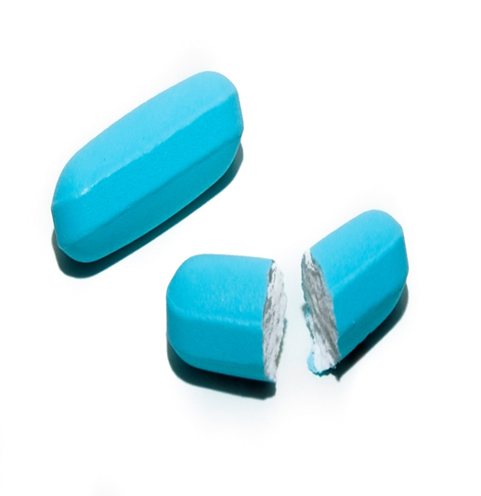
Pre-Exposure Prophylaxis (PrEP)
Pre-exposure prophylaxis (PrEP) is a once-a-day pill (brand name Truvada) demonstrated to reduce the risk of HIV infection up to 92% when taken as directed.
Source: Centers for Disease Control and Prevention (CDC). Preexposure Prophylaxis for the Prevention of HIV Infection in the United States - 2014: A Clinical Practice Guideline.
Notes:
PrEP is pre-exposure prophylaxis.
It's once-a-day pill.
Right now, the brand name of the drug is Truvada, and there may be a newer one coming out soon called Descovy, but it hasn't been approved yet by the FDA.
Truvada has been demonstrated to reduce the risk of HIV infection up to 92% when taken as directed.

Slide 5
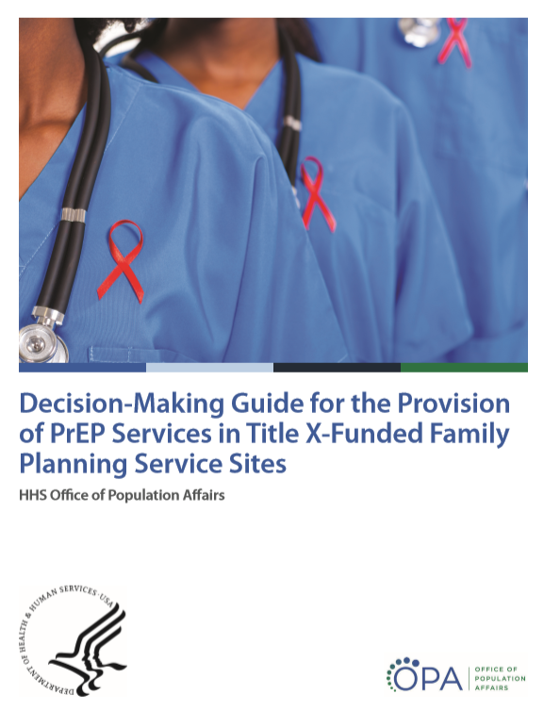
New Family Planning-Specific PrEP Resources from OPA
OPA PrEP Training Webinar Series
National Kick-Off Webinar: PrEP for HIV Prevention in Family Planning Settings
Prescribing PrEP in Family Planning Sites
Financing PrEP Services in Family Planning Sites
Innovative Models for PrEP Services in Family Planning Sites
*Recordings and slides for past webinars are available on www.fpntc.org
https://www.hhs.gov/opa/sites/default/files/OPA-PrEP-Decision-Guide.pdf
Notes:
Decision-Making Guide for the Provision of PrEP Services in Title X-Funded Family Planning Service Sites (https://www.hhs.gov/opa/sites/default/files/OPA-PrEP-Decision-Guide.pdf)
OPA PrEP training webinar series:
National Kick-Off Webinar: PrEP for HIV Prevention in Family Planning Settings
Prescribing PrEP in Family Planning Sites
Financing PrEP Services in Family Planning Sites
Innovative Models for PrEP Services in Family Planning Sites
Recordings and the slides are available on the Family Planning National Training Center's website at FPNTC.org

Slide 6
Establishing Clinical Protocols
Notes:
When we establish clinical protocols, we need to think about:
How we offer PrEP education and counseling
Who will be offering this in your clinic
How to assess risk and how to do this in a non-stigmatizing way
Which laboratory tests that we need to get, and to make sure that we confirm negative HIV test results
Prescribing PrEP and the tools that providers need to prescribe PrEP; and
What kind of follow-up services we need for people who are on PrEP in our clinics, or if we're referring to a local provider in our area.

Slide 7
Starting the Conversation: Educating Clients about PrEP
Discuss HIV vulnerability with every sexually active woman/men
Start to integrate universal PrEP education
A discussion about PrEP should be presented to any person who presents for STD treatment, STD testing, Pregnancy testing, and HIV testing.
This can be done by the Medical Providers as well as the nurses, the medical assistants and the lab staff.
Present the range of prevention options
Focus on positive reasons why persons may want to take PrEP other than sexual risk
Take control over their sexual health - empowering
Increase sexual satisfaction and intimacy
Staying safe and healthy
Notes:
In starting the conversation, it's important to discuss HIV vulnerability with every sexually active woman or man that comes to your clinic. To start integrating universal PrEP education in your clinic, you can start by just addressing this to persons who present for STD treatment, or STD testing, pregnancy testing, and HIV testing.
If we just talk about PrEP to people who come in with STDs, we're going to be covering a lot of people in your clinic who are at risk of getting HIV. This can be done by medical providers, but you also can educate your staff to do the same.
If a person comes in for STD testing, a medical assistant or the lab staff can certainly say to the person, "Hey, you're at risk of getting HIV. Did you know that there's something called PrEP? If you're interested, we'll be happy to refer you to your provider." Or they could be trained to talk a little more detailed about PrEP. Many times that's where lots of education occurs, at the lab, in the lab itself.
We want to make sure when we do train our staff to do education about PrEP that we focus on positive reasons why persons may want to take PrEP, other than sexual risk. When we talk about sexual risk, it can be very stigmatizing and off-putting to clients. Use words like “Take control of your sexual health, by taking PrEP. It's empowering you. You're taking care of your sexual health, you're taking care of your health.”
Also, we know that sometimes taking PrEP increases people's sexual satisfaction and intimacy, because it decreases the stress that someone may be feeling or the worry that someone may be feeling about getting HIV. Congratulate the person on even thinking about PrEP by staying safe and healthy. These are positive messages that are really important to portray to our clients.

Slide 8
Prescribing PrEP: A Review
Assess if patient is a candidate: high risk, can adhere to daily medication regimen, willing to come to clinic every 3 – 6 months.
HIV test must be negative before starting PrEP.
Labs:
STD screen,
Creatinine clearance (>60 ml/min)
HBV screen – if patient has chronic Hep B, tenofovir is treatment; if negative w/out immunities, offer vaccination
Hep C and A screen
Notes:
When we prescribe PrEP, first we want to assess if the patient's a candidate; can they adhere to daily medication regimen? For cisgender women, it's important to take PrEP medication daily. Can they do this? Are they willing to come to clinic every three to six months to get lab tests and to review the need for PrEP?
HIV tests must be negative before starting PrEP. That is a test that we recommend that you do at the time of that appointment where someone is going to be prescribed PrEP. If someone had a test a month ago, that's not good enough. You need to do it that day. You do not want to start someone on PrEP if they already are HIV positive.
The reason is that if someone is already HIV positive and they start Truvada, then they can become resistant to Truvada, because they need to be on a stronger medication than just Truvada. We don't want people to get resistant to Truvada if they have HIV, because Truvada is a very important medication in the regimens that are provided for people who are HIV positive. So make sure that test is negative before you even write the prescription.
We also want to do STD screening when we start the initial visit.
And do a creatinine clearance, because tenofovir, which is one of the components of Truvada, has been known to decrease the renal clearance in people who already have compromised renal function. We want to make sure that they have normal renal function, so the creatinine clearance should be above 60 milliliters per minute.
Then Hepatitis B screening: If a patient has chronic Hepatitis B, then tenofovir actually is the treatment, tenofovir or Truvada, which tenofovir is in Truvada, is the treatment for chronic Hepatitis B. We want to know that before we start or soon after we start, so that if someone has chronic Hepatitis B, we can advise them to continue the Truvada even after they decide to stop the Truvada; that they don't need it anymore for sexual risk, but they still need it for treatment of their chronic Hepatitis B. If they're negative without immunities, then we offer vaccinations.
Also, testing for Hepatitis C and A is just good primary healthcare.

Slide 9
TDF + FTC
Write for PrEP (TDF+FTC) once daily –
no more than 90 days
Tenofovir (TDF) 300 mg
plus
Emtricitabine (FTC) 200 mg
Notes:
If we know the person's negative or their tests are normal, we can write for Truvada, which is tenofovir 300 milligrams, plus emtricitabine, which is 200 milligrams.

Slide 10
Monitor: Every Three Months
HIV 4th generation serum test
Assess for signs and symptoms of acute HIV infection
STI triple screen if at risk
Assess adherence and side effects
Provide effective contraception if desired
Pregnancy test, if attempting pregnancy or not using effective birth control
Notes:
Monitor every three months. Every three months we do an HIV test. The fourth generation is the test that we're recommending, because that has the smallest window period, and it's the best test that we can do for HIV at this time. You can get the results within two days. We want to assess for signs and symptoms of acute HIV infection and talk to the person about their ability to adhere.
When we do STD testing, for people who are more at risk of getting STDs we recommend every three months, but if they're not at an immediate risk of STDs, every six months will suffice.
If someone is having sex in other orifices besides the vagina, then we recommend triple screening. We can do vaginal swabs, rectal swabs and oral swabs for gonorrhea and chlamydia.
If a person desires pregnancy, PrEP is fine to take while pregnancy is being attempted. If the person is not interested in pregnancy, we talk to them about birth control.

Slide 11
Follow up: Every Six Months
Creatinine clearance and STI testing
Refill 90-day supply if HIV negative
Reassess need to continue PrEP
At-risk pregnant women may remain on PrEP
Safe to breastfeed with PrEP
Notes:
Then every six months, we do a creatinine clearance to make sure that the renal function is normal, and STD testing and HIV testing. Then we refill the prescription for 90 days.

Slide 12
Stopping PrEP
Assess reasons for discontinuing
If patient becomes HIV positive while taking PrEP, provide linkage to HIV care, order resistance test, and viral load
If confirmed seroconversion immediate escalation to 3-drug regimen. Do not wait for VL or resistance results
If patient remains HIV negative, continue to provide risk reduction support services as needed
If patient has chronic Hep B, when stopping PrEP, monitor for liver flare. Check LFTs within one month
Recommend continuation of tenofovir for chronic Hep B
Notes:
When someone decides to stop PrEP, we ask them to come in and talk to us about this so that we can make sure there's a good reason for stopping PrEP. We want to advise them if they ever decide to restart Truvada that they come back in to get the initial tests again, especially an HIV test.
We don't want someone to stop Truvada if they're at risk of getting HIV, they seroconvert, they don't know that they're HIV positive, and then they have the Truvada in their medicine cabinet and they start taking it again. Then they're at risk of getting resistant to Truvada. We want to just make sure that people know it's important, come back to the clinic before you restart the medication.
If there's any chance that someone seroconverts--say someone was not adherent, was not taking the medications for two weeks and then restarted, and then they came back for an HIV test and they were HIV positive--they need to have immediate escalations with three drug regimens.
This is information you can get online or by calling the PrEP Hotline where they can talk to you about how to put someone on HIV medicine. Don't wait to get viral loads or resistance results. Start them on a three-drug regimen and refer them to an HIV provider, unless you're doing that in your own setting.
If someone has chronic Hepatitis B when they stop PrEP, it's important to monitor for liver flare. We need to check the LFTs within one month. We recommend continuing the Truvada if they have chronic Hepatitis B and not stopping it.

Slide 13
PrEP During Preconception Period
Pregnancy and breastfeeding are not contraindications to PrEP
No evidence of an increase in congenital anomalies during first trimester
Infants exposed to TDF through breast milk have limited drug exposure
The CDC recommends that an individual who does not have HIV and is planning a pregnancy with a partner who does have HIV start daily PrEP beginning one month before conception is attempted and continuing for one month after conception is achieved.
Report to Antiretroviral Pregnancy Registry: 800-258-4263
Notes:
During pregnancy and breastfeeding, there are no contraindications for PrEP. There is no evidence of increased congenital anomalies during the first trimester or after. Infants that have been exposed to Truvada through breast milk have a limited drug exposure, and we have not seen side effects.
If someone becomes pregnant and they are on Truvada, it's important that you report this to the Antiretroviral Pregnancy Registry. You can also register the patient online. This is the only way we can track the effects of Truvada during pregnancy on the infant.
We certainly do this for women who are HIV positive, but for an HIV negative woman on Truvada while she's pregnant, it's very important so that we can continue to track and make sure that HIV negative women on Truvada don't have any ill effects on the infant.

Slide 14
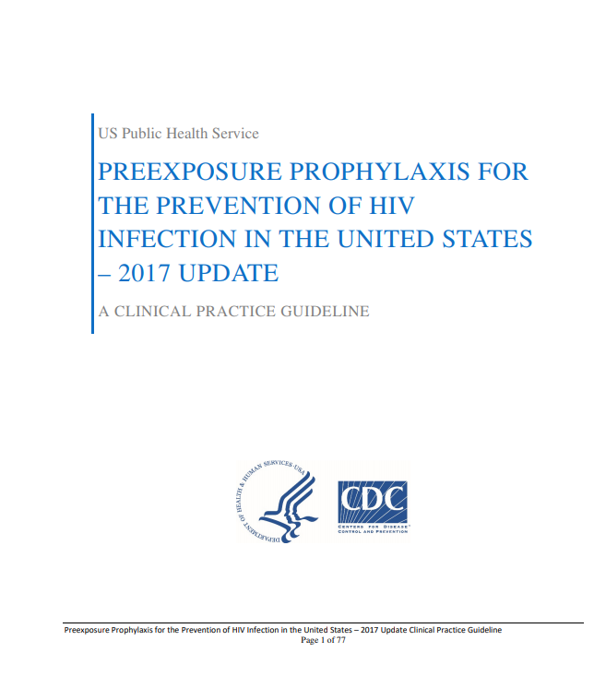
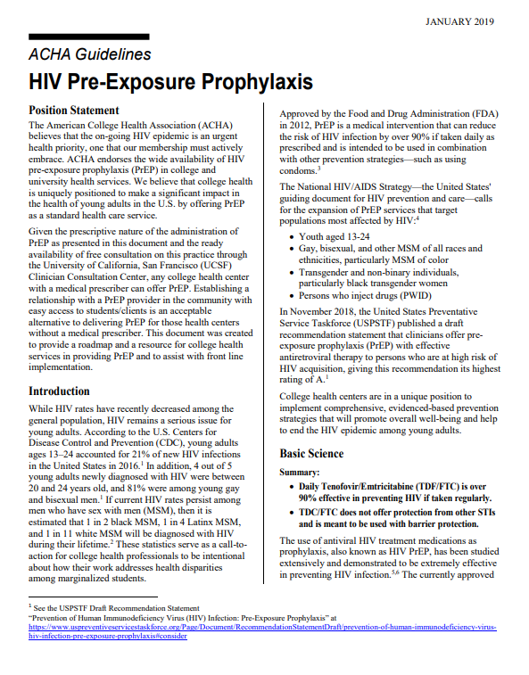
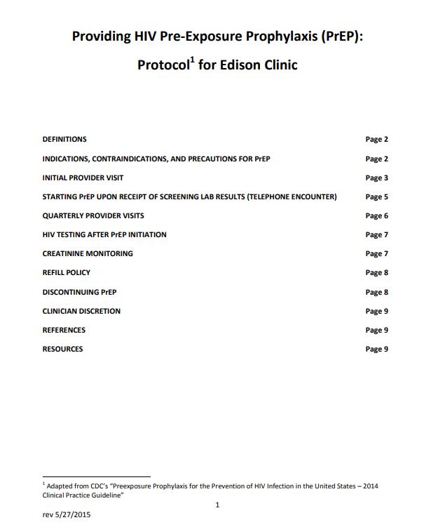
Resources for Clinical Protocols
https://www.cdc.gov/hiv/pdf/risk/prep/cdc-hiv-prep-guidelines-2017.pdf
https://www.acha.org/documents/resources/guidelines/ACHA_HIV_PrEP_Guidelines_Jan2019.pdf
https://www.smchealth.org/sites/main/files/file-attachments/prep_protocol_pending_approval_5-27-2015.pdf
Notes:
A brief review of the guidelines:
The first one is the CDC guidelines that were updated in 2017.
CDC. Preexposure prophylaxis for the prevention of HIV infection in the United States—2017 Update: a clinical practice guideline. https://www.cdc.gov/hiv/pdf/risk/prep/cdc-hiv-prep-guidelines-2017.pdf.
The second one is the American College of Health Association. You can go here and develop protocols for yourself, for your clinic. You can have people read these who are thinking about starting to write a protocol for PrEP.
ACHA Guidelines. https://www.acha.org/documents/resources/guidelines/ACHA_HIV_PrEP_Guidelines_Jan2019.pdf
The third is a specific protocol from a place called the Edison Clinic, and it seems to have good protocols in there as well for you to institute at your own site.
Providing HIV Pre-Exposure Prophylaxis Protocol for Edison Clinic. https://www.smchealth.org/sites/main/files/file-attachments/prep_protocol_pending_approval_5-27-2015.pdf

Slide 15
EMR PrEP Template from Planned Parenthood in Phila
Triple Screen: oral rectal cervical urine
Initial PrEP Visit
Patient education provided on the use of Truvada for HIV pre exposure prophylaxis, (PrEP). Discussed possible drug risks and side effects. Informed Truvada > 90% effective in decreasing HIV acquisition when taken as prescribed. PrEP must only be taken if HIV negative. Family planning discussed, baseline labs were drawn. Patient informed a three month prescription of Truvada will be prescribed providing the baseline HIV test is negative, kidney function is normal and screening for STIs including HBV and pregnancy are reviewed. Instructed on importance of medication compliance as adherence is tied to efficacy. Prevention and risk reduction messages provided to decrease acquisition of HIV and other STIs, as PrEP alone is not 100% effective. Teaching performed on signs and symptoms of acute HIV infection and instructed to return to clinic for testing if symptoms develop following an exposure. Follow up plan includes HIV testing every 3 months, and STI testing. Pt is aware they are responsible for setting up all follow up before med run out.
Patient education booklet given
Notes:
Here's an EMR template from a Planned Parenthood in Philadelphia does a sexual history at the beginning where you just click:
What type of sexual body part does this person have?
Have they had intercourse yet?
Do they have any new sexual partners since their last STD test?
Is it possible that any of their partners in the last year had sex with someone else?
Or, have they had more than one partner in the last 12 months?
These are questions that are really more specific for women who may not recognize that they are at risk of HIV, but it may be their partners who are at risk for HIV.
Don't forget to triple screen, and you can click that you did that or didn't do that.
Then for the initial PrEP visit, this is some language that covers nearly everything you would want to have in your note when you start a person on PrEP. You could just copy this into an EMR record and click that you provided this information. This puts less strain on the provider to document in the EMR.

Slide 16
Protocols
 | Base line | 3m | 6m | 9m | 12m | 15m | 18m | 24M
Sexual Health Assessment and adherence | X | X | X | X | X | X | X | X
HIV Ab/Ag test | X | X | X | X | X | X | X | X
Syphilis serology* | X |  | X |  | X |  | X
CT/NG testing* | X |  | X |  | X |  | X
Pregnancy test** | X | X | X | X | X | X | X | X
HBsAG, HBsAb, HBV vaccine status | X
HCV Ab | X |  |  |  | X |  |  | X
Serum Creatinine | X |  | X |  | X |  | X
*Every 6 months if not at risk of STDs, every 3 months if high risk for STD
**Every visit if attempting pregnancy or if not using a birth control method
Notes:
These are lab draw protocols for PrEP that were derived from different sites, which you could put up in your lab, or put in the provider offices:
Sexual Health Assessment and adherence: Baseline, 3m, 6m, 9m, 12m, 15m, 18m, and 24m
HIV Ab/Ag test: Baseline, 3m, 6m, 9m, 12m, 15m, 18m, and 24m
Syphilis serology (Every 6 months if not at risk of STDs, every 3 months if high risk for STD): Baseline, 6m, 12m, and 18m
CT/NG testing (Every 6 months if not at risk of STDs, every 3 months if high risk for STD): Baseline, 6m, 12m, and 18m
Pregnancy test (Every visit if attempting pregnancy or if not using a birth control method): Baseline, 3m, 6m, 9m, 12m, 15m, 18m, and 24m
HBsAG, HBsAb, HBV vaccine status: Baseline only
HCV Ab: Baseline, 12m, and 24m
Serum Creatinine: Baseline, 6m, 12m, and 18m

Slide 17
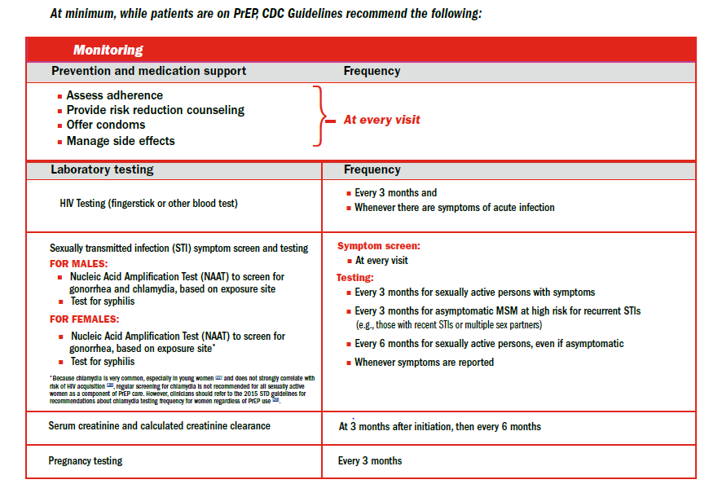
Example of a PrEP Protocol
Notes:
This is another example of a protocol that that is written in a way that might be easy for your staff to utilize.

Slide 18
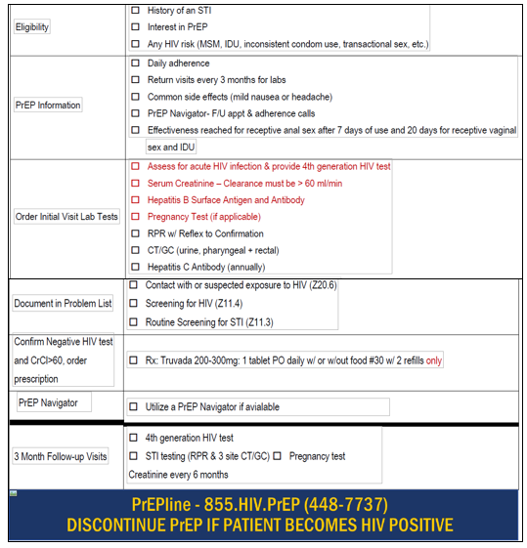
Example of a PrEP Protocol printed on a pocket card
Notes:
This is a nice pocket card that was developed by the Drexel College of Medicine in Philadelphia that they handed out to residents and medical students and providers in OBGYN clinics. It gives a quick review of what you need to do to prescribe PrEP. If you have a PrEP navigator that you refer to or if you have a PrEP clinic that you refer to other than your clinic, you can put phone numbers in here.

Slide 19
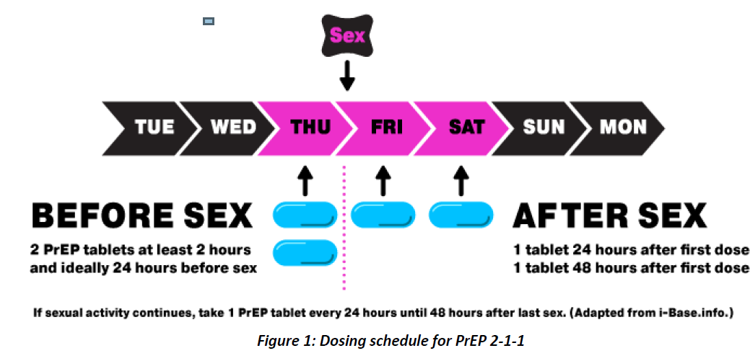
New York City Health Dept “On Demand” dosing schedule for PrEP
Has not been studied in cis gender women. Only recommended for cis gender males.
https://www1.nyc.gov/assets/doh/downloads/pdf/han/alert/2019/prep-to-prevent-hiv-alert.pdf
Notes:
PrEP on Demand: The New York City Health Department has recently put out on their website recommendations that this is actually discussed with all patients who are thinking about PrEP. It's not FDA approved at this point. It's not in the CDC guidelines yet, but it's been well researched.
PrEP on Demand (https://www1.nyc.gov/assets/doh/downloads/pdf/han/alert/2019/prep-to-prevent-hiv-alert.pdf)
There are three major research studies that have a large number of patients in them. But only cisgender males are in these studies. This is not recommended for cisgender women. However, I know many of you have seen males. This may be something that they know about that they may raise to you and you may feel comfortable talking to them about. This would be for someone who's not comfortable taking, or not really able to take, a pill every day.
If you take two Truvadas before the HIV exposure or the possible HIV exposure, within two hours and ideally 24 hours before sex, you can also recommend this to your people who inject drugs who may be in your clinic who want to use PrEP prior to unsafe injection, if they're sharing needles. So, two to four hours before the HIV exposure; then one pill 24 hours after the exposure, and one pill 48 hours after the exposure.
This is called 211 dosing, and there is a website here that goes right to the New York City recommendations, and they also have references for the studies that I just referred to.

Slide 20
Preparing Clinicians and Staff
Notes:
How do we prepare clinicians and staff to write for PrEP? First of all, having leadership support is vital for a successful PrEP program.

Slide 21
Preparing Clinicians and Staff for PrEP
Leadership support is vital to successful PrEP program implementation and sustainability
Identify a PrEP Champion in the Clinic
Assess staff capacity: HIV testing staff, health educators, patient navigators, financial counselors, pharmacists can all help reduce the clinical burden and costs
Staff buy-in is a key factor for service success.
Staff training and standardized PrEP screening tools
Culturally appropriate way to approach risk reduction counseling
Destigmatize risk assessments
Non-clinical staff trained on PrEP with a tailored approach to individual job function (e.g., Billing staff; Front desk staff; Lab personnel etc.)
Notes:
Identifying a PrEP champion in the clinic is very helpful. Usually there is at least one person in the clinic who's passionate about this who can really lead this initiative. If you can identify that person ahead of time and engage them, that's very helpful.
Then you want to assess the staff capacity to provide counseling.
Is there an HIV testing staff?
Are you doing HIV testing comfortably in your clinic?
If you have health educators, you can counsel patients about PrEP so that it takes away maybe from clinician time, or patient navigators.
Are there financial counselors in your clinic? They should be educated about how to help people get free PrEP, for example, if they have no insurance.
Pharmacists can be very helpful. There are pharmacists that are sometimes co-located in clinics or have very close relationships with the clinic. Those pharmacists may be willing to do HIV testing, or counseling about PrEP, or providing PrEP if they have a protocol with your clinic.
Collaborating with pharmacies can be very helpful, and can decrease the burden of the clinical staff.
Then of course staff training needs to be culturally appropriate. We need to destigmatize how we talk to people about their risk. We want to make sure that all non-clinical staff are trained in PrEP, with it being tailored to their individual job function.
Billing staff, making sure your staff knows the billing code. The front desk staff, making sure the front desk staff knows how to triage PrEP or PEP calls.
And then lab personnel, maybe there's a protocol so that the lab knows for all PrEP visits what they need to draw. That again will take away some clinical time.

Slide 22
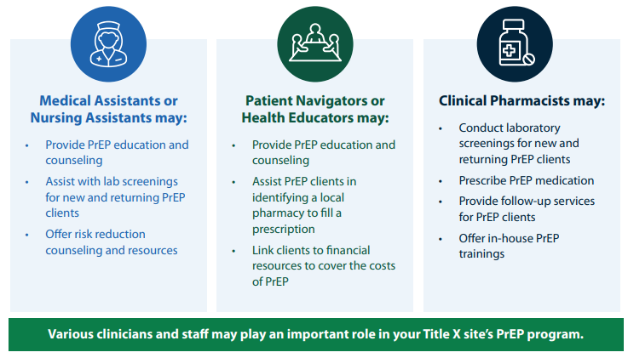
Consider various staff who may be involved in the PrEP program
Notes:
These PrEP and PEP best practices are on the OPA website, which reiterate the info previously discussed:
Medical assistants or nursing assistants can do PrEP education and counseling.
Do you have a PrEP navigator?
Do you have health educators that can answer more detailed questions?
Do you have a pharmacy that you can partner with to help you reduce the burden?

Slide 23
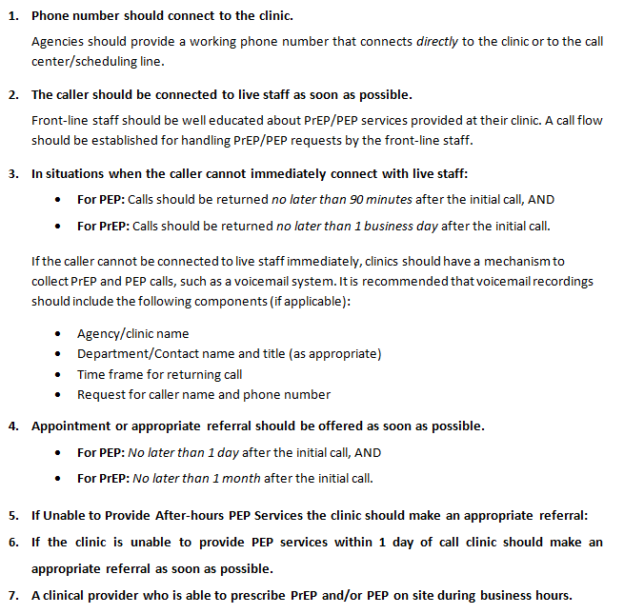
PrEP and PEP Best Practices
Notes:
These are some best practices that the Philadelphia Department of Health has developed to help support front desk staff training.
As you know, when a patient calls your clinic, they're going to get the front desk. They'll be the first introduction to your clinic. We want to make sure that your front desk or your call centers are very educated about PrEP and PEP, and what to do with PrEP and PEP calls.

Slide 24
Front Desk or Call Center Instructions
How to handle a call for PrEP or PEP
Confirm which medication the person is requesting:
A person may be calling for PEP if they have had a recent (recent = within the past 72 hours) potential exposure to HIV.
A person is probably calling for PrEP if they are interested in starting a daily medication that will reduce their risk of HIV infection.
If a person is calling for PEP
Option 1: Arrange for the patient to be seen ASAP.
The appointment should be within the 72-hour window.
Option 2: Transfer the call to the dedicated navigator/nurse.
If your agency has a dedicated navigator/nurse, you can refer the caller to them for intake and assessment. For any confusing or unclear cases, this will be the best option. Your agency should have a plan in place to return a PEP call within 90 minutes.
Option 3: Refer to another agency or emergency department.
If the person is unable to come into your agency, or your agency cannot accommodate the patient for a PEP appointment within 1 day, please refer to:
Local Referral Clinic __________________
Urgent Care Centers
Emergency Departments (EDs)
Notes:
These are some flow charts that we've developed about how to handle calls to make sure that they know what the difference is between PEP (which is that the person had a recent exposure to HIV within the past 72 hours) and PrEP (where they haven't had an exposure, but they're interested in preventing exposures).
We want to make sure that for PEP, an appointment should be available within a 24- to 72-hour period, because PEP has to be given within 72 hours of the exposure.
If it's a PEP call, the front desk should know that they should get transferred to a live person, not a voicemail. Or if the call's going to be returned, we recommend that a call be returned within 90 minutes.
And if you do not offer PEP, the front desk should have a phone number for a local clinic that will offer PEP.

Slide 25
Front Desk Steps for Triaging a PrEP/PEP Call
A1) Which actions will the front desk take once a caller makes a request for PrEP? (Select all that may apply)
Route call to navigator/nurse immediately – Proceed to A1.2
Continue to speak to the caller to collect more information – Proceed to A1.3
A1.2) Which information should the front desk give to the caller before routing calls? (Select all that apply)
Name of individual receiving call
Job title of individual receiving call
Reason for routing
Inform caller that they may reach voicemail, but that call will be returned shortly
Request for caller name and phone number for follow up (if follow up will be conducted)
A1.3) Which information will the front desk collect from/inform the caller? (Select all that apply)
Physical location of caller
Phone number
Name
Insurance type*
Confirm that caller is requesting PrEP
Other (please specify): _________________________________
Notes:
This is another way of helping the front desk to route the calls and to get information about the patients. If it's a PrEP call, it doesn't have to be done within 72 hours. But a PrEP appointment should be given within a week of the call if you can accommodate that.
That's a recommendation that we're making, if it's allowed at the health department, but it depends on your scheduling for PrEP in your office.

Slide 26
PrEP: More Than HIV Prevention
Short Video on Messages for Providers to Say About PrEP
Notes:
This is a nice video that has been made by the assistant health commissioner of New York City. This is a great two-minute video to show to your providers. Key messages:
HIV prevention is not one size fits all.
For some people 100% condom use works, for others it does not.)
PrEP dialogue becomes less about prevention and more about sexual pleasure and contentment with one’s sex life..
The side effect of a content and anxiety free sex life is that HIV is prevented better.
Video: PrEP: More Than HIV Prevention

Slide 27
Training Resources for Clinician and Staff Training
AIDS Education and Training Center Program (AETC) has a series of short training videos on different topics related to PrEP.
American Academy of HIV Medicine has CME credits for PrEP Webinars
National Clinical Training Center for Family Planning Family Planning National Training Center
Recordings and slides for past webinars are available on fpntc.org
OPA PrEP Training Webinar Series
National Kick-Off Webinar: PrEP for HIV Prevention in Family Planning Settings
Prescribing PrEP in Family Planning Sites
Financing PrEP Services in Family Planning Sites
Innovative Models for PrEP Services in Family Planning Sites
Notes:
There are training resources for clinicians and staff. OPA has the webinars that you can connect to that have been given in the past. Your AIDS Education and Training Center Program (AETC) has a series of short training videos on different topics related to PrEP. (https://aidsetc.org/resource/prep-training-videos)
The American Academy of HIV Medicine has CME credits for PrEP Webinars (https://aahivm.org/?s=PrEP). That might be an enticement for some of your providers in order to get trained in PrEP for which they can also get CME credits.
The Family Planning National Training Center website also has links to the previous PrEP webinars that have been offered by OPA.

Slide 28
Financial Resources for PrEP
Financial counseling and other client resources for accessing low- or no-cost PrEP medication may help minimize barriers to care and increase patient adherence to the medication.
State and local prescription programs:
Washington State PrEP Assistance Program, New York Dept of Health PrEP-AP, Illinois PrEP Assistance Program.
Advancing Access Program provides free medication for those without insurance and co pays up to $7200/year
Patient Advocate Foundation assists with out of pocket co-pays for PrEP up to $7500/yr
National Alliance of State and Territorial AIDS Directors (NASTAD) also offers a Billing Coding Guide for HIV Prevention: PrEP, Screening, and Linkage Services
340B Pricing Program may assist with discounted medication
Notes:
Another way that we have to prepare our clinics to offer PrEP is to make sure that financial resources are well known and well versed. Financial counseling and other client resources need to be very easily accessed to prevent barriers to care. Many times patients feel that if they have no insurance or if they can't pay their co-pays, they're not candidates for PrEP. We want to make sure that they know that they are in fact candidates for PrEP.
Some states, such as Washington, New York, and Illinois, have PrEP assistance programs that cover labs and clinical visits. Some also cover some of the cost of the medications.
Gilead, who is the pharmaceutical company that manufactures Truvada, has a very generous Advancing Access Program (https://www.gileadadvancingaccess.com/), which provides free medication for those without insurance, and co-pays up to $7200 a year for those with insurance and have co-pays. It's not that difficult to fill out these forms. They will send monthly bottles of Truvada to either your site or to a patient's residence.
The National Alliance of State & Territorial AIDS Directors (NASTAD) (https://www.nastad.org/resource/billing-coding-guide-hiv-prevention) has a website that also shows billing codes. It's a guide that's very detailed about how you can bill for your services.
Additionally, there's something called 340B Drug Pricing Program, which you may be familiar with, because Title X programs are eligible to be a 340B drug program. This may assist you with discounted medicine and related medical supplies.
There are certain qualifying safety net providers, including FQHCs, specialized clinics such as STD clinics, and Title X-funded family planning clinics, that are all eligible to participate and receive discounts on outpatient medications.
You can get quite a good amount of reimbursement from prescribing Truvada. This gives your program the ability to supplement costs that may not be covered by insurance that you need to ensure that you have to a robust PrEP program.

Slide 29
ICD-10 Codes for PrEP Services
Notes:
These are some of the ICD-10 codes for PrEP services. Again, you can get that on the NASTAD website.

Slide 30
Identifying Key Partners
Notes:
Identifying key partners is important, especially if you have decided that you are not going to prescribe PrEP.

Slide 31
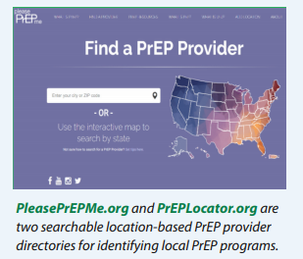
Identifying Key Partners for your Health Center
Partnerships with outside organizations present valuable opportunities for collaboration when beginning to offer PrEP services
Partners include:
State and local health departments
Women-serving community-based organizations
HIV prevention and treatment-focused community-based organizations
Local pharmacies
Local college, universities, and academic medical centers
Other local health centers offering PrEP services
Other key stakeholder agencies
Consider the partnerships you already have in place!
Notes:
Maybe you're a clinic that wants to screen and counsel people about PrEP. Maybe you're even willing to do the initial labs, but then you want to refer to a primary care clinic that the patient goes to, or a local or state health department that's offering PrEP, if you don't feel like your site is able to actually prescribe PrEP.
We recommend that your sites do prescribe PrEP. It's not that much of a burden, and you can get reimbursements that can help support your programs. But there are other partners that you can partner with, and they're listed here. I'm sure these are places that you all have relationships with in your settings.
There's also PrEPLocator.org or PleasePrEPMe.org--these both go to the same site--where you can find a PrEP provider. If you have a patient that comes from a distance and does not want to come to you for PrEP but you want to find a provider in their ZIP Code, you put their ZIP Code in and this is a national search that will come up with PrEP providers in their area. This site actually makes sure that these PrEP providers offer very state-of-the-art care for PrEP.

Slide 32
Working with Key Partners
Partners may be helpful for:
Offering trainings to clinicians and staff
Educating community members about PrEP and referring them to the family planning site
Hosting community outreach events, such as local health fairs
Discussing specific PrEP cases and troubleshooting unusual challenges
Offering complementary services, such as counseling and other social services
Acting as referral partners for any clients identified as HIV+
Notes:
Some of the things you can do with your key partners, for example with your local AIDS Education and Training Centers
Partner with them to offer trainings to clinicians and staff.
Help educate community members about PrEP, because people in the community don't know about PrEP. By educating your community, you will increase your ability to attract people to come to your clinic for PrEP. You can host community outreach events.
The more people in your community who know about PrEP, the safer your community is, the more protected your community will be from getting HIV. It's the only way that we can really end the epidemic, by making sure the people in the community are educated and know what PrEP is.

Slide 33
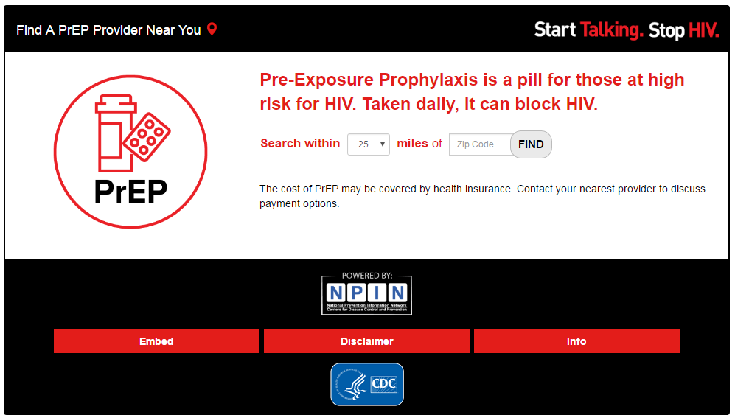
PrEP Provider Locators www.pleaseprepme.org www.preplocator.org
Notes:
This is another screenshot of the PleasePrEPMe.org and the PrEPLocator.org website.

Slide 34
Identifying HIV+ Individuals
Establish a relationship with an HIV clinical specialist
Ryan White Clinic near you
Go to: https://findhivcare.hrsa.gov/
As you start to increase testing while screening persons for PrEP and PEP you may increase the incidence of HIV+ individuals in your clinic.
Recommendations to start ART immediately after a new diagnosis – “Rapid Start”
Notes:
If you're going to be starting to do more HIV testing, you'll probably start identifying more persons who are HIV positive. If your clinic can handle treating people with HIV, that's great. Of course, the recommendation is to start ART immediately. Don't wait for an appointment. Have a protocol that you can start ART as soon as someone is diagnosed with HIV.
The reason why we recommend that is there's been a lot of research that has shown that if you start ART immediately in the clinic when someone is diagnosed, they have more hope and more ability to feel empowered that there's something that they can do about this HIV. We see more success and linkage to care and retention in care.
By starting HIV meds immediately, we see less immunologic dysfunction. There's more of a chance to decrease transmission, and also to engage people in care, to decrease the disparities in care by engaging people in care as soon as their HIV positivity is diagnosed.
It's important for you, if you're not going to provide HIV care in your clinic, to have a clinic in your area that you can refer a patient to. The Find HIV Care website is a resource that shows all the Ryan White-funded clinics in the United States, to assure that you know one that's near you so you can refer someone immediately to get antiretroviral therapy as soon as they're diagnosed in your clinic is critical.
Find HIV Care website (https://findhivcare.hrsa.gov/)

Slide 35
Monitoring and Evaluation

Slide 36
Monitoring and Evaluation
Consider adopting performance measures to assess the success of service implementation.
Percentage of clients who received PrEP counseling and education services.
Percentage of clients screened for PrEP services and at significant risk for HIV who began medication.
Percentage of PrEP clients who attended scheduled follow-up visits at 3, 6, 9, and 12 months.
Percentage of PrEP clients reporting proper adherence to medication and duration of PrEP use.
Number of PrEP clients (taking the medication for more than one month) who seroconvert.
Percentage of PrEP clients choosing to discontinue medication.
Reasons why discontinued meds
Notes:
In terms of monitoring and evaluation, this slide is to encourage you to start with thinking about what kind of performance measures you want to measure in your clinic to assess the success of your PrEP clinic.
You can start tracking information about the
Percentage of clients who receive PrEP counseling and education services; P
Percentage of clients that are screened for PrEP services, and who are at significant risk for HIV who began medication
Percentage of PrEP clients who attended follow-up visits at 3, 6, 9 or 12 months
Percentage who report proper adherence to medication; the number of PrEP clients who may seroconvert; and the percentage of PrEP clients who choose to discontinue medication and the reasons why.
This might be a nice checklist for you to establish before you start your PrEP program, so you can evaluate it.

Slide 37
Resources

Slide 38
CDC PrEP
CDC HIV Prevention > PrEP https://www.cdc.gov/hiv/basics/prep.html
Video PrEP 101: https://youtu.be/TR8-3uAuZGo
Notes:
For the rest of this talk, I wanted to show you some online resources. The CDC guidelines are very helpful, and they also have very good resources on PrEP. CDC HIV Prevention > PrEP (https://www.cdc.gov/hiv/basics/prep.html)
Here's a CDC PrEP video that you can go to and use in your waiting room if you so desire. Video PrEP 101 (https://youtu.be/TR8-3uAuZGo)

Slide 39
Additional Resources
Telephone consultation line:
1-855-448-7737
9 am to 8 pm ET Monday–Friday
http://nccc.ucsf.edu/clinician-consultation/prep-pre-exposure-prophylaxis/.
Notes:
This is a telephone clinical consultation line (1-855-448-7737) provided by San Francisco General Hospital at the University of San Francisco. It's open 9:00 AM to 8:00 PM Eastern time, Monday through Friday.
The people who answer this line are very smart and know a lot about PrEP, and they’re able to help with difficult situations. Any time you feel anything uncomfortable as a clinician, this is a great line to call. This is not a patient line; this is for clinicians specifically.
PrEP: Pre-Exposure Prophylaxis - Clinically supported advice on PrEP for healthcare providers
(http://nccc.ucsf.edu/clinician-consultation/prep-pre-exposure-prophylaxis)

Slide 40
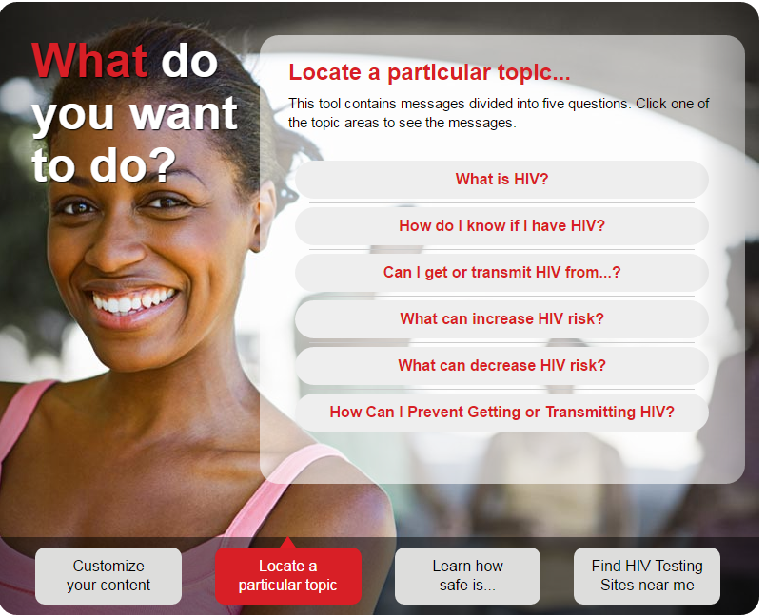
CDC HIV Risk Reduction Tool https://www.cdc.gov/hivrisk/
Notes:
Here's a site that is more women centered. They can assess their risk of being exposed to HIV, and their risk that would lead them to want to start PrEP.
CDC HIV Risk Reduction Tool (https://www.cdc.gov/hivrisk)

Slide 41
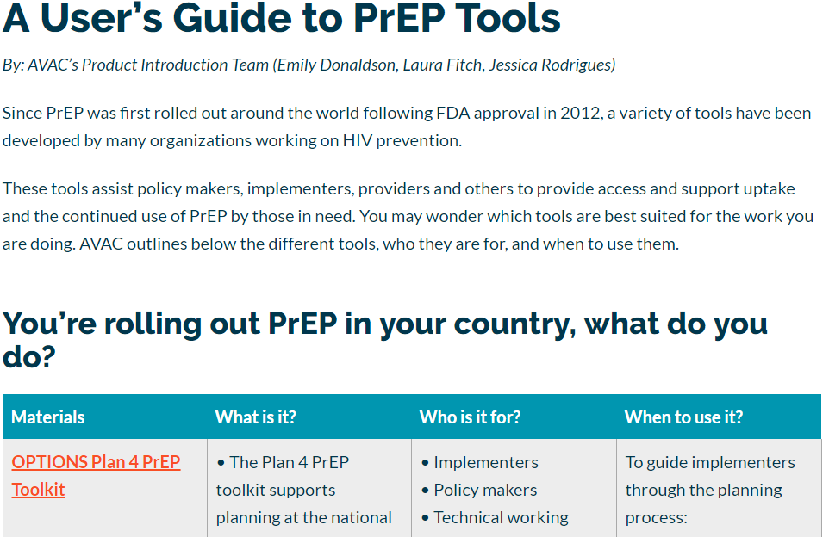
PrEP Implementation Tools https://www.prepwatch.org/users-guide-prep-tools-use/
Notes:
This site is called PrEPWatch. It's an AVAC site (an international HIV research organization) that offers several tools.
PrEP Implementation Tools https://www.prepwatch.org/users-guide-prep-tools-use/

Slide 42
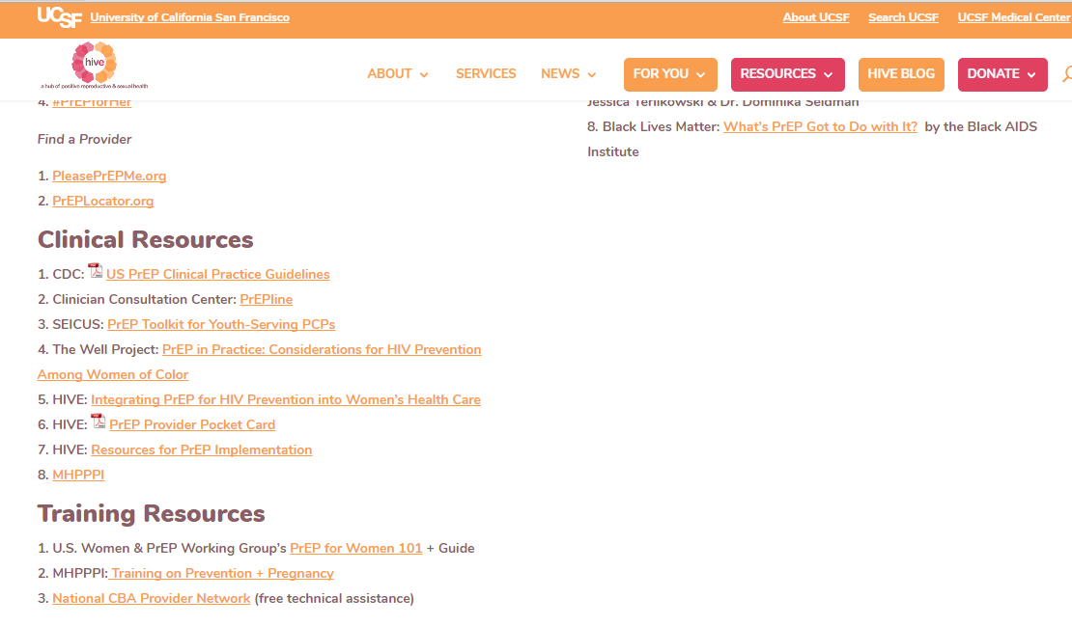
HIVE Clinical and Training Resources
https://hiveonline.org/old-prep4women/
Notes:
This is called HIVEOnline.org. HIVE Clinical and Training Resources (https://hiveonline.org/old-prep4women). It's a wonderful organization that has lots of resources for women specifically who are HIV positive or who are at risk of getting HIV. This is a good site for you to look at, and also to give to your patients so that they can look at this on their own time.

Slide 43
Videos
PrEP: HIV Prevention That Promotes Care – Bridging The Gap (http://immersive.thebodypro.com/LBLN/hiv-prep/?ap=tbptd)
Powered by PrEP: Keith - Virginia Greater Than AIDS (https://youtu.be/gnvAuNlLMEo)
Gender Affirming Hormone Therapy (https://www.plannedparenthood.org/planned-parenthood-massachusetts/campaigns/gender-affirming-hormone-therapy)
PrEP: I Choose Protection, I Choose Control, I Choose My Future. No Apologies. (https://youtu.be/hYJhMm57oHk)
Notes:
This is a list of recommended videos:
PrEP: HIV Prevention That Promotes Care – Bridging The Gap (http://immersive.thebodypro.com/LBLN/hiv-prep/?ap=tbptd)
Powered by PrEP: Keith - Virginia Greater Than AIDS (https://youtu.be/gnvAuNlLMEo)
Gender Affirming Hormone Therapy (https://www.plannedparenthood.org/planned-parenthood-massachusetts/campaigns/gender-affirming-hormone-therapy)
PrEP: I Choose Protection, I Choose Control, I Choose My Future. No Apologies. (https://youtu.be/hYJhMm57oHk)

Slide 44
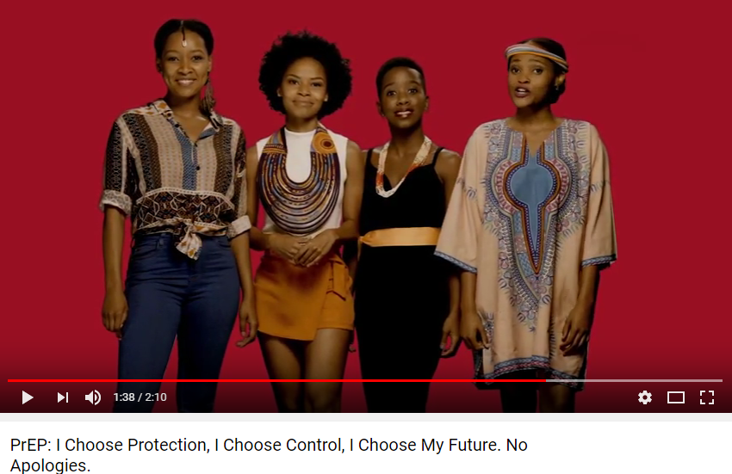
YouTube Videos for PrEP Awareness
https://youtu.be/hYJhMm57oHk
Notes:
This video, of a series of five, all based from South Africa, can apply to all of our patient populations. The key messages include: do not stigmatize me, do not discriminate against me, I am positive, I am powerful, I am HIV free, I choose protection and control for my future.
It's a really fun video with young women talking about how they want to protect themselves and their community.
I recommend you look at this, as it might be appropriate for some of your waiting rooms.

Slide 45
Videos on HIV Awareness https://www.greaterthan.org/stories-empowered-women-and-hiv/
Notes:
These are videos that are on Greater Than AIDS website. All of them are empowered messages for women. Videos on HIV Awareness (https://www.greaterthan.org/stories-empowered-women-and-hiv).

Slide 46
Educational videos on PrEP can be used for community education. You can download copies for your waiting room or easily embed them in web pages
Notes:
These are additional educational videos that are available online.

Slide 47
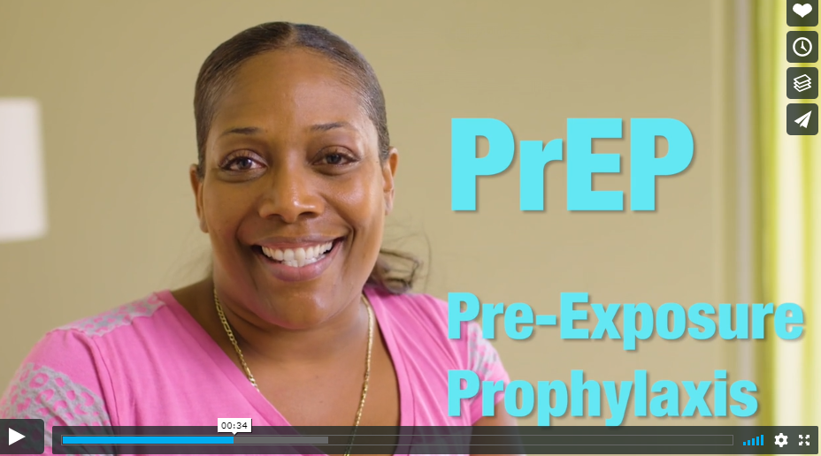
Making PrEP Accessible
https://vimeo.com/186448201
Project Inform / HIVE, accessed 9/28/2018
Notes:
One of them is "PrEP." It's a lovely, very short PrEP message for women about the importance of being empowered and doing something for your health. There are many online resources that you can integrate into your site.
Project Inform / HIVE (https://vimeo.com/186448201)

Slide 48
THANK YOU! QUESTIONS?
Notes:
Are there any questions for the presenters?

