Slide 1
Putting the QFP into Practice Series:
Integrating Reproductive Life Planning (RLP) into Your Family Planning Session
March 19, 2015 Phone lines have been muted upon entry.
You will hear NO sound until 3 PM Eastern time
when the webinar starts.
Click I Will Call In to use the phone and call:
Toll-free #: 1-877-668-4490
Access Code: 662 454 118
Click Call Using Computer to use your computer speakers. (Do NOT click Test computer audio.)
If you have urgent questions, please call 510-835-3700.
Notes:
Bea: Good afternoon and welcome to today’s presentation. This is the second webinar of the Putting the QFP into Practice Series, Integrating Reproductive Life Planning into your family planning session. My name is Beatriz Reyes and I will be your moderator today.
At this time, everyone should be able to see the welcome slide. Due to the large number of participants, all participant lines have been muted. Today’s webinar is being recorded and will be posted on the FPNTC webpage.
If you are experiencing any technical problems or have urgent problems, please contact our office at 510-835-3700.
Audio streaming has been enabled for this webinar to allow you to listen to today’s presentation through your computer’s speakers.
You can also listen to this webinar by calling the toll-free number listed at the bottom of the screen.

Slide 2
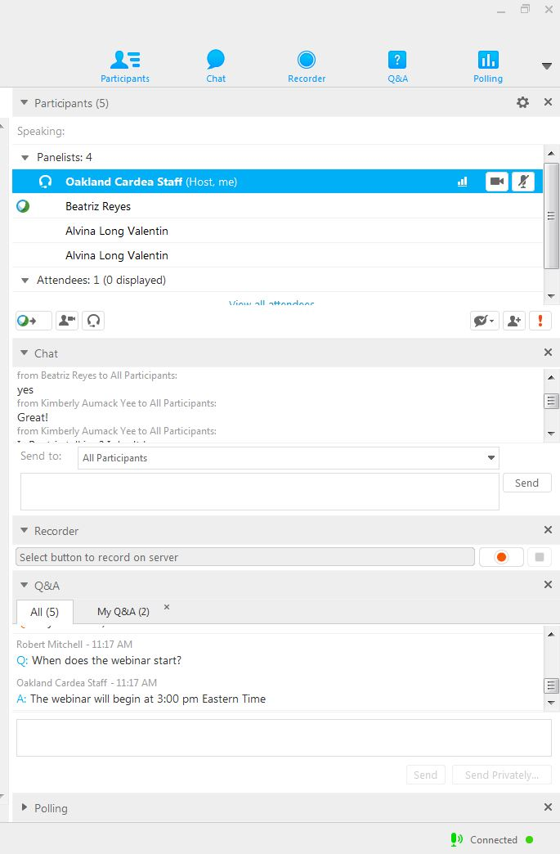
Chat window
Q & A window
Notes:
Bea: We will be using the Q and A window, the Chat window, and the polling panel. You can open or expand these panels by clicking on the arrow next to the panel’s name in the light grey bar on the top left. To close a panel, click the “X” in the corner on the right side.

Slide 3
Use Chat for technical questions: we will usually type responses.
Use Q&A for content-related questions (send to All Panelists): Presenters will address most content-related questions verbally during the Q & A period.
Notes:
Bea: Please use the Chat box to send us any technical questions or comments.
To ask a content-related question at any point during today’s presentation, please use the ‘Q&A’ box. Simply type your question in the text box, select “All Panelists” in the drop down menu, and click the ‘Send’ button. Your questions will be addressed at the end of the presentation. We will also have Sue Moskosky on the line during the Q&A session to respond to Title X programmatic questions.
Now that we’ve finished giving you instructions for participating, we will begin recording this presentation.

Slide 4
Putting the QFP into Practice Series: Integrating Reproductive Life Planning into Your Family Planning Session
March 19, 2015
Alvina Long Valentin RN, MPH
Notes:
Bea: We are happy to bring you today’s webinar on Integrating Reproductive Life Planning into your Family Planning Session.

Slide 5
Disclosures
PROVIDER UNIT: Cardea Services
COMPLETING THIS ACTIVITY
Successful completion of this continuing nursing education (CNE) activity includes the following:
Attending the entire CNE activity;
Completing the online evaluation;
Submitting an online CNE request.
Notes:
Bea: I want to remind you all that this webinar will be approximately 45 minutes including time for Q and A at the end. In order to receive Continuing Nursing Education, participants must attend the entire event, complete the online evaluation at the end of the webinar, and submit an online request. At the conclusion of the webinar we will give information on how to request CNEs.

Slide 6
Conflict of Interest
The planners and presenters of this CNE activity have disclosed no conflict of interest including no relevant financial relationships with any commercial companies pertaining to this CNE activity.
Notes:
Bea: The planners and presenters of this activity have disclosed no conflict of interest including no relevant financial relationships with any commercial companies pertaining to this CNE activity.

Slide 7
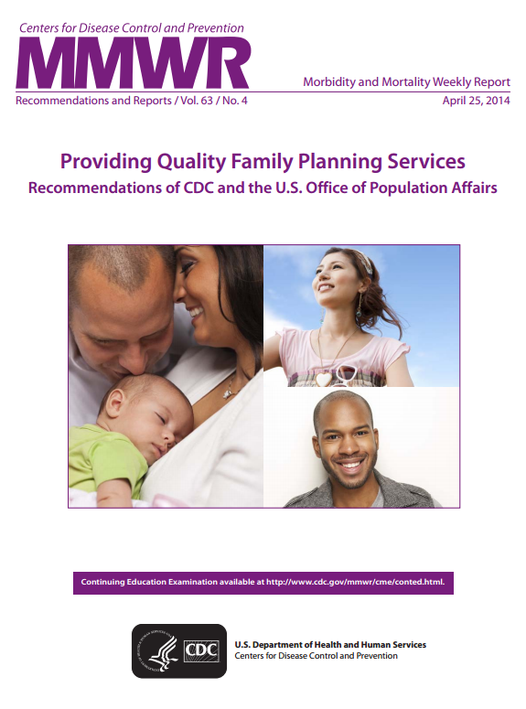
Providing Quality Family Planning (QFP) Services
Notes:
BEA:
As you may know the “QFP” refers to the document you see here titled “Providing Quality Family Planning Services, Recommendations of the CDC and the US Office of Population Affairs. These evidence informed guidelines are the recommendations for all service delivery providers of family planning and reproductive health services .
our 1st webinar, which is now available on the FPNTC website, focused on the QFP recommendations for how to determine a client’s need for services, and briefly included the importance of assessing the client’s reproductive life plan.
Today’s webinar is the 2nd in this 8-part “putting the QFP into practice series” AND focuses on how to help clients to think about their own reproductive life plan in a concrete way— thinking and talking about their goals for having or not having children, and how to achieve these goals. It also provides information about how to use that information to guide the care you provide.

Slide 8
Integrating Reproductive Life Planning into Your Family Planning Session
Overview
Reproductive life plan assessment and delivery of care
Case studies
Integration of reproductive life planning into your clinic
Notes:
BEA. During the time we have together today we will:
Give an overview to reproductive life planning including the benefits of FP and why RLP is important
Discuss Reproductive life plan assessment and use it to guide the delivery of care
Explore case studies, and
Describe ways to integrate reproductive life planning into your clinic or service delivery site

Slide 9
Learning Objectives
Discuss the purpose of the reproductive life plan in the family planning visit
Integrate reproductive life planning into a family planning session in order to guide the provision of care
Notes:
The objectives for today’s session are that you will be able to
Discuss the purpose of the reproductive life plan in the family planning visit, and
Integrate reproductive life planning into a family planning session in order to guide the provision of care.

Slide 10
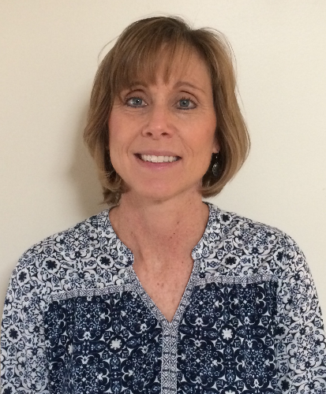
Presenter
Alvina Long Valentin, RN, MPH
Notes:
Bea:
I would now like to introduce our wonderful presenter for today, Alvina Long Valentin. Alvina is the Perinatal Health Unit Supervisor in the Women’s Health Branch – Division of Public Health at the North Carolina Department of Health and Human Services. She provides fiscal and programmatic oversight to perinatal health clinical and community programs. She previously served as the Women’s Health Network Supervisor and focused on integrating preconception health and reproductive life planning into clinical and community programs. Ms. Long Valentin has 20 years of public health nursing, clinic management and program development experience in the areas of women's health, pediatrics, adult medicine and home-based visiting. Alvina received her MPH from Johns Hopkins School of Hygiene and Public Health, her BSN from Johns Hopkins School of Nursing.
Welcome, Alvina.

Slide 11
Overview— Benefits of Family Planning and the Reproductive Life Plan
Notes:
Let’s start with an overview…and discuss the benefits of family planning and the reproductive life plan

Slide 12
Family Planning Services
Contraceptive services
Pregnancy testing & counseling
Achieving pregnancy
Basic infertility
Preconception health
Sexually transmitted diseases
Notes:
FP services are a suite of services designed to help couples and individuals achieve their desired number and spacing of healthy children. These services, as listed on this slide, include: contraceptive services, pregnancy testing and counseling, achieving pregnancy, basic infertility, preconception health and STD services.
STD services are also part of preconception health services –in the QFP we find STDs is a separate section of the document. So when we talk about “preconception” health services we also include STD services.

Slide 13
Health Benefits of Family Planning
Better Health Outcomes: Plan and space births, preconception health services prevention of unintended/teen pregnancies,
Infants
Men
Women
Notes:
The health benefits of family planning are many— for women, men AND infants.
Family planning services help women and men plan and space the births of their children, prevent unintended pregnancies, reduce the number of abortions, and prevent or treat STDs that can cause infertility. FP helps women have healthier pregnancies and births, FP helps women and men live healthier lives and have healthier children.
The benefits of preconception care, birth spacing of at least 18 months between delivery and next conception, and reduction of teen/unintended not only contribute to healthier parents, but the infant also has better health outcomes. The risk of adverse birth outcomes is lower when there is at least 18 months between delivery and next conception.

Slide 14
Health Risks of Unintended Pregnancy
Women have a greater risk of negative mental health outcomes during and after pregnancy and experiencing physical abuse while pregnant
Increased chance of having a low birth weight baby
Increased chance of children having poorer mental or physical health, poorer educational and behavioral outcomes
(Logan,C., Manlove, J., Ryan, S., 2007)
Notes:
An unintended pregnancy is a pregnancy that is mistimed or unwanted at the time of conception. About half of the pregnancies in the U.S. are unintended, 29% mistimed and 19% unwanted at the time of conception.
QFP recommendations address women’s risk behaviors regardless of their pregnancy intention. However we do know that women who have an unintended pregnancy may be more likely to engage in risk behaviors, like smoking, for example. Smoking nearly doubles a woman’s risk of having a low-birth weight baby.
There is also some evidence that unintended pregnancy is associated with a greater likelihood of the mother smoking while pregnant and of the child being born low birthweight.
Another example is women with chronic conditions like diabetes, who have an unintended pregnancy. These women are at an increased risk for having a child with birth defects, delivering preterm, and macrosomia. Many risk behaviors have the most detrimental effect on the fetus in the first few weeks of pregnancy, before a woman may realize she is pregnant.
Overall, the findings from a White Paper done by the National Campaign to Prevent Teen and Unplanned Pregnancies found the following: Experiencing a birth or pregnancy that was unintended by the mother, is associated with an array of negative outcomes, including delayed prenatal care, reduced likelihood of breastfeeding, poorer mental and physical health during childhood, poorer educational and behavioral outcomes of the child, poorer maternal mental health, lower mother-child relationship quality, and an increased risk of the mother experiencing physical violence during pregnancy.
Children born of unintended pregnancies have poorer mental and physical health, less close motherchild relationships, and poorer educational and behavioral outcomes. Most studies indicate that women who experience unintended births are at a greater risk of negative mental health outcomes during and after pregnancy and experiencing physical abuse while pregnant.
References
White Paper on the Consequences of Unintended Childbearing (literature review)
https://thenationalcampaign.org/sites/default/files/resource-primary-download/consequences.pdf

Slide 15
Impact of Family Planning Services
Medical
Social
Financial
(Frost, J., Sonfield, A., Zolna, M., & Finer, L..2014)
Notes:
The public investment in family planning programs and providers not only helps women and couples avoid unintended pregnancy and abortion, but also helps many thousands avoid cervical cancer, HIV and other sexually transmitted diseases. These programs also help women and couples avoid infertility, and preterm and low birth weight births. It helps both women and men live healthier lives. And, this public investment resulted in net government savings of $13.6 billion in 2010, or $7.09 for every public dollar spent.
Source: http://www.guttmacher.org/pubs/journals/MQ-Frost_1468-0009.12080.pdf

Slide 16
What Is Reproductive Life Planning?
Men and women setting life goals in terms of childbearing
Planning the timing and spacing of healthy pregnancies
Identifying and modifying medical, behavioral, and social factors negatively affecting pregnancy outcomes
Managing pre-existing conditions and behaviors before, between and beyond pregnancies
Notes:
16
16
16
Reproductive life planning is a technical term for asking people to contemplate their life goals related to their childbearing goals. It helps with planning the timing and spacing of healthy pregnancies, identifying and addressing a wide range of factors that can negatively affect pregnancy, as well as managing pre-existing conditions.
It is important to ask all clients about reproductive life planning and not make any assumptions about the client’s needs based on
his/her sexual orientation or disabilities.
CDC recommends that all women and men receive reproductive life planning
RLP takes place along a continuum, and it may take a team approach in your clinic to cover the 4 bullets listed here. RLP may happen
differently depending on who is talking to the client. A nurse or MA may take on topics related to the planning and spacing of
pregnancies discussion, while a nurse, nurse practitioner, physician’s assistant or physician may take on more of the preconception
and interconception care listed in the last two bullets here.

Slide 17
Purpose of Reproductive Life Planning
Guide the care provided to clients
Help ensure planned, healthy pregnancies and positive birth outcomes
Support the overall health and well-being of women, men and infants
Notes:
Overall, the purpose of integrating RLP into your family planning setting is to guide the care you provide to clients in order to promote planned, healthy pregnancies, positive birth outcomes, and overall health and well-being for women, men and infants.

Slide 18
Why Reproductive Life Planning Is Important
Essential step in the delivery of family planning services
Helps clients assess their own goals; motivates behavior
Helps staff prioritize which family planning services to provide
Notes:
In addition to the purpose, why should we care about RLP as a part of FP? Why is it important?
During a busy clinic you may find yourself prioritizing what is essential….thinking about what is really important to focus on and what to minimize…Staff may feel like they don’t have enough time to add reproductive life planning into the RLP can motivate and improve health behaviors. RLP also helps staff determine and prioritize the FP services to provide that day.

Slide 19
Reproductive Life Plan Assessment and Delivery of Care
Notes:
Now, we will move on to the reproductive life plan assessment and delivery of care.

Slide 20
Goal of the Questions
Assess the client’s RLP, including personal goals about becoming pregnant or fathering a child
Identify unmet contraceptive and other preconception health care needs
Get specific information from the client, determine which questions to ask next, and ultimately guide care
Notes:
The way we assess RLP is by asking some key questions…..These questions help to:
Assess the client’s RLP, including personal goals about becoming pregnant
Identify unmet contraceptive and other preconception health care needs
Get specific information from the client to help guide the next questions to ask, assist the client in thinking and acting on behalf of their reproductive plan, and ultimately guide care.
Sample questions are available as a guide, to trigger a conversation and can be tailored to fit the circumstance and staff person’s way of speaking.
Staff should ask relevant questions, building on previous questions asked by other staff to guide the services provided for the client

Slide 21
Introducing Reproductive Life Planning
I’d like to ask you some questions, unrelated to the reason of your visit. Some of them may feel personal, however we ask these questions of all our clients to help us provide quality, preventive health care.
Notes:
Before bringing up the Reproductive Life Planning questions, it can be helpful to have a statement to introduce the RLP topic, especially if the person comes in for a visit that is not related to achieving pregnancy. Remember RLP is related to the reason for visit, as it helps the provider determine how to best serve the patient.
For example, an opening statement could be:
I’d like to ask you some questions, that you may feel are unrelated to the reason of your visit. Some of them may feel personal, however we ask these questions of all our clients to help us provide quality, preventive health care.
It let’s the client know that the questions to come may feel personal, and explains WHY we ask these questions— because we want to provide the person with the best care possible.
Then you go on to ask your RLP questions.

Slide 22
Reproductive Life Planning Questions
1. Do you have any children now?
2. Do you want to have (more) children?
3. How many more children would you like to have and when?
And….how can I help you achieve your goals?
Remember to do RLP with women and men!
Notes:
These RLP questions were originally developed in 2006. There is no single “set of questions” that you must ask – but tailor your questions to your client’s needs and offer health education as it fits your client’s health status and future goals.
As you discuss RLP with your clients, you will find that you may incorporate other questions, points of discussion, based on each individual client’s situation.
Remember, it is important to ask the reproductive life plan questions of both men and women.
The CDC has augmented these reproductive life planning questions.

Slide 23
CDC Reproductive Life Plan Tool Questions
Do you plan to have any (more) children at any time in your future?
How many children would you like to have?
How long would you like to wait until you or your partner becomes pregnant?
If pregnancy is not desired
4. What family planning method do you plan to use until you or your partner are ready to become pregnant?
5. How sure are you that you will be able to use this method without any problems?
(Centers for Disease Control and Prevention, n.d.)
Notes:
CDC’s recommendation is that all persons capable of having a child should have a reproductive life plan.
Basically, do you want to have children, the timing and spacing of healthy children and what can I do to help you achieve these goals.
The additional two questions, #4 and #5 on this slide are asked if pregnancy is NOT desired.
PUT REFERENCE AT THE BACK SLIDE: http://www.cdc.gov/preconception/documents/rlphealthproviders.pdf

Slide 24
What to Consider in Developing a Reproductive Life Plan
Age
Educational goals
Career plans
Living situation
Financial situation
Social support
Relationship with partner
Readiness to become a parent
Medical history
Current health status
Health behaviors
Contraceptive use
Notes:
24
24
24
You can add some more specific questions – how old would you like to be? What type of job do you plan to have? Could you support a baby now – emotionally,
physically, financially. How will having a baby affect your relationship with your partner, etc.
How is your health now? Do you have any chronic conditions like diabetes? What about your medical history? Does anything run in your family?
Do you have any health risk behaviors like tobacco use? Are you currently using contraception? Are you able to use your method consistently?

Slide 25
How the RLP Guides the Delivery of Care
Clients who seek pregnancy
Offer counseling to help achieve pregnancy
Offer preconception health services
Clients who are not seeking pregnancy
Offer contraceptive services
Offer preconception health services, especially for clients who are at high risk for unintended pregnancy
Clients who are not sure
Encourage her/him to develop a reproductive life plan
Provide services including contraceptive and preconception health services, as indicated
Notes:
Whether the client is seeking pregnancy, not seeking pregnancy or unsure, a client’s RLP can be used to guide care . It represents an opportunity to discuss the client’s need for assistance in planning pregnancy and for other preconception health services.
So what information and care do you deliver? Let’s look at what the QFP recommends.

Slide 26
When Pregnancy Is Desired
Notes:
Women/men who are currently seeking pregnancy need preconception health and STD services as well as counseling on how to achieve pregnancy – This is a high priority population!
For addressing “achieving pregnancy” and “possible basic infertility services”- Providers should ask the client (or couple) how long they have been trying to get pregnant, and when she hopes to get pregnant. If the client’s situation does not meet one of the standard definitions of infertility, then counseling about how to maximize fertility should occur. If a couple needs basic infertility care, the provider focuses on determining potential causes of their inability to achieve pregnancy and make referrals to specialists.
Preconception health services should be offered to male and female clients. This includes medical history and sexual health assessment; intimate partner violence; alcohol and drug use; tobacco use; immunizations; depression; nutrition including folic acid (for women only); height, weight, and body mass index; blood pressure; diabetes; and of course STD testing services.
Related preventive health services should also be delivered, as appropriate.

Slide 27
When Pregnancy Is Not Desired
Notes:
The woman in this picture is someone who has decided she is not ready for children now!
If this woman’s answers to the reproductive life planning questions indicate she is sexually active, and doesn’t want to get pregnant now, this would lead to a discussion of contraceptive services, beginning with the most effective methods first, such as IUDs or implants. Preconception health services should also be offered especially true for those using the less effective methods or inconsistent method use, as this puts them at a higher risk of pregnancy.

Slide 28
Women’s Contraceptive Use and Number of Unintended Pregnancies in the United States
( Guttmacher Institute, 2014)
Notes:
This graph comes from Guttmacher and it highlights the number of unintended pregnancies in the US by consistency of contraceptive use.
When we look at the data on unintended pregnancy we know that 43% of the unintended pregnancies are among women who are using contraception, but inconsistently or incorrectly.
52% of unintended pregnancies are among women who didn’t intend to get pregnant, but were not using any method at all.
And only 5% of pregnancies are among women who are consistently using a method.
What does this tell us?
-Effective use of methods, and highly effective methods work extremely well at preventing unintended pregnancies.
-Women not using their method consistently or correctly are at higher risk of pregnancy,
-Women using no method….about 85% will become pregnant in a year’s time
For all of these women (and their partners), asking the RLP questions can help them think about and get clarity on whether or not they want to become pregnant BEFORE pregnancy occurs

Slide 29
When the Client is Unsure
Notes:
Some people may not have thought about RLP very concretely, not thought of their individual/personal risk of pregnancy and what that would mean to them now, or, for a man, what it would mean to father a child at this point in his life.
Some people underestimate their risk of pregnancy and overestimate the risks/side effects of the many safe and effective contraceptive methods available.
Or the person may be ambivalent, not have strong feelings either about having or not having a child.
In these situations…. Explore why they are unsure, depending upon why they are unsure this may require more next steps, time, and planning with the client.
Encourage the client to develop a reproductive life plan, ask follow-up questions to help put this into perspective in terms of their own lives now, provide services, as indicated.

Slide 30
Case Studies
Notes:
Let’s look at some case studies. Please think about these cases and how you might approach communication with these clients, and then use the information about the client’s reproductive life plan to guide what care you (and/or other staff) provide.

Slide 31
Case Study #1
Jeanine is a 31 year old Caucasian female who has been with her boyfriend for 10 years. She has type-1 diabetes. You learn they are trying to start a family.
How does this guide future questions and care?
Notes:
Jeanine is a 31 year old Caucasian female who has been with her boyfriend for 10 years. She has type-1 diabetes. You would ask some RLP questions like:
-Do you have any children now?
-Do you want to have (more) children?
-How many more children would you like to have and when?
You then learn they are trying to start a family.
How does this guide future questions, discussion and care?
In addition to diet and exercise and reviewing any medications she’s on, the clinician will want to make sure she has her diabetes under control before she actively tries to get pregnant and make sure she’s not on any medications that will harm a developing fetus. Contraceptive methods should also be offered if she wants to prevent a pregnancy until her diabetes is under control, and information about maximizing her fertility should also be provided.

Slide 32
Case Study #2
Denise is 18 years old, a Hispanic female, BMI 28, current smoker, engages in occasional binge drinking, had 1 child at age 16, has a current boyfriend and is sexually active. They want to have another child once she is done with college in 4 years. She is in for initiation of a family planning method, uses condoms intermittently and has been on the pill before.
How would you begin talking about a birth control method to best fit their needs?
What type of education can you provide to help them start thinking about steps to prepare for a healthy pregnancy in the future?
Notes:
READ CASE STUDY #2 OUTLOUD
How would you begin talking about a BCM to best fi t their needs?
Find out her experience using condoms intermittently and talk about how when you use your method inconsistently you could get pregnant. Also explore her experience with the pill and find out what she is looking for in a method.
Keeping the conversation client-centered, you may talk about the highly effective long term reversible methods of contraception such as the IUD and implant. These methods are safe, easy to use and very effective. When she is ready to plan a pregnancy it can be easily removed.
What type of education can you provide to help them start thinking about steps to prepare for a healthy pregnancy in the future?
Since we know she is a smoker and occasionally binge drinks, include risks to the fetus (due to alcohol and tobacco use) in the event of unintended pregnancy.
Even though she’s not trying to get pregnant right now, if she chooses a less effective method, it’s particularly important to offer preconception health services, explaining that they help to ensure a healthy pregnancy should she become pregnant, and promote good health for when she wants to get pregnant after college.

Slide 33
Reproductive Life Planning for Men
Ask RLP questions from a male perspective:
Have you or your partner used a family planning method (now or ever?)
What were some of the challenges and successes with using that method?
Discuss behaviors that contribute to male fertility and overall health
Notes:
Some staff find it awkward or challenging to ask a man about reproductive life planning, especially if he didn’t come in for a FP visit. However, it is important to ask about reproductive life planning with male clients.
So, how do you start the conversation and ask the questions? It can help to include a segue, or a transitional statement before bringing this up as we mentioned before. Then, a few possible questions might include:
Do you use birth control with your current partner? Have you used birth control with any past partner? How was that experience? What did you like or dislike? What would make it easier to use contraception?
Then you would provide information about consistent and effective method use, and confirm knowledge of correct condom use.
If a man would like to have a child in the future, there are a number of lifestyle choices that might impact his future fertility and health, as well as the health of the baby, such as smoking, heavy alcohol use, illicit drugs, and steroids.

Slide 34
Case Study #3
Jim is a 25 year old Caucasian male, has a current girlfriend and is sexually active. He comes in for evaluation of a possible STD. He has no children, but wants to have children in about 10 years.
How would this discussion guide the care he receives?
(Centers for Disease Control and Prevention, 2011)
Notes:
READ CASE STUDY #3
So this is what you’ve learned after discussing the reason for the visit and asking some RLP questions.
You’ll want to then ask him some questions about contraceptive use, including condom use with his girlfriend. Regardless of whether or not Jim tests positive for an STD, it is important to review with him the effects of transmitting an STD to his partner, particularly in the event of a planned or unplanned pregnancy, and the impact on fertility. If his partner is NOT using a highly effective method and they’re not using condoms, she could get pregnant, and/or an STD, and the baby could be negatively effected by the STD. Some STDs can be transmitted to the baby during pregnancy or delivery. STDs can cause stillbirth, low birth weight, brain damage, blindness and deafness. STDs can also affect male and female fertility and make it difficult to achieve pregnancy. For women, untreated STDs can lead to pelvic inflammatory disease, which can result in infertility and ectopic pregnancy. So you can see how important it is to discuss RLP with men.
http://www.cdc.gov/nchhstp/newsroom/docs/STDs-Women-042011.pdf

Slide 35
Case Study #4
It is an extremely busy afternoon, 4 clients have been added to your schedule, and you need to leave on time today. Monica, a 37 year old African American female, is your next client. She is in for a Pap. She is sexually active, but not taking her pills on a consistent basis. She doesn’t have children and strongly feels that she doesn’t want children in the future, but sometimes she feels unsure about that. She does not think she is at risk for becoming pregnant.
On a busy clinic day, what are some ways to discuss RLP and guide care?
Notes:
READ Case Study #4
There some different options for this very busy afternoon. You can ask “one question” about RLP that you think might be most helpful in this situation, such as: Would you like to be pregnant in the next year? Based on the client’s response…in this case you find out she doesn’t want to get pregnant, although sometimes she’s unsure…. you can discuss how to help her be more successful with her oral contraceptive pills or discuss another method that might be more effective for her, such a IUD or implant. And, you or another staff member can discuss preconception care, especially given that she is sometimes unsure about her decision to not get pregnant.
Looking at the clinic system, you can encourage clients to complete an RLP booklet in the waiting room before their visit and review it with them during their visit. If you're the provider, you can ask another team member like RN, MA or health educator to discuss RLP in more detail with the client and counsel about other FP methods, as well as her risk for becoming pregnant, and the benefits of planning ahead for a possible pregnancy in the future. If the client decides she wants to get pregnant (given that she is unsure now), it is important to discuss the benefits about being intentional if you want to conceive, follow preconception care recommendations and to be sure that any chronic conditions, like diabetes or hypertension, are under control prior to becoming pregnant. This helps women stay healthy and have a healthy birth outcome.

Slide 36
Integrating Reproductive Life Planning at Your Clinic
Notes:
Ok, let’s look at integrating reproductive life planning at your clinic.

Slide 37
Integrating RLP into Your Clinic
Ask all clients about their reproductive life plans
Revise forms to add questions about RLP including client self-assessment and clinical history forms
Incorporate RLP into the electronic health records
Select RLP tools for clients to complete in the waiting room
Notes:
Whether a client comes in for contraceptive services, pregnancy testing and counseling, achieving pregnancy or basic infertility, STD services or would benefit from preconception health care, ask all clients about their reproductive life plans.
Revise forms to add questions about RLP including client self-assessment and clinical history forms
RLP is being incorporated into many electronic health records
Select RLP tools for clients to complete in the waiting room
A resource document with links to a variety of RLP tools and booklets for both providers and clients is being provided as part of this webinar. I would urge you to review the different resources that are available for use in your clinic, both from CDC and other states. There are tools tailored to teens, women, and men, as well as tools for those planning pregnancy and those not planning pregnancy.

Slide 38
Integrating RLP into Your Clinic
Bring staff on board through discussions and training
Determine which provider will counsel about RLP and at what point during the visit (MA, nurse, mid-level provider, health educator)
Have tailored information available for people who are contemplating pregnancy and for people who are not
Notes:
Additional tips for integrating RLP into your clinic are:
Bring staff aboard through discussions and trainings, this will not only assist with building skill and offer staff the opportunity to ask questions, but this may assist with staff buy-in.
Coordinate which provider will counsel about RLP, for example will the MA provide reproductive life planning or will it be the nurse? As mentioned earlier, staff of different disciplines can take on different pieces of RLP, creating a team approach.
And, tailor the information for clients who are contemplating pregnancy or preventing pregnancy.

Slide 39
Contemplators vs Non-Contemplators
Contemplators - women who are planning a pregnancy, more open to messages about behavior change, contemplating some serious life choices, prepared to make appropriate adjustments in behavior and beliefs.
Non-contemplators - women who are not currently thinking about or planning a pregnancy, more resistant to pregnancy-related messages and harder to inform.
( Centers for Disease Control and Prevention, 2004)
Notes:
http://www.cdc.gov/ncbddd/folicacid/documents/MediaCampaignKit.pdf
Contemplators are women who are planning to get pregnant, and they may be more ready and motivated to follow preconception health care guidelines. Their readiness may help them follow through with healthy behaviors, and you can ask about what they have done so far, and how this has worked for them in terms of preparing for a healthy pregnancy.
Non-contemplators are not actively trying to get pregnant, and they may benefit from hearing why it is important for them to think and care about preconception health now, even if they are not planning a pregnancy soon.
Contemplator and non-contemplator checklists for clients to complete are available at CDC website. They include checklists and help clients make action plans related to healthy behaviors.

Slide 40
Summary
Reproductive life planning guides the tailored care you provide to clients, and assists clients with achieving a healthy pregnancy or preventing pregnancy.
There are different strategies for integrating reproductive life planning into clinical services including revising clinic forms, providing client tools and engaging a team approach.
Notes:
Reproductive life planning guides the care you provide, and helps women and men prevent a pregnancy, or Plan the timing and spacing of healthy pregnancies.
As mentioned earlier, there are different strategies for integrating RLP into your settings, such a revising forms, providing client tools, and engaging in team approach.

Slide 41
Summary cont.
RLP includes counseling about risk behaviors, environmental exposures, positive health behaviors, providing protection, and assistance with managing conditions – regardless of pregnancy intention.
Ask all clients about their reproductive life plan
Notes:
RLP can promote healthy behaviors like avoiding tobacco, alcohol, illicit drug use, and being up to date on immunizations, taking a multi-vitamin with folic acid, getting regular exercise, eating healthy, controlling chronic conditions and protecting against STDs– are all topics that should be discussed with all women and men, regardless of pregnancy intention, because they promote the health of the woman and healthy birth outcomes.
And, ask all clients about their reproductive life plan

Slide 42
Thank You For Your Participation!
Alvina Long Valentin RN MPH
alvinalong@hotmail.com
Notes:
Alvina: Thank you for your participation, we will have time for Q&A in a few moments. I am going to turn it back over to Beatriz now.
_________________________________________________________________________________________________________________________________________________________________________________________
Bea: Thanks, Alvina. Before we get into the Q &A portion of the webinar, let’s do a quick poll. Jana, will you open the poll please? The poll will be open for about 45 seconds.
Please choose the best response to the following statement, Reproductive Life Planning should:
Only be done by clinicians
Always be focused on helping a woman achieve pregnancy
Help staff work with clients to determine what services they need
Only be done with women
Once you have made your selection, please click the submit button on the bottom right corner.

Slide 43
Q & A
Notes:
Bea: Once you have submitted your response to the poll, please feel free to send your questions using the Q & A box. Simply type your question in the text box, select “All Panelists” in the drop down menu, and click the ‘Send’ button.
Also, as mentioned earlier, in addition to Alvina responding to your Reproductive life planning questions, we also have Sue Moskosky on the line to respond to any Title X programmatic questions.

Slide 44
References
Logan, C., Holcombe, E., Manlove, J., & Ryan, S. (2007). The consequences of unintended childbearing: A white paper. Washington, DC: Child Trends, and the National Campaign to Prevent Teen and Unplanned Pregnancy. Retrieved March 17, 2015, from The National Campaign to Prevent Teen and Unplanned Pregnancy website: https://thenationalcampaign.org/sites/default/files/resource-primary-download/consequences.pdf
Frost, J., Sonfield, A., Zolna, M., & Finer, L. (2014). Return on investment: A fuller assessment of the benefits and cos of saving of the US publicly , funded family planning programs. The Milbank Quarterly, Vol. 92, No. 4, 2014. (pp. 703-704). Retrieved on March 17, 2015, from the Guttmacher Institute website: http://www.guttmacher.org/pubs/journals/MQ-Frost_1468-0009.12080.pdf
Centers for Disease Control and Prevention. (n.d.). Preconception Health. Retrieved on March 17, 2015, from
http://www.cdc.gov/preconception/documents/rlphealthproviders.pdf
Guttmacher Institute: Contraceptive Use in the United States (2014). Retrieved on March 17, 2015, from http://www.guttmacher.org/pubs/fb_contr_use.html
Centers for Disease Control and Prevention. (2011, April). 10 ways STDs impact women differently from men. Retrieved March 17, 2015, from http://www.cdc.gov/nchhstp/newsroom/docs/STDs-Women-042011.pdf
Centers for Disease Control and Prevention. (2002, April). Media Campaign Implementation Kit. ( 3-5). Retrieved March 17, 2015, from http://www.cdc.gov/ncbddd/folicacid/documents/MediaCampaignKit.pdf
Notes:
This is the references slide for this presentation.

Slide 45
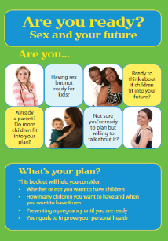
Reproductive Life Planning: Resource Page
Life Planning Tool – Someday starts now
www.somedaystartsnow.com/wp-content/uploads/fileDownloads/HTB-Lifeplan.pdf
Are You Ready? Sex and Your Future (Reproductive life planning booklet)
whb.ncpublichealth.com/Manuals/AreYouReadySexAndYourFutureRevised-9-10-10.pdf
Que Haras en Tu Futuro? (Spanish adaptation)
whb.ncpublichealth.com/Manuals/QueHarasEnTuFuturo-9-10-10-WebLayout.pdf
Clinical Self-history Form
whb.ncpublichealth.com/Forms/4060F_WEB_20120530.pdf
Notes:
The resources mentioned throughout this webinar are compiled on this resource sheet. Please review and utilize the resources as appropriate.
Following today’s webinar you will receive an email with a link to this resource page, this document will also be made available on the FPNTC resource page along with the archived recording of this webinar within two weeks of today.

Slide 46
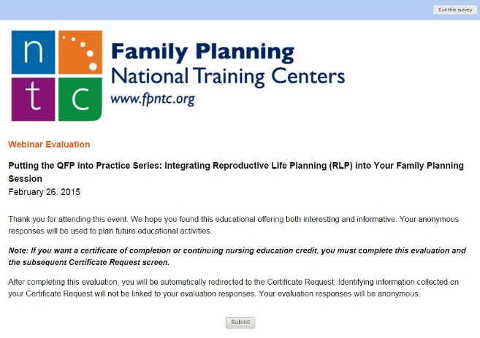
Online Evaluation
When you close the webinar, a survey will appear in your Internet browser.
If receiving continuing education credit or requesting a certificate of completion, you must complete the survey.
Notes:
Bea: Before you go, please fill out the online evaluation as we really value your feedback. The evaluation will open once you close your browser window.
Those of you receiving continuing education credit or requesting a Certificate of Completion must fill out the evaluation.

Slide 47
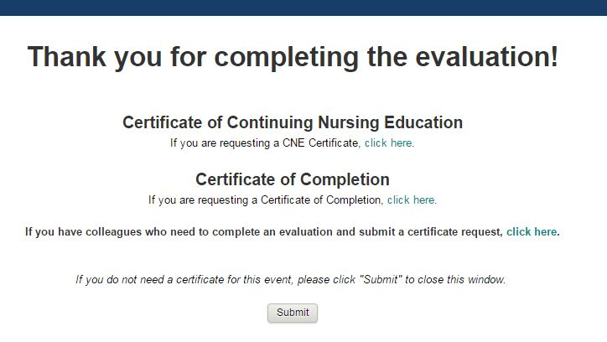
Don’t need a certificate?
Click “Submit”
Colleagues sitting with you who also need to complete an evaluation and submit a certificate request?
Return to this screen.
Notes:
Bea: After you click Submit on the evaluation, you will see a screen that looks like this, and you can request either a CNE Certificate or a Certificate of Completion.
Even if you registered prior to the webinar, you must click on one of these options to verify your attendance and receive a certificate.
After you have made your selection and register your information for your certificate, you have the option to return to this screen to allow other colleagues sitting with you to complete an evaluation and request a certificate as well. If you don’t need ANY kind of certificate, simply click “Submit.”

Slide 48
Contact us
Follow us on Twitter @fp_ntc
Subscribe to our newsletters at fpntc.org/enewsletter
Questions:
Contact Jana Dolsen at 510-835-3700 or OaklandEvents@cardeaservices.org
Notes:
Bea:
If you have any problems with completing the evaluation or requesting your certificate, please call our Training Coordinator, Jana Dolsen, at 510-835-3700.
Thank you again, and have a wonderful rest of your day.

