Slide 1
HHS Office of Population Affairs Innovative Models for PrEP Programs in Family Planning Sites July 24, 2019 3:00 pm ET
Notes:
Slide 1
Welcome to today's webinar, Innovative Models for PrEP Programs in Family Planning, hosted by the HHS Office of Population Affairs.

Slide 2
Welcome!
Objectives
Discuss the role of Title X family planning clinics in assuring access to PrEP services in their communities.
Describe various innovative models for implementation of PrEP services at three Title X-funded service sites.
Share lessons learned from Title X funded sites implementing PrEP services.
Note: This call will be recorded
Notes:
Slide 2
The discussion will include the role of Title X Family Planning Clinics in assuring access to PrEP services in their communities.
We'll look at various innovative models for implementation of PrEP services at three Title X-funded service sites
Our presenters will share their lessons learned regarding implementing PrEP services.

Slide 3
Today’s Speakers
Shannon Weber, Director, PleasePrEPMe.org
University of California, San Francisco
Jessica Downes, Clinical Pharmacist
OneWorld Community Health Centers, Inc.
Tammy Bennett, Reproductive Health Statewide Nurse Consultant
Louisiana Department of Health, Office of Public Health, Bureau of Family Health (BFH)
Michelle Ama Dankwah, Women’s Health Nurse Practitioner
Planned Parenthood Southeastern Pennsylvania
Notes:
Slide 3
Our presenters represent three Title X funded organizations, who will share their innovative approaches to implementing PrEP services and lessons learned. These organizations are:
One World Community Health Centers
Louisiana Department of Health's Bureau of Family Health, and
Planned Parenthood of Southeastern Pennsylvania.
The moderator for today's webinar is Shannon Weber. Shannon is the director of HIVE Online, at the University of California, San Francisco.

Slide 4
Pre-Exposure Prophylaxis (PrEP)
Pre-exposure prophylaxis (PrEP) is a once-a-day pill (brand name Truvada) demonstrated to reduce the risk of HIV infection up to 92% when taken as directed.
Source: Centers for Disease Control and Prevention (CDC). Preexposure Prophylaxis for the Prevention of HIV Infection in the United States - 2014: A Clinical Practice Guideline.
Notes:
Slide 4
PrEP stands for pre-exposure prophylaxis.
PrEP was approved by the FDA in the form of a pill called Truvada, for daily use of HIV prevention, in 2012. PrEP is safe and highly effective, and PrEP works for all people, including youth, and people of all genders, gender identities, and sexual orientations.

Slide 5
Family Planning Services and PrEP
Title X family planning sites are a primary source of care for many women, serving approximately 3.5 million women annually.
40% of women access reproductive health care only, making family planning clinics a logical and efficient location for offering PrEP to women.
Family planning providers are exceptionally qualified to provide HIV prevention services to women while incorporating clients’ health goals into individual health care decisions.
Women also consider family planning clinics a preferred source for information about PrEP and access to PrEP services.
Sources: Auerbach, J. D., et al. (2015). Knowledge, attitudes, and likelihood of pre-exposure prophylaxis (PrEP) use among US women at risk of acquiring HIV. AIDS patient care and STDs, 29(2), 102-110.; Sales, J. M., et al. (2019). Patient recommendations for PrEP information dissemination at family planning clinics in Atlanta, Georgia. Contraception.; Seidman, D., & Weber, S. (2016). Integrating preexposure prophylaxis for human immunodeficiency virus prevention into women's health care in the United States. Obstetrics & Gynecology, 128(1), 37-43.
Notes:
Slide 5
Forty percent of women access reproductive health care only, which makes family planning clinics a logical and an efficient location for offering PrEP to women.
Family planning providers are uniquely skilled to offer options within a shared decision-making model, and women want to hear about PrEP from family planning providers. We've heard this over and over in focus groups since 2011.
Prevention of sexually-transmitted infections, including HIV, is a core part of providing quality family planning services. Title X sites have a key opportunity to address gaps in PrEP awareness and access among women by integrating PrEP services into existing HIV prevention services, which can include HIV and STD prevention education, testing and referral, risk reduction counseling, and behavioral interventions, such as condom use and promotion of post-exposure prophylaxis.

Slide 6
PrEP Implementation Challenges in a Family Planning Environment
Sources: Auerbach, J. D., et al. (2015). Knowledge, attitudes, and likelihood of pre-exposure prophylaxis (PrEP) use among US women at risk of acquiring HIV. AIDS patient care and STDs, 29(2), 102-110.; Seidman, D., et al. (2016). United States family planning providers' knowledge of and attitudes towards preexposure prophylaxis for HIV prevention: a national survey. Contraception, 93(5), 463-469.; Sheth, A. N., Rolle, C. P., & Gandhi, M. (2016). HIV pre-exposure prophylaxis for women. Journal of virus eradication, 2(3), 149.
Notes:
Slide 6
Family planning visits are busy clinical encounters that address multiple health priorities in a limited time.
Integrating a new service into this environment can feel daunting, particularly when PrEP provision may require some navigation for clients who are underinsured or uninsured, and there is, in fact, more frequent lab testing and follow-up than other family planning services.
Even screening for HIV vulnerability can seem like an overwhelming task, given that there are no validated questions that accurately assess a woman's HIV risk.
In addition to these structural challenges, providers and clinic staff require training on both medical provision of PrEP
While it's not overly complicated, it does require some familiarity, and on counseling on a variety of HIV prevention options.
While many family planning providers agree that PrEP provision is within their scope of practice, they have indicated that they would like more training.
In recent years, leaders across the U.S. have collaborated to develop clinically sound and widely available tools to increase PrEP provider knowledge and support implementation of PrEP by family planning clinics. This webinar series is an important part of the tools that have been developed.

Slide 7
Innovative service models for PrEP delivery can help reduce implementation challenges and increase access to PrEP for our clients!
Notes:
Slide 7
Implementing these innovative models for integrating PrEP services can help reduce some of these implementation challenges that we just identified.
We can engage a range of providers, staff, and community partners, and increase access to PrEP for clients.
We see health centers offering a range of service models for PrEP, such as weekly after-hours PrEP clinics, doing task-shifting and engaging nurses and community health workers to educate and screen for PrEP, developing relationships with pharmacists who can play an important role, and leveraging online or mobile PrEP delivery or provision options.
Our presenters are from three health centers that are integrating PrEP use using various innovative models. Each of them share about their PrEP program, and the benefits of the model they're using, the challenges they've encountered, and key lessons learned. Our hope is that through hearing these implementation stories that you'll glean some ideas about how you can integrate PrEP in your setting.
First, we're going to hear from Jessica Downes at the OneWorld Community Health Centers in Omaha, Nebraska, about their pharmacy-based PrEP services.
Then, we'll hear from Tammy Bennett about the telehealth services for PrEP at the Bureau of Family Health at the Louisiana Department of Health.
Finally, we'll hear from Ama Dankwah at the Planned Parenthood Southeastern Pennsylvania about how their health centers are integrating PrEP and gender-affirming care.
As you listen to each of these presenters, I want you to think about where you're at at your health center, in terms of providing PrEP, and thinking about whether that's offering PrEP, using a referral service, or offering the full range of services on-site, and how these ideas from these innovative implementation models might work in your area.

Slide 8
OPA PrEP Training Webinar Series
National Kick-Off Webinar: PrEP for HIV Prevention in Family Planning Settings, April 4, 2019, 3 pm EST
#1: Prescribing PrEP in Family Planning Sites, May 20, 2019, 12 pm EST
#2: Financing PrEP Services in Family Planning Sites, June 6, 2019, 3 pm EST
#3: Innovative Models for PrEP Services in Family Planning Sites, July 24, 2019, 3 pm EST
#4: Ready to Offer PrEP? Implementing PrEP Services in Family Planning Sites, August 2019 (TBD)
Note: Recordings and slides for past webinars are available at fpntc.org.
Notes:
Slide 8
This is part of a webinar series. The recordings from the other series are available online.
We did an overview that outlines the background and history of how these various tools supporting family planning providers in offering PrEP have been developed.
Then, there was some really specific information shared about how to prescribe PrEP in family planning sites, detailed information about financing and health insurance navigation services at family planning sites
And then today's webinar, which is covering the innovative models of PrEP provision.

Slide 9
Engaging Clinical Pharmacists in PrEP Services at OneWorld Community Health Centers Jessica Downes, PharmD, BCACP Clinical Pharmacist ____________________________________________ Our vision is to be an innovative leader in health care, empowering individuals and creating healthier communities.
Notes:
Slide 9
Jessica Downes, clinical pharmacist at OneWorld Community Health Center.
OneWorld is a federally-qualified health center located in Omaha, Nebraska.
We're a patient-centered medical home that offers a range of services, including adult and pediatric medicine, behavioral health, as well as women's health.
We receive Title X funding through the Family Planning Council of Nebraska.
You can see our Title X demographics from last year, with just over 8500 users in 2018, with a majority of those being female, white, and over half of them were 100% or below the federal poverty level.

Slide 10
OneWorld Community Health Centers
OneWorld Community Health Centers is a FQHC in Omaha, NE offering a range of services including adult medicine, behavioral health, pediatrics and adolescent health care, and women’s health
Receives Title X funding through the Family Planning Council of Nebraska
Title X Patient Demographics, 2018:
Total Users: 8,533
Female Users: 92% of total
Age Groups: 18-24 (26%); 25-29 (15%); 30-34 (15%)
Race/Ethnicity: White (82.4%); Black/African-American (8.1%); Asian (1.1%)
Income 100% FPL and below: 69% of total
Notes:
Slide 10
We've been offering PrEP at OneWorld for a little over two years now.
We offer a full range of services, including counseling, risk-assessment, prescription and monitoring follow-up services, as well.
We identified a need for this a couple of years ago, when we had some isolated patients come to us, and they would get scheduled with providers, interested in PrEP, and many of our providers weren't familiar with how to go about prescribing this.
Often, we were finding that these patients would be referred out to the local Specialty Care Clinic through the University of Nebraska Medical Center, who's also located in Omaha, to provide these services.

Slide 11
PrEP at OneWorld CHC
Full range of PrEP services offered on-site: Counseling, Risk Assessment, Prescription Services, and Follow-Up Services
Started as a collaborative partner agreement with the University of Nebraska Medical Center
UNMC has a well-established specialty clinic with clinical pharmacists providing HIV treatment and PrEP and was studying the role of pharmacists as central PrEP providers
OneWorld began PrEP services utilizing clinical pharmacists to reduce the burden on family practitioners
Two clinical pharmacists attended PrEP training at UNMC
Family practice clinicians can refer potential PrEP patients to a clinical pharmacist via an electronic referral; appts are made with a clinical pharmacist
Clinical pharmacists conduct risk assessment, order labs, assess medication accessibility and schedule follow-up care for PrEP patients
Notes:
Slide 11
UNMC, the Specialty Care Clinic, is a clinic that offers HIV treatment, and also has a clinical pharmacist embedded in their clinic that was actually in charge of their PrEP services.
As they started to see these patients be referred to them from our clinic, they actually became interested in wondering if they could study the role of pharmacists as central PrEP providers potentially in other clinic settings. We became involved with that.
We have myself and another colleague, the two clinical pharmacists at OneWorld Community Health Center.
We do have a pharmacy on site, although as clinical pharmacists, we work outside of the pharmacy, and rather in the clinic alongside the providers, the physicians, nurse practitioners, and PAs.
By working with UNMC, we were able to attend some PrEP training from their clinical pharmacist and see how their model works. We really found that we were able to implement that quite seamlessly into our clinic model, as well.
By partnering with them, we were able to have access to their treatment algorithm that they had already established, and with that, we were able to develop a system where the family practice clinicians in our clinic could make an electronic referral to clinical pharmacists for patients who were interested in PrEP.
With that, we would:
arrange a face-to-face follow-up appointment for the patient with the clinical pharmacist to again conduct risk-assessment;
order any potential initial labs that were needed;
assess medication accessibility; and
then schedule follow-up.
Whether that follow-up was with the clinical pharmacist, or if they needed to see a provider for additional needs, we could arrange that follow-up that way.

Slide 12
Benefits of OneWorld’s PrEP Program
Our patients are now able to access their PrEP care at our centers, and do not have to go outside of the network for services
Clinical pharmacist-based model reduced burden on family practitioners
As time went on, family practitioners became more comfortable offering PrEP to their patients
Notes:
Slide 12
By offering PrEP, it's really allowed our patients to now access care at our health center without having to refer them outside of our network.
By having clinical pharmacists as champions for this service, it initially was intended to help reduce the burden on family practice providers at our clinic.
It gave us the algorithm that we needed to be able to be consistent with how we manage these patients.
By having these algorithms in place, and having clinical pharmacists be the champions, it allowed the family practice providers at our clinic to become more comfortable with prescribing it.
Oftentimes, we would see patients initially, and maybe refer them back to their provider for follow-up, if they needed additional things addressed outside of PrEP, so these clinicians became comfortable.
We're seeing this more frequently prescribed, which really has led to an increase in the family practitioners at our clinic prescribing this initially.
When we weren't offering this, and we didn't have the treatment algorithms in place, our providers weren't necessarily screening patients, because they weren't as comfortable with who was appropriate for treatment, or even how they would go about prescribing this medication.
Now that we have this process in place, it has actually led to our providers being able to screen patients more appropriately, which has also increased access to PrEP for patients.

Slide 13
Challenges and Opportunities #1
Challenge: Providers not comfortable providing PrEP services.
Opportunity: At OneWorld, we began by training the two clinical pharmacists who both became champions for our PrEP services. The pharmacists were able to get clients started on PrEP while educating other providers about the medication and prescribing protocols. Once more providers became comfortable with PrEP, we started to see fewer patients coming to clinical pharmacists for their initial visit because providers were prescribing in the health centers.
Notes:
Slide 13
These are a few challenges and opportunities that we've seen over the last couple of years in rolling this out:
Providers weren't necessarily comfortable with providing this. It's not difficult, but it's more just making sure that we know exactly what needs to be done, who is at risk, who would benefit from this, and what monitoring parameters need to be put in place.
By partnering with the local Specialty Care Clinic through the university, we were able to feel more confident in our abilities to do this.

Slide 14
Challenges and Opportunities #2
Challenge: Clients interested in PrEP do not have insurance and have questions about accessing the medication.
Opportunity: Our pharmacy has a coordinator on site who helps our patients with medication assistance programs. At first, we saw a bit of turnover in that role, which negatively impacted patients seeking the medication assistance program. Now that we have a solid coordinator, the PrEP program at our site has taken off.
Notes:
Slide 14
The second challenge is, as a federally-qualified health center, many of our patients are uninsured. Making sure that they had accessibility to the medication was important.
I mentioned that our clinic has a pharmacy on site, at its main clinic location, and we're very familiar with the medication assistance programs that are available for a variety of medications.
This is a medication that also has the MAP program. However, that system is not always the speediest, and can sometimes take up to a month to get the medication.
While starting PrEP is not necessarily urgent, it is timely with respect to when labs are ordered, and when patients need to have labs for follow-up. Initially, when we started this, it was taking patients a month, or maybe even longer, to get access to the medication, which just wasn't ideal.
Thanks to our partnership with the Specialty Care Clinic, we were able to have our MAP coordinator work with their social worker, who was also utilizing the MAP program, and we were able to take away some tips from their experience to make this a more seamless process. Now, we're able to get these medications for patients definitely within a week of when patients are seen.
That has increased not only patient satisfaction, but obviously just making the whole process a little bit smoother for patients and providers with respect to the labs and follow-ups.

Slide 15
Challenges and Opportunities #3
Challenge: Few women seek PrEP at our health centers.
Opportunity: Our site is continuing to work on increasing outreach and marketing to improve PrEP awareness among female clients (e.g., PrEP locator, clinic website)
Notes:
Slide 15
The third challenge is something that we are still in the process of trying to identify opportunities, because, in general, fewer women are seeking PrEP at our health centers compared to men. Our overall opportunity that we've identified for this is just trying to increase outreach in general and marketing for this.
A couple of things that we have done:
On our clinic website, we've included PrEP as a service, along with other chronic disease-state managements, and that sort of thing, so that patients who are maybe not familiar with OneWorld, if they find us online, they can see that we are a PrEP provider. We have the phone numbers for the clinical pharmacists, so that they know how to go about scheduling that, which I think has been helpful.
Also, if you're not familiar with the PrEP locator, you can type this into Google, and it will pull up a search engine where you can type in the ZIP Code that's nearest to you, and identify all of the providers or clinics within that ZIP Code that are offering PrEP. By getting OneWorld on this search engine, this has also helped patients identify OneWorld as a potential clinic.
Something that we've found is that many of these patients have done their homework. They've talked with family, or friends, or partners, and they are really seeking a clinic who can help them with this.
Making it very visible to the community has helped us in increasing our outreach to all patients for PrEP.

Slide 16
Lessons Learned
Consider the different providers and staff who may play a role in your site’s PrEP services, including clinical pharmacists
Identify a PrEP champion at your site who can advocate for the importance of the services and motivate providers and staff to talk to patients about PrEP
Establish partnerships with other local health centers offering PrEP services who you can ask questions about specific cases or bounce around ideas about your services
Notes:
Slide 16
To recap a few lessons that we've learned:
This is just one example of a model where we have clinical pharmacists as the champions for offering PrEP on-site, but that helped us to streamline the process more, and also be able to be knowledgeable, so that we can provide education to our other clinicians. This has also trickled down in increasing their overall comfortability in prescribing this and monitoring this.
This was successful because of our initial partnership with the University of Nebraska Medical Center and their Specialty Care Clinic. We were able to go to them for any initial questions that we had, and then if we had specific or unique cases that we needed to bounce around ideas on, they were a great resource for us.

Slide 17
Contact Us!
Jessica Downes, PharmD, BCACP
Clinical Pharmacist
Email: jdownes@oneworldomaha.org
Phone: 402-504-6368

Slide 18
Louisiana Department of Health, Office of Public Health, Bureau of Family Health TelePrEP Services
Tammy Bennett, RN, MSN, WHNP-C – Reproductive Health Statewide Nurse Consultant
Notes:
Slide 18
Tammy Bennett, Reproductive Health Statewide Nurse Consultant for the Bureau of Family Health at the Louisiana Department of Health.
Topic: TelePrEP Services in Louisiana

Slide 19
Title X in Louisiana
Notes:
Slide 19
The Bureau of Family Health lies within the Louisiana Department of Health Office of Public Health. That houses our Reproductive Health Program.
We provide services both for direct and sub-recipients, who provide those services to men and women for reproductive and sexual health.
We are the sole Title X grantee in Louisiana, and the Reproductive Health Program offers all components of the Quality Family Planning Visits, with the goal to reduce female and infant mortality, morbidity, and teen pregnancy.
Another one of our specific goals is to provide individuals and families with information and a means to personally decide the number and spacing of their children.

Slide 20
Reproductive Health Program in Louisiana
Title X Patient Demographics, 2018:
Total Users: 53,327
Female Users: 75.8% of total
Male Users: 37.7% of total
Age Groups: <18 (6%); 18-24 (30.6%);
25-29 (20.7%); 30-34 (15.8%); >34 (19%)
Race/Ethnicity:
Black/African-American (58.2%)
White (32.7%)
Hispanic/Latino (7.2%)
Asian (0.5%)
Income 100% FPL and below: 67.2% of total
Notes:
Slide 20
In review of our 2018 FPAR data, we saw a total of over 53,000 clients, with:
51% of those clients being from the ages of 18-29
75% were female
58% were Black/African-American
67% of those clients were at 100% of the federal poverty level or below

Slide 21
Bringing TelePrEP to the Reproductive Health Program
In 2019, Louisiana’s STD/HIV Program (SHP) partnered with the Reproductive Health Program (RHP) to assist with the TelePrEP program.
RHP was in planning for telehealth services for Reproductive Health clients.
Reproductive health program manager and nurse consultant championed the program in the health centers, working with SHP on establishing policies and procedures, workflow processes, integrating into EHR, etc.
TelePrEP Collaborative
OPH Pharmacy
STD/HIV Program
Reproductive Health Program
Bureau of Health Informatics (EHR)
Notes:
Slide 21
For the TelePrEP Program, the Reproductive Health Program collaborated with other key stakeholders to bring TelePrEP into Louisiana.
The collaboration included the STD/HIV Program, Reproductive Health, Bureau of Health Informatics, which is the bureau that assists with our data analysis, and also our electronic health record, and the state pharmacy, who would work directly with insurances and mailing medications to clients.

Slide 22
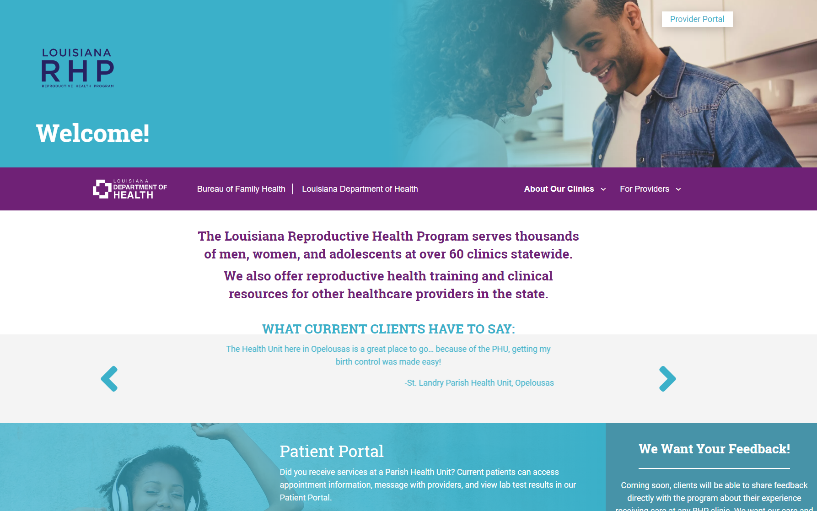
Louisiana RHP
www.healthychoicesla.org
Notes:
Slide 22
There are several ways a client can find out about the TelePrEP Services of Louisiana, but one of those ways is the Reproductive Health Program's website, which is where it links to the STD/HIV Program's website called Louisiana Health Hub.

Slide 23
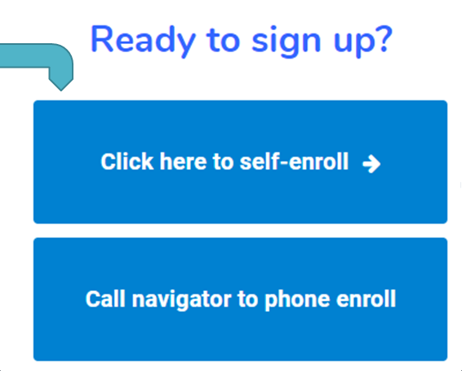
PrEP Information/Enroll in Program
www.louisianahealthhub.org
Notes:
Slide 23
This is a picture of the TelePrEP portion on Louisiana Health Hub.
The STD/HIV Program goes into a little more detail on TelePrEP Services:
What PrEP is;
How to effectively maintain a negative HIV status;
What telemedicine services involve; and
Allows the client to self-enroll, or if they want to speak with a live person, then they can call directly to the navigator.

Slide 24
How to Obtain TelePrEP Services
Referral to the TelePrEP program through website www.louisianahealthhub.org
Enroll: Self-enroll via website or client can discuss/enroll directly with TelePrEP Navigator
After client enrolls, PrEP Navigator provides one-on-one, “hands on” guidance and non-clinical support to individuals in need to access and fully engage in TelePrEP services.
Notes:
Slide 24
We've tried to make access to TelePrEP as easy as possible by using a hands-on approach with the PrEP Navigator.
When the client clicks "Self-Enroll or Call Navigator," the client fills out basic contact information so that the PrEP Navigator can then contact them within 24 hours. However, I can tell you that our PrEP Navigator is amazing, and he is usually calling the patient within 30 minutes.

Slide 25
TelePrEP Program Eligibility Requirements
1. Any HIV-negative adult 18 years of age or older
2. Medicaid insured, Medicaid Eligible, Privately Insured
3. Anyone who has access to email and a smartphone, tablet, or computer
Notes:
Slide 25
Part of the program's requirements include the client is 18 years of age or older; has a form of Medicaid or insurance; and has access to a computer, smartphone, tablet, some form so that they can have the telemedicine visits.

Slide 26
TelePrEP Navigator Role
An overview of the program
Preliminary PrEP, HIV/STD education
Review of financial assistance options and insurance plan considerations
Review of technology needed to collect copies of insurance, identification, and consent for services
Expectations of the TelePrEP program, the importance of committing to taking daily medication and completing follow-up lab tests
Review of platform to conduct visits
Assessment of potential barriers and facilitators
Lab testing procedure
Warm hand off to another referral source if patient does not qualify or chooses to discontinue intake process
Notes:
Slide 26
We have found that the PrEP Navigator to be an essential and vital part of our program, as they are the initial contact source for our clients.
They give an overview of the program requirements.
They verify insurance, identify any barriers to obtaining PrEP.
They provide a one-handoff referral to a local PrEP provider, if for some reason the patient would rather have a brick-and-mortar clinic to obtain services instead of doing it the telemedicine way. Also, if they don't meet our eligibility requirements for any reason, then we also provide them a local provider, so that they can still obtain services.

Slide 27
TelePrEP Services (slide 1 of 3)
Initial TelePrEP clinical visit:
Goal: To ensure responsiveness to client interest and need, and to promote timely access and engagement in the program.
May be performed before or after lab testing and/or before lab results are available.
Includes:
Full sexual history
Assess for any recent HIV exposure
Assess for acute viral syndrome
Conduct a medical history
Conduct a review of systems
Conduct a modified examination appropriate to telehealth
Further discuss any social-ecological barriers and facilitators identified by the TelePrEP Navigator
Ensure client understanding of risks, benefits, and commitments involved in the PrEP Program (medication adherence, regularity of lab and clinical visits)
TelePrEP visits may be conducted via:
Video application on smartphone, tablet or desktop/laptop
Phone audio
Notes:
Slide 27
Labs can be done before or after the initial clinical visit. If the clinician has labs before the visit, then of course they can go ahead and review the labs with the client.
Additional components of the visit include:
a full sexual history;
assessing for any recent HIV exposure, which would indicate a need for PEP before PrEP; and
assessing for any acute viral syndrome which may indicate new HIV acquisition.
We always review the medical history to make sure that there's no contraindications to PrEP; the review of systems; and a modified exam on telehealth indicators.
I would like to just give a shout-out, also, to Maine's and New Mexico's Title X Programs for assisting with the exam requirements for telehealth.

Slide 28
TelePrEP Services (slide 2 of 3)
Labs:
Third party labs are used based on patient's insurance, location, and preference.
LabCorp via Beacon online portal
Clinical Pathology Laboratories, Inc. (CPL) via fax
Quest Diagnostics via Quanum online portal
Frequency:
Labs ordered based on CDC guidance on PrEP monitoring
(https://www.cdc.gov/hiv/pdf/risk/prep/cdc-hiv-prep-guidelines-2017.pdf)
Notes:
Slide 28
Our labs are ordered according to the client's insurance requirements, preference, and location.
If their insurance requires them to use a certain lab, then we send the orders to that lab.
Currently, we're using LabCorp, Quest, and Clinical Pathology Labs, or CPL for short.
The labs are ordered by the clinician, and the frequency for testing follows CDC's guidance on PrEP monitoring. The link is shown, if you need those guidelines.

Slide 29
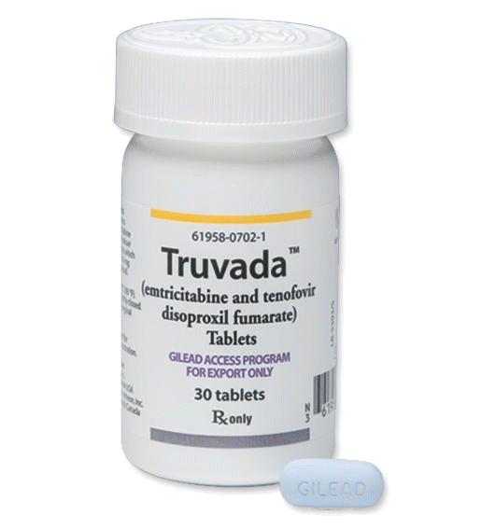
TelePrEP Services (slide 3 of 3)
Medication Ordering:
Provider e-prescribes Truvada to either special pharmacy required by insurance or OPH State Pharmacy
If OPH State Pharmacy is used, pharmacy will direct mails monthly Truvada medication to client at the address desired
Follow-up Calls/Visits:
TelePrEP Navigator calls 5-7 days after medication mailed from pharmacy to verify medications received and troubleshoot any issues
TelePrEP Navigator calls in 30 days to verify adherence, identify side effects, risk reduction counseling and next appointment follow-up
Clinician subsequent TelePrEP visits at 6 and 12 months or as needed
TelePrEP providers give schedule to Navigator in advance to allow scheduling for initial and subsequent visits
If client unable to participate during pre-scheduled provider availability, the provider is consulted for additional availability
Notes:
Slide 29
After the initial visit, the clinician will e-prescribe Truvada to either our state pharmacy, or to a specialty pharmacy, depending on the insurance requirements.
But if our state pharmacy is used, the pharmacist will directly mail monthly Truvada to an address of the patient's choice. It does not always have to be the address that they live at. It depends on where they would like to pick up that medication.
Critical to the program are follow-up calls made by the PrEP Navigator. The navigator develops a rapport with each patient, and can connect the client to an APRN rapidly if medical questions, or any issues or side effects arise.
After the state pharmacy mails the medication, the navigator will call the client about five to seven days later, just to ensure they received the medication, and they have started taking it.
At 30 days, the navigator calls them to ensure compliance with daily medication; side effects; and reinforce risk-reduction education; then the clinician will follow up with them at six months and 12 months.

Slide 30
Benefits of the TelePrEP Program
Have increased access to PrEP counseling, education, and prescription services in an easy, convenient way especially in rural areas of Louisiana
Eliminate traveling to see a provider
Participate in virtual visits during breaks from work without lost wages
Opportunity for the RHP to pilot Telemedicine in Louisiana in hopes of offering expanded telemedicine services for all Title X clients in all areas of Louisiana
Notes:
Slide 30
Some of the main benefits of the TelePrEP is that it has increased access to PrEP services in rural areas of Louisiana, where there are no PrEP providers.
It's also eliminated some travel issues that we have, where the client would usually have to travel into one of the bigger cities to have PrEP prescribed. Now it allows them to have a virtual visit on their lunch break, and they can still obtain the needed services.
Due to the success of this virtual platform and compliance of visits, we have very limited no-show visits.
Then we're looking also to expand telemedicine to other forms of Title X visits where a physical exam may not be required or needed.

Slide 31
Referrals to TelePrEP
Referrals can be from:
Parish Health Units (64 units in the state)
Community Business Organizations
Private Providers
Community Partners
Self-referral
All clients at the Parish Health Units have a full sexual health assessment at each visit. This provides opportunity to identify risk reduction strategies and identify clients who may be at risk for contracting HIV.
Notes:
Slide 31
To increase the referrals of clients for TelePrEP, we have had referrals from all regions of our Parish Health Units. We have 64 Health Units in the state.
We also have partnered with community business organizations, private providers, and community partners.
Patients can also self-enroll after they see advertising on billboards, park benches, buses, social media, which includes Facebook and Instagram.

Slide 32
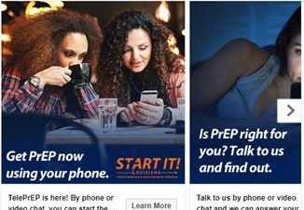
Public Awareness Campaign Facebook/Instagram
Pictured: Black Women and PrEP
Notes:
Slide 32
Here are some of the public health awareness campaigns for PrEP. You can see this on Facebook
Also, here is a picture of one of our central office staff with the Black Women and PrEP logo.

Slide 33
Challenges and Opportunities in the TelePrEP Program
Challenge #1: Louisiana Medicaid will not reimburse for Telemedicine visits unless originating and destination locations are in a clinic setting. | Opportunity #1: The STD/HIV and RHP in Louisiana are working with Medicaid to allow billing for services using Telemedicine when client is at location of their choice and using secure platform for confidential visit.
Challenge #2: Identify the elements of a TelePrEP Title X visit. | Opportunity #2: Ensure all elements of a Title X visit are covered in TelePrEP visits and move under the direction of the Title X Program.
Challenge #3: High cost of funding APRN medical clinics in low volume/rural locations in Louisiana. | Opportunity #3: To open Telemedicine option to all RH clients statewide.
Notes:
Slide 33
With TelePrEP, one of the main challenges is that Louisiana Medicaid does not reimburse for telemedicine services unless both the provider and the client are in a clinic setting.
If the client is using their smartphone from work or home, Medicaid will not reimburse for that visit.
Currently, we're working with Louisiana Medicaid to change this rule, and allow for the client to choose their location as long as the visit meets the current guidelines for documentation and confidentiality.
Another challenge with identifying the components of a TelePrEP visit is to include the documentation and what is involved in a physical exam.
The last challenge involves many rural areas in Louisiana, and the high cost for the provision of those services, due to limited clients.
Then you have to pay for the team to travel out to those rural locations.
We're actually looking at this as a pilot, so that we can open up telemedicine to all reproductive health clients where a hands-on exam may not be required or needed.

Slide 34
Lessons Learned from the TelePrEP Program
Consider creative methods for offering PrEP services that are tailored to your clients’ needs.
Establish strong partnerships with other programs within your health system to find ways to work together to offer services.
Have established processes in place for rolling out PrEP (e.g., workplan that lays out concrete goals and expectations, job descriptions, billing, workflows)
Never give UP!
Notes:
Slide 34
Lessons learned include to think outside the box and come up with creative methods for offering needed services that will meet our clients' needs.
If Medicaid won't reimburse, let's find out why, and let's strive to change those regulations.
We need to make sure that we have good, strong partnerships with other programs within our agency, so that we can collaborate to make these services available.
The last thing is to have in place policies and procedures, the job descriptions, along with the goals and expectations, before rolling out a program. That way, everybody is on the same page.
The last thing is never give up. If something needs to happen, then keep going until it happens.

Slide 35
Thank you!
Gail Gibson
RN, BSN, MN, CPM, FABC
Clinical Systems Team Lead
gail.gibson@la.gov
Tisha Reed
MA - Reproductive Health Program Manager
tisha.reed@la.gov
Tammy Bennett
RN, MSN, WHNP-C – Reproductive Health Statewide Nurse Consultant
tammy.bennett2@la.gov

Slide 36
PrEP in the Context of Gender Affirming Care
Planned Parenthood Southeastern Pennsylvania
Michelle Ama Dankwah MSN, CRNP
Notes:
Slide 36
Ama Dankwah, a nurse practitioner who provides PrEP and gender-affirming hormone therapy for patients at Planned Parenthood Southeastern Pennsylvania, or PPSP.
Topic: How PPSP integrated PrEP into its gender-affirming care services.

Slide 37
Planned Parenthood Southeastern Pennsylvania (PPSP)
PPSP is an affiliate of the Planned Parenthood Federation of America (PPFA) serving patients in Philadelphia, Chester, Montgomery, and Delaware counties via its 8 health centers - 2 of which currently provide Gender Affirming services.
Title X Patient Demographics, FY2019:
Total Users: 10,131
Age Groups: 15-17 (8%); 18-24 (32%); 25-29 (26%); 30-34 (15%); 35-39 (9%); 40-44 (5%); >45 (6%)
Race/Ethnicity: White (36%); Black/African-American (34%); Hispanic/Latino (19%); Asian (4%); Multi-Racial (3%); Other/Unknown (3%)
Income 100% FPL and below: 20% of total
Notes:
Slide 37
PPSP is an affiliate of the Planned Parenthood Federation of America, or PPFA, which serves, as its name suggests, patients in Pennsylvania's southeastern counties. However, of note, we do see our fair share of patients from neighboring states, such as New Jersey and Delaware.
PPSP provides services via its eight health centers, two of which currently provide gender-affirming care.
As you can see below, PPSP sees a large number of patients through the Title X Program--over 10,000 uninsured patients in fiscal year 2019 alone. Of those 10,000 patients, over 8,000 were female.
The majority of our Title X users range from about age 18 to 34, and are fairly diverse in terms of race and ethnicity; 20% of our Title X users live at or below the federal poverty level.

Slide 38
PrEP at PPSP
PrEP services initiated in July 2018.
91 patients in FY19
Pilot program heavily supported by Gilead, the makers of Truvada for PrEP, and the AIDS Activity Coordinating Office (AACO) who provided multiple in-services to center staff.
Prior to PPSP PrEP services, outside referrals were necessary and PrEP discussion was limited.
Currently, PrEP services at PPSP are offered on-site with no referral necessary.
Notes:
Slide 38
PPSP officially began offering PrEP services in July of 2018, initially piloting the service at one of our downtown Philadelphia locations.
Our program is actually just now celebrating its one-year anniversary, having served 91 patients in fiscal year 2019.
Our initiation of the program was heavily supported by Gilead, the makers of Truvada for PrEP, as well as the AIDS Activities Coordinating Office in Philadelphia, who both provided multiple in-services to center staff.
Prior to offering PrEP services at PPSP, patients had to be referred out to other health care centers or providers.
All patients were offered HIV screening, and counseled on safer sex, but PrEP was not always explicitly discussed, unless patients were clearly high risk. I believe that this was a bit of a disservice to our patients at the time, so I'm happy to now say that PrEP services at PPSP are offered on-site, and with no referral necessary.
Patients may either walk in, or schedule appointments online or via phone, to receive PrEP services.

Slide 39
The PrEP Process
The process for starting PrEP at PPSP is summarized as follows:
Patient schedules an appointment or walks in for PrEP services.
Initial intake is done by Center Assistant (CA) which includes:
Vitals, height, and weight
Allergies and current medications
Review of systems
Medical and surgical history
Sexual history
Baseline labs
HIV (4th generation), RPR, Hep B, Hep C as needed, Creatinine, all-site Gonorrhea and Chlamydia, and urine pregnancy test as indicated.
Notes:
Slide 39
Before discussing the integration of PrEP with gender-affirming care services, I would first like to provide a brief overview of the process of starting PrEP at PPSP.
As you can see listed here, after arriving for their scheduled or walk-in appointment, the patient is first seen by a Center Assistant, or CA, who completes the initial intake.
Of special importance in this intake are the sexual history questions, which help determine the patient's HIV and STI risk, and the baseline labs, which, per PPFA guidelines, must be received and found to be within normal limits prior to the prescription of PrEP.
Most lab results are received within four to seven days of being obtained. At this time, we do not offer same-day PrEP prescriptions.

Slide 40
The PrEP Process (Cont’d)
After CA intake is completed, patient is then evaluated by clinician (MD, NP, PA).
Clinician evaluates patient to determine if PrEP is appropriate and if any medical contraindications or precautions exist.
Counseling on:
Benefits, risks, and side effects of PrEP.
Importance of strict medication adherence
Continued safer sex practices, and
Maintaining quarterly follow-up appointments for HIV re-screening.
Determination of insurance coverage and/or need for financial assistance.
PrEP is then electronically prescribed (90 day supply only) if labs WNL.
Patient returns quarterly (every 3 months) for repeat labs and evaluation for risks and signs/symptoms of possible HIV infection.
Notes:
Slide 40
After the CA intake is completed, the patient is then seen by the clinician, who determines the patient's medical eligibility for PrEP, and provides counseling on risks, benefits, side effects, importance of medication adherence, and continued safer sex practices.
After counseling and medical evaluation, the patient is then discharged, with PrEP electronically prescribed to the patient's pharmacy of choice within seven days, as long as all relevant labs are normal.
Of note, per our guidelines, HIV labs for PrEP are only valid for seven days after the date of collection. If PrEP is not started at that time, unfortunately, labs must be repeated.
After prescription, the patient then returns every three months for re-screening to continue PrEP.

Slide 41
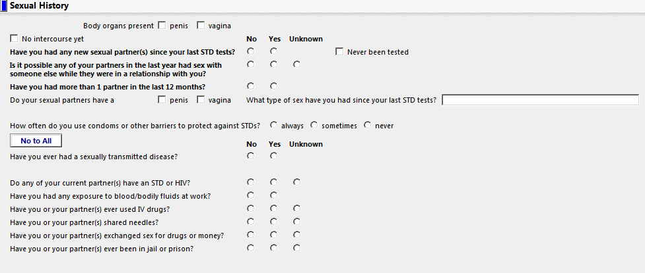
The PrEP Process – Utilizing the EMR
The sexual history as obtained by the CA and verified by the Clinician is crucial to identifying patients who may benefit from PrEP.
Notes:
Slide 41
Here, you can see an example of the sexual history questionnaire used. The history is specific to body parts of the patient, body parts of the partners, and the types of sex engaged in, which helps allow for more accurate assessment of risk.
Additionally, other questions, such as "Is it possible any of your partners in the last year had sex with someone else while they were in a relationship with you?" helps flag patients who may otherwise have been considered lower risk.

Slide 42
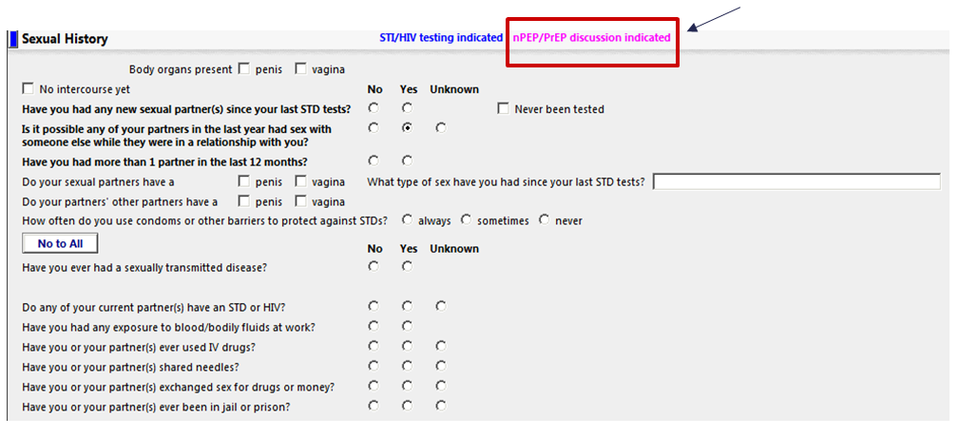
The PrEP Process– Utilizing the EMR (Cont’d)
As such, even patients who did not initially present for PrEP are offered. If accepted, labs are drawn and patient to return within 7 days for counseling and to initiate PrEP.
Notes:
Slide 42
Given that nearly all patients at PPSP are asked about sexual history, this flag is helpful in even targeting patients who did not initially present for PrEP services.
This is especially applicable to our gender-affirming care patients, who may or may not have come in with PrEP on their radar.
You can see, outlined here in red, the indicator light or flag that may indicate that someone should be on PrEP, or at least offered it.

Slide 43
Integrating Gender-Affirming Care and PrEP
PPSP began offering Gender-Affirming (GA) care in 2017.
494 patients in FY19
PrEP integration timeline:
Pre-PrEP: Standard HIV/STI risk assessment and counseling. PrEP referral as needed.
Post-PrEP: Transfeminine individuals, POC, and sex workers primarily offered.
EMR upgrade to sexual history questionnaire - more inclusive language allowing for better risk assessment.
More generalized inclusion criteria for offering PrEP - most patients offered.
RTC within 7 days of labs/GA visit for counseling to initiate PrEP due to time constraints.
Notes:
Slide 43
PPSP began offering gender-affirming services in summer of 2017. Like PrEP, the program is still relatively new. However, it has grown rapidly.
As of fiscal year 2019, we saw 494 patients for initial gender-affirming visits at our two participating centers.
In integrating PrEP into gender-affirming care services at PPSP, we were flying by the seat of our pants. We didn't have a specific plan or road map, and integration wasn't exactly always purposeful.
In some ways, it seemed to happen organically over time, through a bit of trial and error.
Therefore, it is easiest to talk about the integration process as a timeline, as opposed to specific steps.
Prior to officially offering PrEP at PPSP, all patients, including those receiving gender-affirming care, were provided with standard HIV and STI risk-assessment and counseling. However, PrEP referrals were typically only provided as indicated by either patient interest, or by exceptionally high risk level, such as those with HIV-positive partners.
Once PrEP finally was available at PPSP, we quickly became comfortable with offering it, especially to those in statistically-known higher-risk groups. In the context of gender-affirming care, that may have meant transfeminine folks, transgender persons of color, and transgender sex workers.
However, that obviously neglects a sizable amount of potential at-risk individuals, especially those who don't fit neatly into those categories, such as folks who are transmasculine, or even folks who are white. Clearly, our risk assessment for our trans patients at the time was lacking.
Fortunately, in a lot of ways, this issue was actually rectified by continued staff education, as well as by a subsequent upgrade of our electronic medical records system. Prior to the upgrade, the EMR, which helps facilitate the majority of our visits, had very limited ways to truly assess the nuances of a patient's sexual behaviors.
For example, patients may have been asked if they had sex with men, women, or a very broad, non-specific transgender category. With the upgrade, patients were now being assessed on what specific body parts they had, what specific body parts their partners have, and what specific kinds of sex they were having.
This was in addition to standard questions, like the number of partners, and condom usage. But having this more accurate information on the who and the how of how our patients were having sex allowed for more accurate assessment of our patients' risk for HIV acquisition.
This helped fill gaps in our previous strategy.
For instance, it is a well-known fact that anal sex is riskier than oral sex, in terms of HIV transmission.
As such, a transman who engages exclusively in receptive anal sex with male partners may actually be at a higher risk for HIV than a transwoman who only practices oral sex with female partners.
With our previous strategies, that transman may not have been offered PrEP.
Thus, the EMR upgrade now prompts us to discover and target patients who are candidates for PrEP even more effectively.
It also allows us to more easily explain a patient's specific personal risk factors back to them, as well. Of course, especially with gender-affirming care, talking in terms of specifics helps eliminate any awkward confusion for both the patient and the provider.
Even more recently, another subsequent EMR update, as discussed in that previous slide, flags patients as PrEP candidates for additional risk factors.
For example, if their partners are non-monogamous. This really helps to cast a wider net, and change our thinking more liberally on who should be offered PrEP.
I'm happy to say that now most patients at PPSP are offered PrEP if they engage in risky sexual behaviors, regardless of their gender identity or sexual orientation. It is my hope that being able to offer PrEP so universally may actually be helpful in reducing some of the unfortunate stigma surrounding PrEP in the LGBTQ community.
Now that patients receiving gender-affirming services are being adequately risk-assessed and offered PrEP, the next hurdle was how to actually integrate it into their care.
Gender-affirming initial visits at PPSP are meaty visits, where patients can spend upwards of two hours meeting with a social worker, center assistant, and then a clinician.
It is often too difficult to then incorporate PrEP counseling on top of this, not only due to time constraints, but so as to not overwhelm the patient with too much information.
As such, what is typically done is that the patient who does end up desiring PrEP, PrEP labs are drawn at the gender-affirming initial visit, along with any of the other labs associated with their gender-affirming care, with the plan for the patient to then return within that seven-day timeframe for PrEP counseling and prescription.
With follow-up gender-affirming visits, which are much, much shorter, PrEP counseling can often be done the same day, with subsequent e-prescribing after receipt of labs, which eliminates the need for a return visit.

Slide 44
Challenges and Opportunities
Challenge #1:
Education and Training
Challenge #2:
Time
Challenge #3:
Interest
Opportunities to overcome challenge #1:
Gilead presentations (pre- and post-initiation)
Support from AIDS Activities Coordinating Office
Clinician phone conferences
Pilot lead
PPFA Medical Standards and Guidelines
“Cheat sheets”
Opportunities to overcome challenge #2:
Initial labs and separate counseling appointments
Sexual history questionnaire as a “heads up”
Opportunities to overcome challenge #3:
Accurate communication of risk
Destigmatization
Ease of initiation
Notes:
Slide 44
Now that we've discussed the integration of PrEP into gender-affirming care services, let's discuss some of the challenges and opportunities we have faced in doing so.
Naturally, in implementing any new program, educating and training staff is always going to be the first hurdle. PPSP was very, very fortunate in that our staff education process was supported in a multitude of ways, such as by Gilead and the AIDS Activities Coordinating Office in Philadelphia, who provided multiple trainings and education materials.
We were also supported by the explicit medical standards and guidelines put forth by PPFA, as well as numerous cheat sheets posted around the clinic with helpful reminders. We also did have regular clinician conference calls, as well as a pilot lead clinician to help ease initiation and troubleshoot any issues we ran into.
Our second, and possibly biggest challenge, has been time. As stated before, integrating PrEP with gender-affirming initial visits is nearly impossible, given time constraints.
So far, having patients have labs drawn, and then return for counseling, has been our way around this. It seems to work, but without stats to verify, it's hard to know if we're losing patients who may not be as highly motivated to return for PrEP services.
The updated sexual history questionnaire is also helpful with regards to time.
First off, it provides a structured and brief tool to accurately assess risk in a timely fashion.
Secondly, if a patient is flagged, the Center Assistant can then begin the conversation surrounding PrEP, by providing PrEP education materials that the clinician can then more easily build upon. This is opposed to perhaps getting caught off guard at the end of an already long visit with new info that may indicate a patient is at risk for HIV.
The third challenge we face is interest.
Some patients are really easy, in that they come in to gender-affirming care knowing that they would like to start PrEP.
However, for those who are unsure about it, or maybe were even unaware of PrEP to begin with, cultivating interest can sometimes be a challenge.
Sometimes, that challenge is due to simple misunderstanding, such as, believe it or not, some patients believing Truvada will actually give them HIV.
Other times, though, it can be due to stigma. For example, those that are aware of Truvada's use in HIV treatment, as well, may be wary of other people assuming they have HIV, since they would be taking HIV medication.
Breaking that stigma can be difficult, but being able to normalize PrEP, like, "Hey, PrEP is something we're offering nearly everyone, and we thought you might be a good candidate, too, based on some of your answers to the sexual history form," can be a bit helpful in destigmatization. In that way, patients know that they are being offered PrEP because of their specific sexual behaviors, and are not just being targeted because of their gender-identity.
Communicating ease of starting and continuing PrEP is also important for fostering interest. Like, "Did you know that there's a once-daily pill that can reduce your risk of getting HIV through sex? We can probably even get you started within the week." Being able to do that is another way we can and have cultivated interest.

Slide 45
Lessons Learned…
External support
Gilead is an invaluable resource for information, financial assistance for patients, and other issues
AIDS Activities Coordinating Office (AACO) of Philadelphia Dept of Public Health and Erika Aaron, CRNP were fantastic navigators and experts pre- and post-initiation
Ease of initiation is crucial to success
E-prescribing
Separate appointments and pending labs may prove to be a potential barrier
Appointment availability
Stigma is a very real barrier to uptake in some patients
Education is key
Metrics are necessary to evaluate impact
Notes:
Slide 45
Through this entire process, the staff at PPSP has learned many valuable lessons:
Outside resources and supports are invaluable to a successful program.
We've also learned that ease of initiation is definitely going to be crucial to success, and that stigma is unfortunately a real and potential barrier to uptake.
Staff and patient education is always going to be key. That's always helped by technology advances, as well.
As with everything, metrics will be necessary over time to really evaluate the impact and success of our program.

Slide 46
For More Information...
Michelle Ama Dankwah, CRNP
Email address: michelle.dankwah@ppsp.org
215-351-5560
You may also visit PPSP at: https://www.plannedparenthood.org/planned-parenthood-southeastern-pennsylvania

Slide 47
QUESTIONS?
Notes:
Are there any questions for the presenters?

