Slide 1
Evidence-Based Strategies for Increasing Chlamydia and Gonorrhea Screening in Title X Settings
May 9, 2019

Slide 2
Holly Howard, MPH
Director, National Quality Improvement Center
Notes:
Holly Howard is the director of the CDC funded National Quality Improvement Center, where she works with a team of subject matter experts to design, conduct, and evaluate clinical quality improvement interventions and resources focused on supporting providers in implementing STD clinical care best practices.
Holly additionally serves as the Chief of Health Promotion and Health Care Quality Improvement at the California Department of Public Health STD Control Branch where she has served for 18 years including over 10 years as the state's infertility prevention project coordinator. Over the last five years, Holly has served as the program director for a chlamydia screening quality improvement imitative in California.
Jennifer Kawatu, a women's health nurse by training, has worked for over two decades developing training and resources for Title X and serves as the clinical quality training consultant for the Family Planning National Training Center.

Slide 3
Today’s Objectives
By the end of the webinar, you will be able to:
Describe the current rates and trends of chlamydia and gonorrhea infections and screening
Explain CDC’s screening, treatment, and management recommendations
Describe evidence-based implementation strategies for increasing screening
Identify three FPNTC tools that are available to support Title X grantees in increasing screening in their networks
Notes:
This presentation covers best practices and implementation strategies for chlamydia and gonorrhea screening in Title X settings, including:
Highlights related to national rates and trends in chlamydia and gonorrhea infections and screening;
CDC's screening, treatment and management recommendations for both infections;
Evidence-based implementation strategies for increasing screening rates; and
Tools developed by the FPNTC to support Title X grantees in increasing screening in their networks.

Slide 4
Chlamydia rates are rising
Rates of Reported Cases by Sex
Figure 1. Chlamydia — Rates of Reported Cases by Sex, United States, 2000–2017, Centers for Disease Control and Prevention, 2017 Sexually Transmitted Diseases Surveillance Report
Notes:
To set the stage, it's no secret that we are seeing rising chlamydia rates across the country. These rates are increasing among both men and women. In some areas like my home state of California, these rates are higher than they have been during any time within the last 25 years.
Source:
Centers for Disease Control and Prevention. Sexually Transmitted Disease Surveillance 2017. Atlanta: U.S. Department of Health and Human Services; 2018. https://www.cdc.gov/std/stats17/2017-STD-Surveillance-Report_CDC-clearance-9.10.18.pdf.

Slide 5
While some areas have higher rates of chlamydia…
Rates of Reported Cases by County
Figure 4. Chlamydia — Rates of Reported Cases by County, United States, 2000–2017, Centers for Disease Control and Prevention, 2017 Sexually Transmitted Diseases Surveillance Report
Notes:
This slide shows the aggregate rates of reported chlamydia cases between 2000 and 2017 by county with the light yellow color representing the lowest rates and the dark blue color representing the highest rates of chlamydia infection, which highlights that there are geographic disparities in these rates.
Source:
Centers for Disease Control and Prevention. Sexually Transmitted Disease Surveillance 2017. Atlanta: U.S. Department of Health and Human Services; 2018.
https://www.cdc.gov/std/stats17/2017-STD-Surveillance-Report_CDC-clearance-9.10.18.pdf.

Slide 6
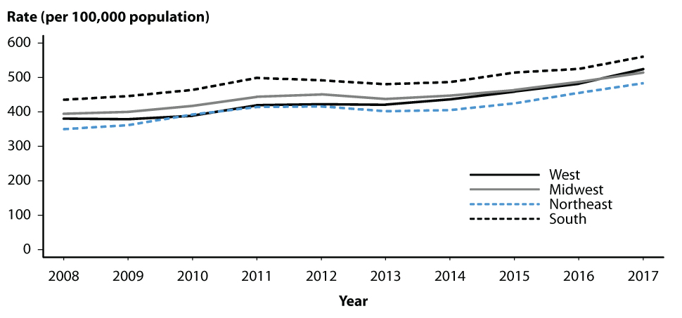
…chlamydia rates are rising everywhere
Rates of Reported Cases by Region
Figure 2. Chlamydia — Rates of Reported Cases by Region, United States, 2008-2017
2017 Sexually Transmitted Diseases Surveillance Report
Notes:
But while some areas of the country experience higher rates of chlamydia, chlamydia rates are rising everywhere including within all four major regions of the country.
Source:
Centers for Disease Control and Prevention. Sexually Transmitted Disease Surveillance 2017. Atlanta: U.S. Department of Health and Human Services; 2018.
https://www.cdc.gov/std/stats17/2017-STD-Surveillance-Report_CDC-clearance-9.10.18.pdf.

Slide 7
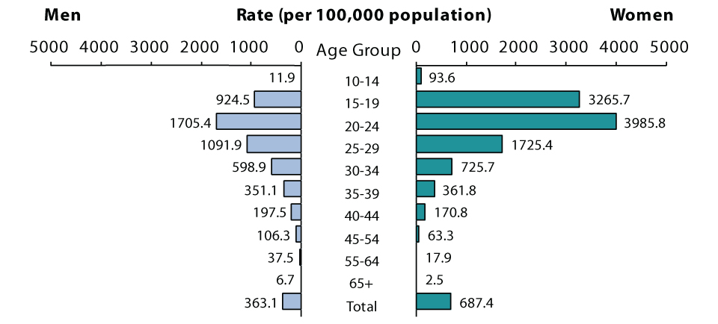
Chlamydia disparities
Rates of Reported Cases by Age Group and Sex, 2017
Figure 5. Chlamydia — Rates of Reported Cases by Age Group and Sex, United States, 2017
2017 Sexually Transmitted Diseases Report
Notes:
Chlamydia is also not an equal opportunity player when it comes to age and sex.
Source:
Centers for Disease Control and Prevention. Sexually Transmitted Disease Surveillance 2017. Atlanta: U.S. Department of Health and Human Services; 2018.
https://www.cdc.gov/std/stats17/2017-STD-Surveillance-Report_CDC-clearance-9.10.18.pdf.

Slide 8
Chlamydia disparities
Rates of Reported Cases by Age Group and Sex, 2017
Adolescents and young adult women are most impacted
Figure 5. Chlamydia — Rates of Reported Cases by Age Group and Sex, United States, 2017
2017 Sexually Transmitted Diseases Report
Notes:
Young people are most impacted by these skyrocketing chlamydia rates and especially adolescent girls and young women, which you can see by looking at the incredible disparities in rates, accented within the pink box on the CDC graphic, which is showing U.S. rates of reported chlamydia cases, stratified by sex with men on the left in light blue and women on the right in green, and by age group with the ages getting older as you move down the graph.
It is likely that since chlamydia often presents without clinical signs or symptoms and because we have clear screening recommendations specifically for women, reported cases such as those represented in this CDC graphic may reflect a disproportionate number of chlamydia infections identified through screening programs offered primarily to women.
However, there is research evidence that demonstrates higher incidents of chlamydia among females, even when both sexes are screened universally and we have substantial evidence that demonstrates that chlamydia infection is strongly associated with younger age.
Source:
Centers for Disease Control and Prevention. Sexually Transmitted Disease Surveillance 2017. Atlanta: U.S. Department of Health and Human Services; 2018.
https://www.cdc.gov/std/stats17/2017-STD-Surveillance-Report_CDC-clearance-9.10.18.pdf.

Slide 9
Chlamydia disparities
Rates of Reported Cases by Race and Hispanic Ethnicity
Figure 8. Chlamydia — Rates of Reported Cases by Race and Hispanic Ethnicity, United States, 2013–2017, 2017 Sexually Transmitted Diseases Report
Notes:
There is also great disparity in rates of chlamydia infections across races and ethnicities, with Black and African American communities experiencing a much higher burden of disease compared to other racial ethnic groups, a trend that has not been changing over time.
Source:
Centers for Disease Control and Prevention. Sexually Transmitted Disease Surveillance 2017. Atlanta: U.S. Department of Health and Human Services; 2018.
https://www.cdc.gov/std/stats17/2017-STD-Surveillance-Report_CDC-clearance-9.10.18.pdf.

Slide 10
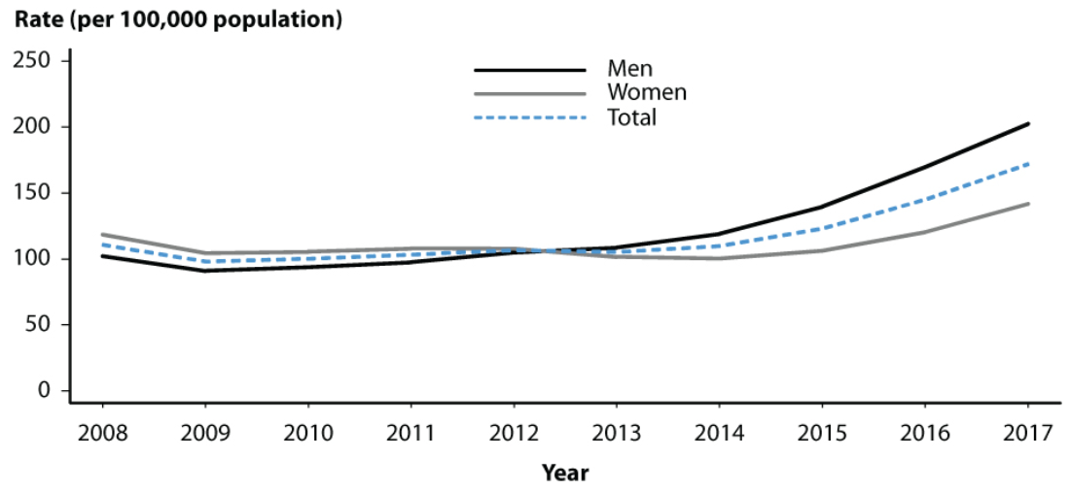
Gonorrhea rates are also rising…
Rates of Reported Gonorrhea Cases by Sex
Figure 18. Gonorrhea — Rates of Reported Cases by Sex, United States, 2008–2017, 2017 Sexually Transmitted Diseases Report
Notes:
Gonorrhea rates are also rising among both men and women but with this reversed trend compared to chlamydia when looking at rates by sex.
This CDC graph shows reported gonorrhea cases from 2008 through 2017
Rates of reported cases among men surpass those among women some time in 2012.
Reported cases in males are rising at a steeper rate than females.
Gonorrhea tends to be more symptomatic in men versus women.
Many of these reported cases among men are likely a reflection of diagnostic testing among men with symptoms.
Gonorrhea cases among men also disproportionally represent men who have sex with men.
Source:
Centers for Disease Control and Prevention. Sexually Transmitted Disease Surveillance 2017. Atlanta: U.S. Department of Health and Human Services; 2018.
https://www.cdc.gov/std/stats17/2017-STD-Surveillance-Report_CDC-clearance-9.10.18.pdf.

Slide 11
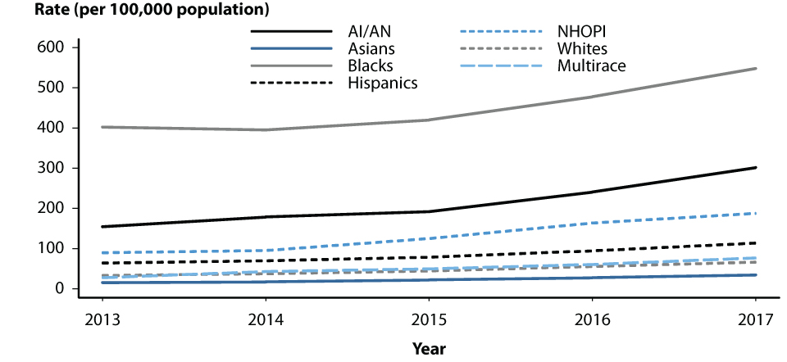
…and disparities in gonorrhea prevalence persist
Rates of Reported Gonorrhea Cases by Race and Ethnicity
Figure 22. Gonorrhea — Rates of Reported Cases by Race and Hispanic Ethnicity, United States, 2013–2017
Notes:
And we see the same disparities in rates of gonorrhea among racial ethnic groups as we saw with chlamydia with much higher reported rates among Blacks and African Americans. So while STD rates are surging everywhere, the burden of these infections are disproportionately impacting different communities and populations.
Source:
Centers for Disease Control and Prevention. Sexually Transmitted Disease Surveillance 2017. Atlanta: U.S. Department of Health and Human Services; 2018.
https://www.cdc.gov/std/stats17/2017-STD-Surveillance-Report_CDC-clearance-9.10.18.pdf.

Slide 12
Meet Jade
Jade is a 22-year-old female student at the local technical college. She comes to your clinic as a walk-in for contraception. She is started on Depo Provera using “Quick Start” and is encouraged to come back at a later date for an exam and labs.
Notes:
To put things into context, meet Jade. Jade is a 22 year old woman and student at the local technical college in your community. She comes into your clinic as a walk-in for contraception. She's started on Depo Provera using Quick Start and is encouraged to come back at a later date for a full well woman exam and labs.
As we go through this talk today, let's think about Jade and many patients like her. And if we're missing opportunities to best serve them.

Slide 13
Why is chlamydia screening important?
Most common reportable communicable disease
Curable bacterial STI
Highest reported rates are among adolescent + young adult females
(15-24 years)
Infection usually asymptomatic + can lead to serious health outcomes
Notes:
Back to chlamydia, why does it matter? Why is chlamydia screening important? Chlamydia continues to be the most commonly reported national notifiable disease in the United States by far with 1.7 chlamydia infections reported to CDC in 2017 and climbing each year.
It is not just the most commonly reported STD but wins the award over any notifiable diseases reported overall. Can you guess what the second most commonly reported notifiable disease is in the nation? Gonorrhea.
Plus, we know this is an underestimate as a large number of chlamydia and also gonorrhea cases are not reported because most people with these infections do not have symptoms and do not seek testing. Additionally, we should note that the population most commonly served by your Title X networks, adolescents and young adult women aged 15 to 24, have the highest chlamydia rates. Also, chlamydia is an easily and inexpensively curable bacterial infection. If we can identify these infections, we can quickly and effectively treat them.
But because the vast majority of chlamydia infections are asymptomatic and yet still can silently progress to more severe health outcomes, routine screening is considered the cornerstone in preventing chlamydia related adverse health outcomes and slowing the rising rates of infection.

Slide 14
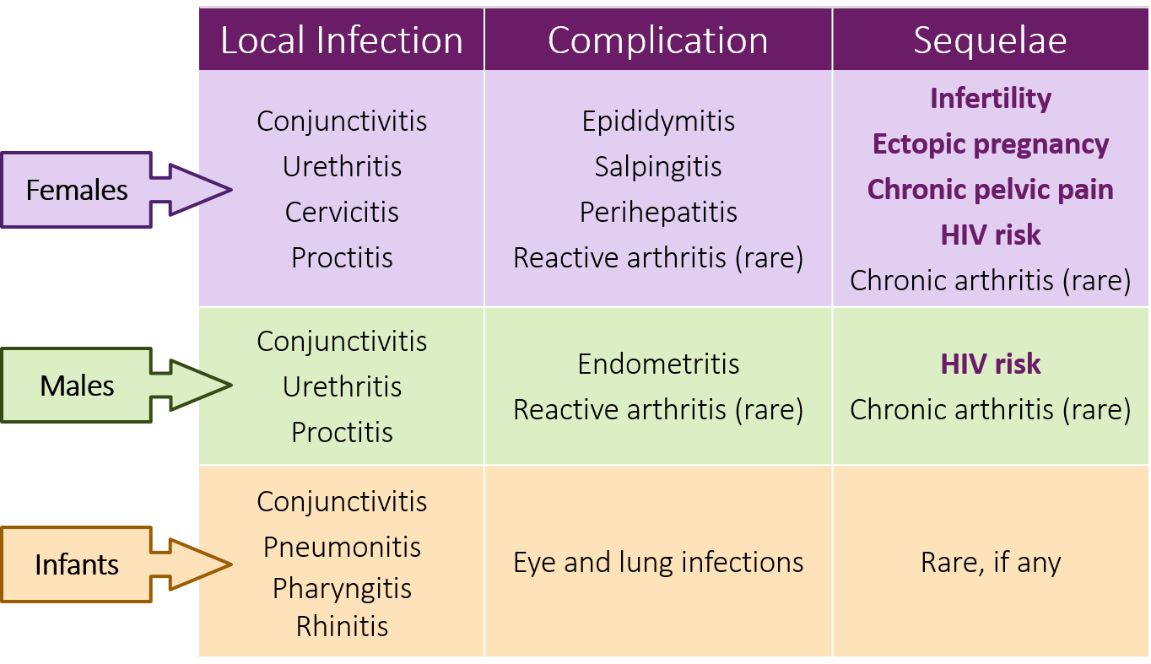
Chlamydia and gonorrhea can cause serious adverse outcomes
Notes:
What are the serious adverse health outcomes we are concerned about with chlamydia? Women infected with chlamydia or gonorrhea can develop Pelvic Inflammatory Disease or PID which in turn can lead to reproductive system morbidity such as tubal factor infertility, ectopic pregnancy and chronic pelvic pain. Symptomatic PID occurs in 10 to 15% of females with unrelated chlamydia.
Tubal scarring from PID can cause infertility in 20% of women. Ectopic pregnancy in 9% and chronic pelvic pain in 18%. And chlamydia and gonorrhea infections are also both known to increase the risk of HIV transmission amongst females and males.
Women infected with C. trachomatis or N. gonorrhoeae can develop PID, which, in turn, can lead to reproductive system morbidity such as ectopic pregnancy and tubal factor infertility. Symptomatic PID occurs in 10%–15% of females with untreated chlamydia^{1, 2}. Among women with PID, tubal scarring can cause infertility in 20% of women, ectopic pregnancy in 9%, and chronic pelvic pain in 18%³.
In women, untreated chlamydia can spread into the uterus or fallopian tubes and cause pelvic inflammatory disease (PID). Symptomatic PID occurs in about 10 to 15 percent of women with untreated chlamydia.^{2, 3} However, chlamydia can also cause subclinical inflammation of the upper genital tract (“subclinical PID”). Both acute and subclinical PID can cause permanent damage to the fallopian tubes, uterus, and surrounding tissues.
The vague symptoms associated with chlamydial and gonococcal PID cause 85% of women to delay seeking medical care, thereby increasing the risk of infertility and ectopic pregnancy.^{4, 5}
Untreated chlamydia may increase a person’s chances of acquiring or transmitting HIV—the virus that causes AIDS.⁶
About 80%–90% of chlamydial infections and up to 80% of gonococcal infections in women are asymptomatic. These infections are detected primarily through screening.⁷ The symptoms associated with PID are vague so 85% of women with PID delay seeking medical care, thereby increasing the risk for infertility and ectopic pregnancy.⁸ Data from a randomized controlled trial of chlamydia screening in a managed care setting suggest that such screening programs can reduce the incidence of PID by as much as 60%.⁹
End Notes:
¹Haggerty CL, Gottlieb SL, Taylor BD, Low N, Xu F, Ness RB. Risk of sequelae after Chlamydia trachomatis genital infection in women. The Journal of infectious diseases 2010;201 Suppl 2:S134–55.
²Oakeshott P, Kerry S, Aghaizu A, et al. Randomised controlled trial of screening for Chlamydia trachomatis to prevent pelvic inflammatory disease: the POPI (prevention of pelvic infection) trial. BMJ (Clinical Research ed) 2010;340:c1642.
³http://www.cdc.gov/std/pregnancy/STDFact-Pregnancy.htm
⁴Center for Disease Control and Prevention. STD Surveillance, 2011: Women and Infants. http://www.cdc.gov/std/stats/womenandinf.htm
⁵Hills SD, Wasserheit JN. Screening for Chlamydia—A Key to The Prevention of Pelvic Inflammatory Disease. New England Journal of Medicine. 1996;334(21):1399–1401.
⁶Fleming DT, Wasserheit JN. From epidemiological synergy to public health policy and practice: the contribution of other sexually transmitted diseases to sexual transmission of HIV infection. Sexually Transmitted Infections 1999;75:3-17.
⁷Centers for Disease Control and Prevention. Sexually Transmitted Disease Surveillance 2011.
https://www.cdc.gov/std/stats/archive/Surv2011.pdf.
⁸Ibid
⁹Ibid

Slide 15
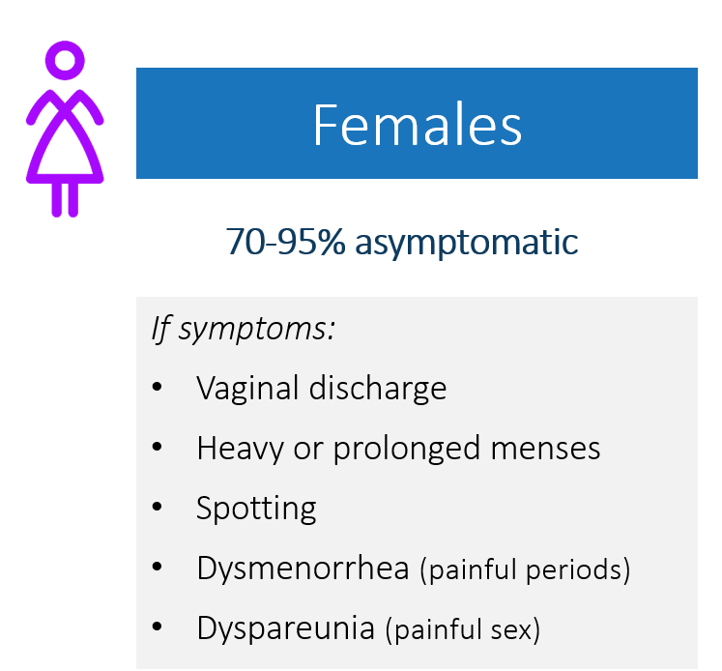
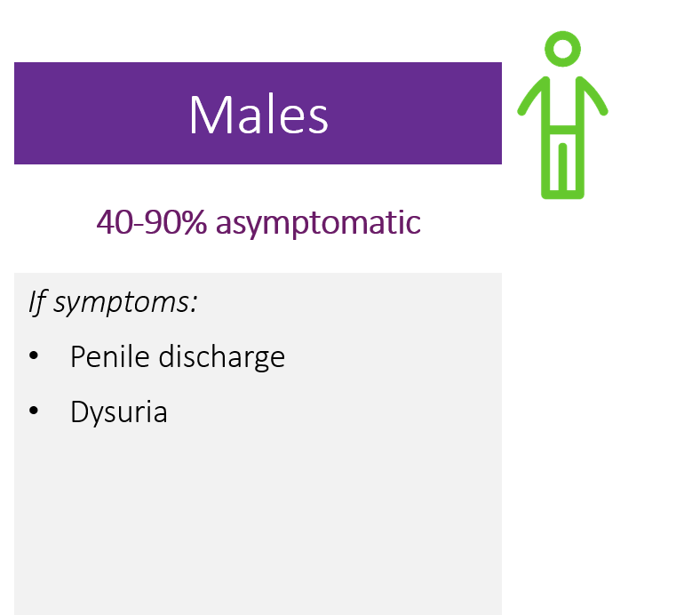
Chlamydia is most often asymptomatic
Notes:
Chlamydia is most often asymptomatic but if girls and women do have symptoms, they may include vaginal discharge, heavy or prolonged periods, spotting in between periods, painful periods or pain with sexual intercourse. Boys and men might experience penile discharge or report painful urination. But we know from research that an estimated 70 to 95% of chlamydia infections in females are asymptomatic and 40 to 90% of infections in males are asymptomatic.
Estimates of the proportion of chlamydia-infected people who develop symptoms vary by setting and study methodology; two published studies that incorporated modeling techniques to address limitations of point prevalence surveys estimated that only about 10% of men and 5–30% of women with laboratory-confirmed chlamydia infection develop symptoms.¹
Based on this information, up to 90% of males are asymptomatic and up to 70–95% of females are asymptomatic.
End Notes:
¹Centers for Disease Control and Prevention. Chlamydia Detailed Fact Sheet.
https://www.cdc.gov/std/chlamydia/stdfact-chlamydia-detailed.htm

Slide 16
Routine screening is recommended by national experts
American Academy of Pediatrics (AAP) – Bright Futures | all sexually active youth annually
American Academy of Family Physicians (AAFP) | sexually active females ≤24 yrs. annually & others at increased risk
American Congress of Obstetricians & Gynecologists (ACOG) | sexually active females ≤24 yrs. annually & others at increased risk
Centers for Disease Control & Prevention (CDC) | sexually active females ≤24 yrs. annually adolescent males in high prevalence areas
US Preventive Services Task Force (USPSTF) | sexually active females ≤24 yrs. annually & others at increased risk
AAP Performing Preventive Services: A Bright Futures Handbook (pg. 147)
CDC 2015 STD Screening Guidelines
USPSTF Recommendations for STI Screening
Notes:
For all of these reasons, routine screening for chlamydia is recommended by numerous national medical and public health bodies, including the American Academy of Pediatrics, American Academy of Family Physicians, ACOG, CDC and the US Preventive Services Task Force. Many of these recommendations are aligned, recommending routine, at least annual screening for all sexually active girls and women aged 24 and under or older if they are at increased risk. And boys and men in high prevalence settings or at increased risk.
The American Academy of Pediatrics (AAP) – Bright Futures recommends all sexually active youth annually.
The American Academy of Family Physicians (AAFP) recommends sexually active females ≤24 yrs. annually & others at increased risk.
The American Congress of Obstetricians & Gynecologists (ACOG) recommends sexually active females ≤24 yrs. annually & others at increased risk.
The Centers for Disease Control & Prevention (CDC) recommends sexually active females ≤24 yrs. annually, and adolescent males in high prevalence areas.
The US Preventive Services Task Force (USPSTF) recommends sexually active females ≤24 yrs. annually & others at increased risk.
Sources:
Tanski, S, Garfunkel, LC, Duncan, PM, and Weitzman, M, eds. Performing Preventive Services: A Bright Futures Handbook. American Academy of Pediatrics.
https://brightfutures.aap.org/materials-and-tools/PerfPrevServ/Pages/default.aspx.
Centers for Disease Control and Prevention. Screening Recommendations Referenced in the 2015 STD Treatment Guidelines and Original Recommendation Sources. https://www.cdc.gov/std/tg2015/screening-recs-2015-std-tx-guidelines.pdf.
U. S. Preventive Services Task Force. Final Recommendation Statement: Chlamydia and Gonorrhea Screening. https://www.uspreventiveservicestaskforce.org/Page/Document/RecommendationStatementFinal/chlamydia-and-gonorrhea-screening

Slide 17
Jade returns
Jade comes every 3 months for a Depo shot – although she is late one month and has a pregnancy test done. It is negative and she gets another shot. She is again encouraged to come in for “an annual exam.”
Notes:
Returning to Jade, Jade is coming into your clinic regularly now, every three months for her Depo shot. One month she comes late and has a pregnancy test done as a precaution. It's negative and so she gets another shot. Again, she's encouraged to come back for an annual exam.
While we are doing a pretty good job at helping to take care of Jade's contraception needs, I'm concerned about some missed opportunities in her comprehensive sexual health care and the potential implications these care gaps may have for Jade, including some that put her future reproductive health at risk.

Slide 18
Chlamydia screening rates in Title X need improvement
% of females age <25 tested for CT in Title X sites
Source: 2017 FPAR
Notes:
This slide shows a trend line for the percent of females under age 25 who are tested for chlamydia in Title X sites on average across the country from 2007 through 2017. These are FPAR data.
Since these are Family Planning clients and therefore, we can assume they are sexually active.
And they are being seen in the Title X networks setting that are already clearly committed to providing quality sexual and reproductive health care; yet, there are still significant gaps in chlamydia screening rates without very much improvement over time.
Source:
Fowler, CL, Gable, J, Wang, J, and Lasater, B. (2018, August). Family Planning Annual Report: 2017 National Summary. Research Triangle Park, NC: RTI International.
https://www.hhs.gov/opa/sites/default/files/title-x-fpar-2017-national-summary.pdf.

Slide 19
Title X chlamydia screening rates vary by region
% of females age <25 tested for CT in Title X sites, by Region
Source: 2017 FPAR
Notes:
Title X settings do vary somewhat by region. Most regions fall within the national average. There are a few that fall significantly lower and one that performs significantly better than average but still has room to improve.
Source:
Fowler, CL, Gable, J, Wang, J, and Lasater, B. (2018, August). Family Planning Annual Report: 2017 National Summary. Research Triangle Park, NC: RTI International.
https://www.hhs.gov/opa/sites/default/files/title-x-fpar-2017-national-summary.pdf.

Slide 20
Jade has PID
Jade returns to the clinic complaining about her vaginal discharge and pelvic pain. During a pelvic exam, the nurse practitioner sees signs of infection and is concerned about possible pelvic inflammatory disease (PID).
Could this have been prevented?
Notes:
Hi Jade, it's good to see you again. I'm so sorry you're experiencing vaginal discharge and pelvic pain today. Our nurse practitioner will perform a pelvic exam to see what she can determine. The NP detects some ooze from Jade's os and diagnoses cervicitis. Jade also shows signs on exam of cervical motion tenderness. Oh no, it looks like Jade may have PID. Could this have been prevented?

Slide 21
Who should be screened for chlamydia?
Women
<25 yrs. annually* if ever sexually active
≥25 yrs. if at risk
All pregnant <25 yrs.
Pregnant ≥25 yrs. if at risk
Men who have sex with women
High prevalence settings
Men who have sex with men (MSM)
At least annually*
Exposed sites: genital, rectal, pharyngeal
After treatment
All patients should be re-tested ~3 months after being treated for a chlamydia infection
*At least annually and more frequently if new/ongoing risk
CDC STD Treatment Guidelines, 2015
Notes:
CDC has specific recommendations for who should be screened for chlamydia at least annually and more frequently if indicated by risk. This includes young sexually active women under age 25 as we have noted and women 25 and older if considered at risk.
Also, all pregnant women under age 25 should be screened at their first prenatal visit. They should be re-screened in the third trimester if indicated by risk. Pregnant women aged 25 and older should also be screened at their first prenatal visit if that is determined a need because of their risk.
Among men who have sex exclusively with female partners, screening is recommended in clinical settings serving populations of young males with a high prevalence of chlamydia infections for example adolescent clinics, correctional facilities and STD clinics. Screening is recommended for men who have sex with men at least annually in anatomical sites, specifically genital, rectal and pharyngeal sites if exposed.
Re-screening, also called retesting, for chlamydia and gonorrhea is recommended for all patients who have been diagnosed and treated for chlamydia or gonorrhea infection approximately three months after treatment.
CDC and the US Preventive Services Task Force have specified risk factors for chlamydia and gonorrhea, based on gender and age, and also note racial disparities.
Source:
Centers for Disease Control and Prevention. 2015 Sexually Transmitted Diseases Treatment Guidelines.
https://www.cdc.gov/std/tg2015/default.htm.

Slide 22
The U.S. Preventive Services Task Force (USPSTF) specifies risk factors for chlamydia and gonorrhea
Gender/Age
Females ages 15-24 years
Males ages 20-24 years
Racial Disparities
Black and Hispanic populations have higher rates vs. Whites
Sex Partners
New sex partner
>1 sex partners
Sex partner w/ STD
Sex partner w/ other partners
Behavior
Inconsistent condom use
Substance abuse
Exchanging sex for money or drugs
Special Populations
Incarcerated populations
Military recruits
Public STD clinic patients
STD History
Past STDs
Concurrent STDs
Screening for Chlamydia and Gonorrhea: Clinical Summary of USPSTF Recommendation
Notes:
Risk factors for chlamydia and gonorrhea related to sex partners include having a recent new partner, for example within the last three months, having more than one sex partner for example within the past year, having a sex partner who has been diagnosed with an STD and having a recent sex partner where the patient suspects may have had concurrent sex partners.
Behavioral factors noted include inconsistent condom use, substance use and exchanging sex for money or drugs. Special populations with demonstrated higher rates of infection include people who are incarcerated, military recruits and public STD clinic patients. And having been diagnosed with an STD in the past year or having a current STD diagnosis, for example syphilis, are also strongly associated with chlamydia and gonorrhea infection.
Clinicians should consider the communities they serve and may wish to consult with local public health authorities for guidance on further identifying groups at increased risk in their area.
Source:
U. S. Preventive Services Task Force. Clinical Summary: Chlamydia and Gonorrhea: Screening.
https://www.uspreventiveservicestaskforce.org/Page/Document/ClinicalSummaryFinal/chlamydia-and-gonorrhea-screening

Slide 23
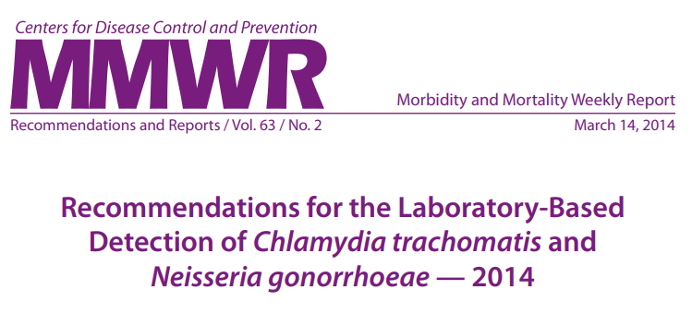
What are the recommended specimen types for chlamydia and gonorrhea?
Nucleic acid amplification tests (NAATs) are recommended for detection of genital tract infections in men and women
highly sensitive and specific compared to culture
less dependent on specimen collection, handling
Optimal specimen types are:
First catch urine for men
Self collected vaginal swabs from women
NAATs are recommended for: detection of rectal and oropharyngeal infections
Not FDA-approved for rectal or pharyngeal specimens but remain the preferred testing method over culture
MMWR, Recommendations for the Laboratory-Based Detection of Chlamydia trachomatis and Neisseria gonorrhoeae — 2014
Notes:
CDC recommends nucleic acid amplification tests or NAATs for detection of genital, rectal or oropharyngeal CT and GC infections. Because rectal and oropharyngeal lab tests are not yet FDA-approved, lab validation testing is needed before this testing can be offered. Many of the major lab companies have already gone through these internal validations so you can check with local facilities to see if they offer this testing.
CDC notes that the most optimal specimen test for asymptomatic infections include first catch urine for men and self-collected vaginal swabs for women. The first catch urine for women is also highly recommended.
Source:
Centers for Disease Control and Prevention. Recommendations for the Laboratory-Based Detection of Chlamydia trachomatis and Neisseria gonorrhoeae – 2014.
https://www.cdc.gov/mmwr/preview/mmwrhtml/rr6302a1.htm.

Slide 24
If Positive 1. Treat the Patient
CHLAMYDIA
GONNORHEA
Recommended regimens (non-pregnant):
Azithromycin 1 g orally in a single dose
Doxycycline 100 mg orally twice daily for 7 days
Recommended regimens (pregnant*):
Azithromycin 1 g orally in a single dose
Recommended regimens (uncomplicated infections of cervix, urethra and rectum):
Ceftriaxone 250 mg IM in a single dose PLUS
Azithromycin 1g orally in a single dose
Alternative regimens (if ceftriaxone unavailable):
Cefixime 400 mg orally in a single dose PLUS
Azithromycin 1 g orally in a single dose
*Test of cure at 3-4 weeks only in pregnancy
CDC 2015 STD Treatment Guidelines
Notes:
After screening patients, if their tests come back positive, the first step, of course, is to ensure their timely and adequate treatment. Here are the recommended treatment regimens for chlamydia.
For non-pregnant women Azithromycin one gram orally in a single dose which can be directly observed, or a seven day regimen of Doxycycline 100 milligrams orally twice a day.
For pregnant women Azithromycin one gram orally is also recommended.
Gonorrhea, because of considerable concerns about growing antibiotic resistance, currently requires a dual treatment regimen that includes both Ceftriaxone 250 milligrams IM [intramuscular] in a single dose plus Azithromycin one gram orally in a single dose.
It is important to note that these are intended to be taken and given at the same time.
So being able to dispense of Azithromycin on site at your health center is a facilitator to adhering to this recommended dual concurrent treatment regimen.
An alternative regimen for chlamydia treatment, for example if Ceftriaxone is unavailable, includes Cefixime 400 milligrams orally in a single dose plus Azithromycin one gram orally in a single dose, both taken at the same time. This is a regimen used in expedited patient therapy for sex partners.
Source:
Centers for Disease Control and Prevention. Sexually Transmitted Diseases Treatment Guidelines, 2015.
https://www.cdc.gov/std/tg2015/tg-2015-print.pdf.

Slide 25
If Positive 2. Screen for concurrent STDs
All patients diagnosed with chlamydia or gonorrhea should be tested for other STDs, including:
Syphilis
HIV
Notes:
For patients who test positive for chlamydia or gonorrhea, it is also incredibly important to screen for concurrent STDs including syphilis and HIV. National rates of syphilis among women of reproductive age have increased by 143% over the last four years and following in parallel, reported cases of congenital syphilis have increased by 156%, reaching a 20 year high, and is considered to be at epidemic proportions in some areas of the country.
Co-infection with a concurrent STD is a risk factor for syphilis. So screening your patients for syphilis if they have tested positive for chlamydia or gonorrhea is incredibly important.

Slide 26
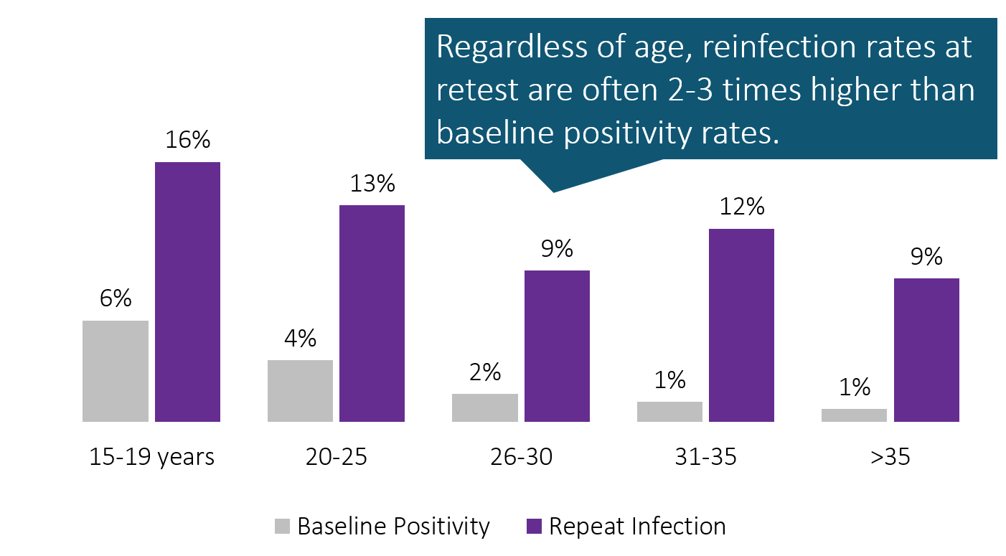
Chlamydia reinfection is common
Source: Family PACT and Quest Diagnostics data, 2008-09 Prepared by: CDPH STD Control Branch
Notes:
Reinfection with chlamydia and gonorrhea in the months after initial diagnosis is very common. This slide shows baseline chlamydia infection rates in light gray bars by age group in the California state Family Planning program in 2008 through 2009, compared to the reinfection rates, the dark purple bars, among those patients with initial infections who are retested within the year following.
While initial infection with chlamydia is highly associated with younger age, reinfection rates at retest were two to three times higher than their baseline positivity, regardless of age.

Slide 27
Chlamydia reinfection is dangerous
Highly associated with increased risk for adverse reproductive health consequences.
2nd infection:
4x risk of PID
2x risk of ectopic pregnancy
3+ infections:
6x risk of PID
5x risk of ectopic pregnancy
Prepared by: CDPH STD Control Branch; Source: Hillis SD, et al. (1997). Am J Obstet Gynecol 176(1 Pt 1): 103-7
Notes:
Chlamydia reinfection is also very dangerous and highly associated with increased risk for adverse reproductive health consequences. Having a second chlamydia infection increases a woman's risk for developing PID by four fold and doubles the risk of ectopic pregnancy, compared to having only one chlamydia infection. A third chlamydia infection pushes your risk of PID up to six fold with a five-fold risk of ectopic pregnancy.
Source:
Hills, SD, Owens, LM, Marchbanks, PA, Amsterdam, LF, and MacKenzie, WR. Recurrent Chlamydial Infections Increase the Risks of Hospitalization for Ectopic Pregnancy and Pelvic Inflammatory Disease. American Journal of Obstetrics Gynecology, 1997, 176(1 Pt 1), 103-107.

Slide 28
If Positive 3. Treat sexual partners
First-Line Option: Concurrent Patient-Partner Therapy
Performing a clinical evaluation of recent/current sex partners at patient’s STD treatment visit
Ask patient to bring his/her partner to treatment visit -- can be effective for one primary partner
Also Effective: Expedited Partner Therapy (EPT)
Treating a sex partner of a patient diagnosed with an STD without first examining the partner
Patient-Delivered Partner Therapy (PDPT) is EPT via patient delivery of the treatment -- Offering prepackaged medication is most effective; giving Rx is also an option
Offer routinely to patients for partner(s) who cannot be promptly treated
CDPH STD Control Branch. Best Practices for the Prevention and Early Detection of Repeat Chlamydial and Gonococcal Infections: Effective Partner Treatment and Patient Retesting Strategies for Implementation in California Health Care Settings. June 2011.
Notes:
One of the most effective ways of reducing a person's risk for reinfection is by ensuring their sex partners also get treated. The first line gold standard recommendation for partner treatment is concurrent patient partner therapy, sometimes lightly referred to as BYOP or Bring Your Own Partner.
In this scenario, the patient is asked to bring his or her current or main partner with them to their treatment visit to allow for clinical evaluation of the partner as well as presumptive treatment for the partner and risk reduction counseling. This strategy ensures that both the patient and partner are treated at the same time which also starts their clock together for delaying their return to sex until seven days after treatment is concluded. Concurrent patient partner therapy or BYOP seems to be an effective option for patients with one primary sex partner.
Also very effective for ensuring partner treatment is expedited partner therapy or EPT which is the treating of sex partners of a patient diagnosed with an STD without first examining the partner. Patient-delivered partner therapy or PDPT is a common method of EPT, offering the patient pre-packaged medication to give to their partners is the most effective PDPT modality. Providing extra prescriptions to give to the patient to give to his or her partners is also an option. PDPT is something that can be routinely offered to patients for partners who cannot be promptly treated.
These are two evidence-based partner treatment options that have been shown to be effective at reducing reinfection rates in the index patient.
Source:
California Department of Public Health Sexually Transmitted Disease Control Branch. Best Practices and Early Detection of Repeat Chlamydial and Gonococcal Infections: Effective Partner Treatment and Patient Retesting Strategies for Implementation in California Health Care Settings. https://www.cdph.ca.gov/Programs/CID/DCDC/CDPH%20Document%20Library/Best_Practices_for_Preventing_RepeatCT_Inf.pdf

Slide 29
Legal status of Expedited Partner Therapy (EPT)
Last updated Nov. 2018
CDC.gov Legal Status of Expedited Partner Therapy (EPT)
Notes:
EPT is currently legal in 43 states and potentially allowable in five others plus Puerto Rico. It is only expressively prohibited in two states. A number of state and large city public health department STD programs have figured out mechanisms for helping eligible clinical settings access PDPT medications. Check with your state and city program to learn what options may exist in your area.
Source:
Centers for Disease Control and Prevention. Legal Status of Expedited Partner Therapy (EPT).
https://www.cdc.gov/std/ept/legal/default.htm

Slide 30
If Positive 4. ReScreen (“retest”)
Retesting is recommended for ALL patients who have tested positive for chlamydia or gonorrhea ~3 months after treatment…or opportunistically at next visit
Timing: need to wait at least 3 weeks after treatment to re-test for chlamydia with NAAT because of risk for false positives (continued presence of nonviable organisms)
Retesting is especially important for adolescents; high prevalence of repeat infection
Notes:
Finally, because reinfection is so common and dangerous, if your patient tests positive for chlamydia and/or gonorrhea, CDC recommends re-screening, also called retesting, for all patients approximately three months after their treatment or opportunistically, the very next time they present at your health center for care. It is important that the retest occur more than three weeks post-treatment to reduce their risk of not detecting lingering non-viable organisms and giving a false positive result. Retesting is especially important for adolescent patients where repeat infection rates are exceptionally high.

Slide 31
Screening + management – in summary:
Screen for chlamydia + gonorrhea
If screen is positive for either:
Screen for syphilis + HIV
Treat patient + Treat partners
ReScreen again in 3 months
Notes:
CDC recommendations for chlamydia and gonorrhea screening and management in summary includes screening for chlamydia and gonorrhea at least annually and if positive, for either or both infections, screening for syphilis and HIV, treating the patient, treating the partners and re-screening the patient again in three months.
Because we're a fun-loving bunch in the STD world, we sometimes use the funny little mnemonics for this that sounds a bit like a dance step and it goes like this, screen, screen, treat, treat, screen. We can call it the CTGC five step boogie.

Slide 32
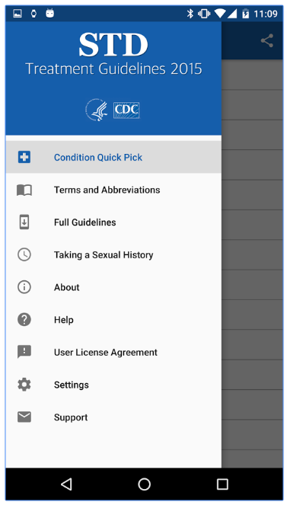
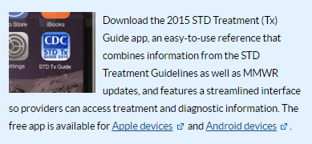
Hey! There’s an app for that…
Notes:
CDC has translated their STD Treatment Guidelines into a handy reference app you can download to your Apple or Android device. Get it for free from your app store.

Slide 33
STD Clinical Consultation Network (STDCCN)
Provides STD clinical consultation services to healthcare providers nationwide (1-5 days depending on urgency)
Your consultation request is linked to a CDC-funded STD Prevention Training Center’s expert faculty
http://www.STDCCN.org
Notes:
If you're in need of STD clinical consultation, the National Network of STD Clinical Prevention Training Centers offers a free consultation service called the STD Clinical Consultation Network or STDCCN which is a man and woman powered by CDC funded STD Prevention Training Center expert clinical faculty. You can use this service for clinical advice about your STD clients.
http://www.STDCCN.org

Slide 34
What to do about it? Best Practice Implementation Strategies for Improving Chlamydia Screening
Notes:
How can your Title X health centers implement these best practices? What are some of the implementation strategies that are associated with success for screening programs?

Slide 35
Chlamydia Screening Change Package
Include chlamydia screening as a part of routine clinical preventive care
Use normalizing and opt-out language
Use the least invasive, high-quality, recommended laboratory technologies available
Utilize diverse payment options to reduce cost as a barrier
Notes:
The Chlamydia Screening Change Package is a compendium of recommendations for increasing chlamydia screening developed by the FPNTC as a guide for chlamydia screening quality improvement at Title X sites.
The four primary recommendations are to:
Include chlamydia screening as a part of routine clinical preventive care for women 24 years and younger, women >24 who are at increased risk, and men at increased risk;
Use normalizing and opt-out language;
Use the least invasive, high-quality, recommended laboratory technologies available for chlamydia screening, with timely turnaround; and
Utilize diverse payment options to reduce cost as a barrier for the client and the facility.
Source:
Chlamydia Screening Change Package.
https://www.fpntc.org/resources/chlamydia-screening-change-package.

Slide 36
Best Practice 1. Include chlamydia screening as a part of routine clinical preventive care for women 24 years and younger, women >24 who are at increased risk, and men at increased risk.
Have a written policy and protocol
Establish standing orders and a standardized workflow
Utilize a team approach to care
Share screening data with staff and providers
Utilize service delivery approaches that increase efficiency
Notes:
Best Practice 1 is to include chlamydia screening as part of routine clinical preventive care for women 24 years and younger, women older than 24 who are at increased risk, and men at increased risk.
Because chlamydia screening is recommended for sexually active women 24 years and younger, regardless of risk profile, staff can begin to prepare for chlamydia screening for women in this age range even before they arrive at the clinic.
Screening can be offered with an “opt-out” approach, meaning women can refuse screening if they don’t want it, but the default scenario is that you prepare for screening.
Include chlamydia screening in all visits, not just preventive health visits, and ideally all primary care visits - not just “family planning” visits.
Include assessment of the need for screening as a part of pregnancy test and emergency contraceptive counseling visits as well.
The primary strategies that drive this best practice recommendation are to:
Have a written policy and protocol for screening all sexually active women 24 years and younger for chlamydia and gonorrhea as part of preventive health care, women 24 years or older who are at increased risk, and men at increased risk.
Establish standing orders and a standardized workflow.
Utilize a team approach to increase chlamydia screening rates. Meaning, engage all staff in identifying clients who should be screened—not just the provider.
Share screening data with staff and providers.
Utilize service delivery approaches to increase efficiency (to free up time for increased screening).
36

Slide 37
Best Practice 2. Use normalizing and opt-out language to explain chlamydia screening to all women 24 years and younger, women >24 at increased risk, and men at increased risk.
Avoid asking questions like, “Do you want to be tested for chlamydia today?”
Use opt-out language such as, “I recommend a test for chlamydia to all my clients under 25.”
Include all staff in training
Educate clients on the importance of screening, and how to reduce their risk for STDs
Notes:
Best practice number two is to use normalizing and opt-out language to introduce chlamydia screening to sexually active women.
Normalizing language decreases the chance that clients will feel judged and frames this service simply as part of standard care.
The primary strategies to drive this best practice recommendation are to avoid asking closed questions such as "Do you want to be tested for chlamydia today?," that put the patient in a position of having to decide if they think they are at risk.
Share sample scripts and have staff practice role playing with opt-out language such as phrases like, "I recommend testing for chlamydia and gonorrhea to all my clients under age 25."
Include all staff in training. Staff with client contact should receive training on preferred and acceptable specimen collection options, current screening criteria and national recommendations and potential sequelae of untreated chlamydia, local chlamydia prevalence and how to respond to positive results.
Educate your clients to help them understand the importance of screening, including sharing how common chlamydia is among young people, how rates are rising and how most people don't know when they have an infection because there are often no symptoms.
Also, share with them the risk for complications if infections remain undetected.
And help clients understand how they can reduce their risks for STDs, including the importance of using condoms in addition to their effective method for contraception.
Don't forget to similarly educate your clients who test positive for chlamydia or gonorrhea about the importance of getting their partners treated and of their three month retesting visit, given the very high rates and dangerous reproductive health consequences associated with reinfection.
37

Slide 38
Michigan’s Success Story
Michigan Department of Health and Human Services’ Title X Implementation Strategies:
Notes:
Here is a great success story from Michigan, highlighting the use of best practices one and two. Amy Peterson from the Michigan Department of Health's STD program partnered with her state's Title X networks to successfully improve their FPAR chlamydia screening rates between 2015 and 2016 by double digits among 15 to 24 year old females Title X clients.
She did this by first highlighting Michigan Title X's low FPAR chlamydia screening rates to capture people's attention within a formal STD update training she was asked to provide for Michigan Title X providers.
She then helped key informant interviews and focus groups for Title X providers and staff to ask them to help her identify missed opportunities for screening among their Family Planning client visits.
She distilled what she learned from these sessions into three system intervention change ideas and solicited 13 volunteer Title X health centers who agreed to pilot test one of these three intervention changes over a period of about six months.

Slide 39
Michigan’s Success Story
Michigan Department of Health and Human Services’ Title X Implementation Strategies:
Routinely included CT/GC screening for pregnancy-test-only and EC-only visits
Notes:
The three interventions they tested were:
Routinely including chlamydia and gonorrhea screening within pregnancy-test-only and EC-only visits;
Bundling chlamydia and gonorrhea screening within Title X and annual visits, using an opt-out approach; and
Standing order for routine urine collection.

Slide 40
Michigan’s Success Story
Michigan Department of Health and Human Services’ Title X Implementation Strategies:
Routinely included CT/GC screening for pregnancy-test-only and EC-only visits
Bundled CT/GC screen within Title X initial + annual visits using an opt-out approach – e.g., postcard summarizing “all services you will receive today as part of your annual exam”
Notes:
Because chlamydia and gonorrhea screening was included on this list, bundled into this list of services and not simply called out or asked about, this normalized screening is just a standard part of the annual Title X visit, reducing client refusals to the screen.

Slide 41
Michigan’s Success Story
Michigan Department of Health and Human Services’ Title X Implementation Strategies:
Routinely included CT/GC screening for pregnancy-test-only and EC-only visits
Bundled CT/GC screen within Title X initial + annual visits using an opt-out approach – e.g., postcard summarizing “all services you will receive today as part of your annual exam”
Standing order for routine urine collection implemented for all Title X clients; submission of specimen if no CT/GC screen in past 12 months
Notes:
The third intervention they tested was creating standing orders for routine urine collection implemented for all Title X client visits with submission of specimen for chlamydia and gonorrhea screening if no screen had occurred within the past 12 months.
Somebody would look up and see if there was a screen in the chart over the past 12 months and if none, they would recommend putting forward that urine for screening.
Again, the provider would share the standard practice with the client when in the room and ask about any concerns but it was another spin on the opt-out approach with a more proactive specimen collection and submission protocol.

Slide 42
Michigan’s Title X CT Screening Success
Success in Pilot Clinics
Screening rates increased from 45% to 89% by 6 months post-intervention
CT positivity remained high: 8.0% pre- to 7.5% post-intervention
CDC STD Prevention Conference 2018; prepared by Amy Peterson, MDHHS
Notes:
Within the Title X sites that piloted one of these three interventions, their screening rates increased from 45% to 89% by six months.
They only tested one each with the biggest jump, an increased jump right up to 85% occurring right at the gate within the first three months and then just increasing more gradually and sustaining over time.
The chlamydia positivity remained high in these settings, pre and post intervention in spite of the broader group of clients being screened which means that approximately twice the number of chlamydia cases were being detected, cases that previously would have been missed.

Slide 43
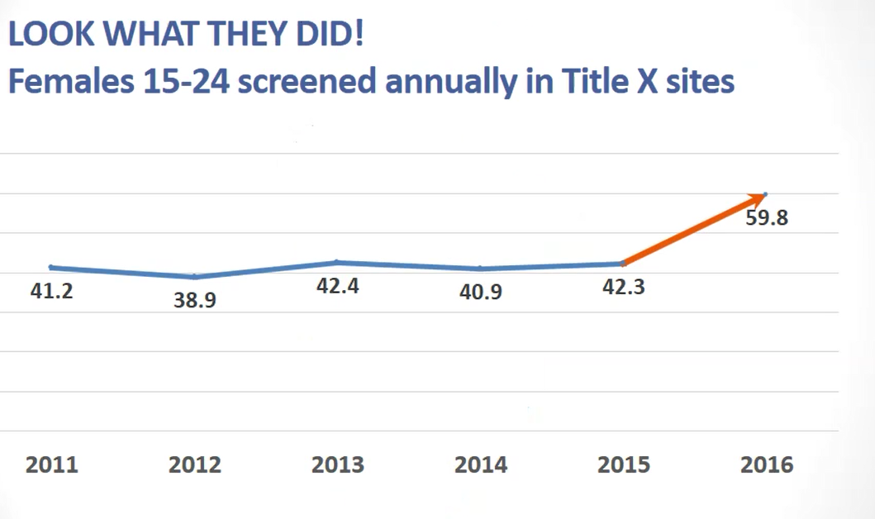
Michigan’s Title X CT Screening Success
Success in Pilot Clinics
Success across Entire MI Title X Network
Screening rates increased from 45% to 89% by 6 months post-intervention
CT positivity remained high: 8.0% pre- to 7.5% post-intervention
CDC STD Prevention Conference 2018; prepared by Amy Peterson, MDHHS
Notes:
And even though only 13 of the 100 or so Michigan Title X sites piloted this intervention formally, there were a lot of opportunities for these sites and the STD program to share results back with the broader Title X network, which led to other sites initiating some of the same strategies, and this resulted in a big uptake in the Michigan Title X chlamydia screening rates, the first real improvement in the state's rates after many years of status quo.

Slide 44
Best Practice 3. Use the least invasive, high-quality, recommended laboratory technologies available for chlamydia screening, with timely turnaround.
Establish routine clinic flow processes for routine screening
Procure lab services with timely turnaround
Make all screening options available, including self-collected vaginal swabs
Establish a recall system to retest clients 3 months after treatment
Notes:
Best practice 3 is to use the least invasive, high-quality recommended laboratory technologies available for chlamydia screening, with timely turnaround. This means making all optimal urogenital specimen types available, including self-collected vaginal swabs for women.
Historically, chlamydia and gonorrhea specimens were collected during pelvic exams at “annual” preventive health visits, at the same time pap testing was being conducted. But now recommendations for pelvic exams and pap testing have changed, and fewer pelvic exams are being done.
Test technologies now allow for screening without a pelvic exam.
2015 CDC STD Treatment Guidelines cite that chlamydia and gonorrhea urogenital infections can be diagnosed in women by testing first-catch urine or collecting swab specimens from the endocervix or vagina.
CDC recommends a self-collected vaginal swab as the recommended sample type.
The primary strategies that drive this best practice recommendation are to:
Establish routine clinic flow processes and systems
Make all screening options available, including self-collected vaginal swabs
Procure lab services with timely turnaround
Establish a recall system to retest clients three months after treatment in the case of a positive result
44

Slide 45
Best Practice 3. Success Story
Nevada Health Centers
“We used to have women in the waiting room just waiting until they had to pee. Now, with vaginal swabs, either the provider does it during their exam, or they can do it themselves...”
Notes:
Another Title X chlamydia screening success story is from Nevada and highlights the use of best practice number three.
To make testing as easy for women as possible and increase their screening rate, Nevada health centers introduced vaginal swabs for chlamydia screening.
They adjusted their workflow to include this new test technology and worked through implementation challenges.
One front-line staff person said, "We used to have women in the waiting room, just waiting around until they had to pee. Now, with vaginal swabs, either the provider does it during their exam or they can do it themselves, no matter what and they're much happier about that. No more waiting around with a full bladder."
Having the Chief Medical Officers buy in and rolling out the new process at an all staff meeting helped them with this transition.

Slide 46
Patient Instructions
University of Washington STD Prevention Training Center Resources
To order, please email aradford@uw.edu
Notes:
The University of Washington STD Prevention Training Center is happy to provide free, high-quality prints of our pharyngeal, rectal, and vaginal self-testing visual aids for your clinic.
http://depts.washington.edu/uwptc/index.html
To order, please send an email and include the quantity of each size and type desired with your shipping address to:
aradford@uw.edu

Slide 47
Best Practice 4.
Ensure organizational policy is in line with Title X program requirements
Ensure client confidentiality
Bill third parties when possible
Provide insurance eligibility screening
Develop strategies to pay for safety-net screening services
Utilize diverse payment options to reduce cost as a barrier for the client and the facility.
Notes:
Best practice 4 is to “utilize diverse options to reduce cost as a barrier for the client and facility”, because we never want cost to be the reason someone doesn’t get screened – if they should be screened.
The recommendations are to:
First, ensure your organizational policy is in line with Title X program requirements – such as make sure you are using your sliding fee scale and following the other guidelines that help make sure services are affordable,
Second, bill third-parties when possible, but also make sure systems are in place to ensure client confidentiality (and it’s always a good practice to provide insurance application assistance to help clients get the coverage they’re eligible for),
And, develop strategies to pay for safety net screening services – for clients that remain uncovered or unwilling to use their coverage. So, this might be utilization of grant funding, coordination with the state STD program, and so on.
The bottom line is that we do not want cost to be a barrier.
47

Slide 48
What about Jade?
What could we do differently next time?
Routinely include CT/GC screening in all visits, even quick-starts
Routinely bundle CT/GC screening with pregnancy testing
Standing order: collect urine at all Title X visits; submit if no screen in past 12 months
Check for last annual exam – if none in past 12 months, schedule
Notes:
Remember Jade? What can we do differently next time to ensure that chlamydia and gonorrhea screening does not slip through the cracks for clients like Jade. Think about your own setting and how you might close the clinical gaps we've experienced with Jade given your clinic systems and flow. Here are some recommendations, based on the best practices and implementation strategies already discussed.
One idea is to routinely integrate chlamydia and gonorrhea screening into all Title X visits, even quick starts.
Also, specifically routinely bundle chlamydia gonorrhea screening within pregnancy testing as you are already collecting urine specimen that can be split and used for both tests.
You could set up standing orders as they did in Michigan to collect urine at all Title X visit, look up whether a screen occurred during the past 12 months and after an opt-out framed brief discussion with the client, submit the specimen for screening if there was no screen or if the client had a positive test during the previous year.
And always a good practice, check for the patient's last annual well woman exam and if none has occurred during the past 12 months, take the time to schedule it with her while she is at your clinic instead of simply encouraging her to come back.

Slide 49
Emma, Primary Care Visit
Emma is an 18-year-old patient at your clinic coming in for her annual well check. She is not currently a Title X client.
Emma comes into the visit with her mother.
How do we know if Emma needs a CT/GC screen?
Notes:
Introducing one more patient, Emma, Emma is an 18 year old, coming to your clinic for her annual primary care well check. She is not currently a Title X client. She comes to the visit with her mom. How can we know if Emma needs chlamydia and gonorrhea screening?

Slide 50
Emma, Primary Care Visit
Routinely assess sexual activity
National medical associations recommend assessment of sexual activity as a standard part of routine care:
Starting in adolescence
In an age-appropriate manner
At least annually
Source: CDC, AMA, AAP, ACOG, AMFP
Notes:
One important step is to assess whether or not Emma is sexually active. Routine assessment of sexual activity is recommended by national medical associations as a standard part of primary health care. These are organizations, including the American Academy of Pediatrics Bright Futures, recommends that this assessment start during early adolescence, in an age-appropriate way and that it occur at least annually.
All of these organizations also recommend some amount of private time between the patient and provider, separate from mom or dad or siblings or any friends that the patient may have brought with them to their visit. This ensures that the provider has an opportunity to discuss any sensitive issues confidentially with the patients, including the sexual activity assessment.

Slide 51
Emma, Primary Care Visit
If Emma is identified as sexually active:
Initiate comprehensive sexual and reproductive health education and services as part of her primary care visit:
Including CT/GC screening
Notes:
If Emma is identified as sexually active, you want to ensure you initiate comprehensive sexual and reproductive health education and services as part of her primary care visit including chlamydia and gonorrhea screening.
Source: CDC, AMA, AAP, ACOG, AMFP

Slide 52
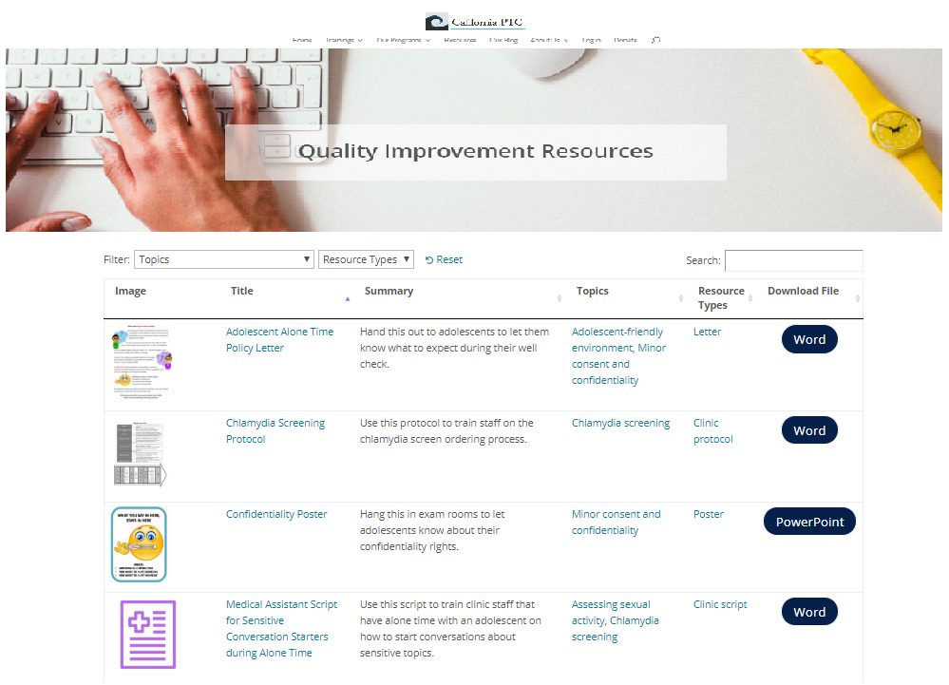
STD Clinical QI Resource Library
Implementation resources – tools, scripts, sample protocols, posters, patient education materials
Downloadable, editable
National Quality Improvement Center
Notes:
The CDC funded National STD Quality Improvement Center has developed an STD Clinical QI Resource Library where you can search and download editable implementation resources such as job aids, tools, scripts, sample protocols, patient facing materials et cetera to help your practice implement STD clinical best practices.
National Quality Improvement Center URL:
https://californiaptc.com/national-quality-improvement-center/

Slide 53
Chlamydia Screening Toolkit
Best Practice Recommendations
Action Steps
Training Guides
Other Implementation Resources
FPNTC Chlamydia Screening Toolkit
Notes:
The Family Planning National Training Center has many tools and resources to support implementation of the best practices for increasing screening at Family Planning sites. One of those is the Chlamydia Screening Toolkit.
Source:
Chlamydia Screening Toolkit.
https://www.fpntc.org/search?keys=chlamydia+screening+toolkit

Slide 54
Training Guides
For each Best Practice Recommendation:
PowerPoint Slide Deck with Talking Points
Discussion Guide
Notes:
Included in the toolkit are training guides for training staff in your networks directly. Either you can use them by webinar or on site in person. They're editable PowerPoint presentations with talking points and with a discussion guide and facilitation questions.

Slide 55
NEW! Normalizing and Opt-Out Language
Sample Script and Palm Card
Notes:
There are also another couple of new job aids the FPNTC is rolling out based on the intervention in the learning collaboratives they’ve done and the work done with the Title X networks. In this work, the intervention that had the single biggest impact on screening rates in Family Planning sites was using that opt-out language.
These job aids can be used in the clinic sites. They can be posted in the clinic, displayed on a desk, or slipped into a lab coat. The aids include reminders about the screening recommendations as well as sample language to use that normalizing and opt-out approach to offering screening. There is both the one pager with more comprehensive information, referred to as the sample script; and there is a palm card with the basic information.
Sources:
Using Normalizing and Opt-out Language for Chlamydia and Gonorrhea Screening: Sample Script.
https://www.fpntc.org/resources/using-normalizing-and-opt-out-language-chlamydia-and-gonorrhea-screening-sample-script.
Using Normalizing and Opt-out Language for Chlamydia and Gonorrhea Screening: Palm Card.
https://www.fpntc.org/resources/using-normalizing-and-opt-out-language-chlamydia-and-gonorrhea-screening-palm-card.

Slide 56
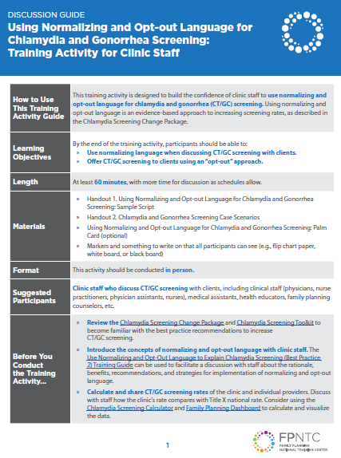
NEW! Normalizing and Opt-Out Language
Training Activity for Clinic Staff
FPNTC Opt-Out training activity
Notes:
The FPNTC developed a training activity to help staff practice and get confident using normalizing language and offering screening with an opt out approach. This is a case-based role play training activity for front-line staff.
The training activity comes with instructions, a handout, and sample script.
FPNTC Opt-Out Training Activity URL:
https://www.fpntc.org/resources/using-normalizing-and-opt-out-language-chlamydia-and-gonorrhea-screening-training

Slide 57
Questions?
Clinical questions?
www.STDCCN.org

Slide 58
Thank you!
Contact us at
fpntc.org
fpntc@jsi.com

